Slide 1
Onboarding LTC & AL
into ImmsBC

Slide 2
This presentation has been designed to support people who do not directly fall into a Health Authority gaining access to ImmsBC including LTC, AL and GP.

Slide 3
L T C P R O C E S S
User Provisioning
Complete Training

Slide 4
To get your account set-up within ImmsBC there are two key steps you need to take.
Training
Watch 4 videos
Join Office Hours if you have questions
Provisioning
To get your login credentials use your BC Services Card to gain access to the Provider Identity Portal and request ImmsBC access

Slide 5
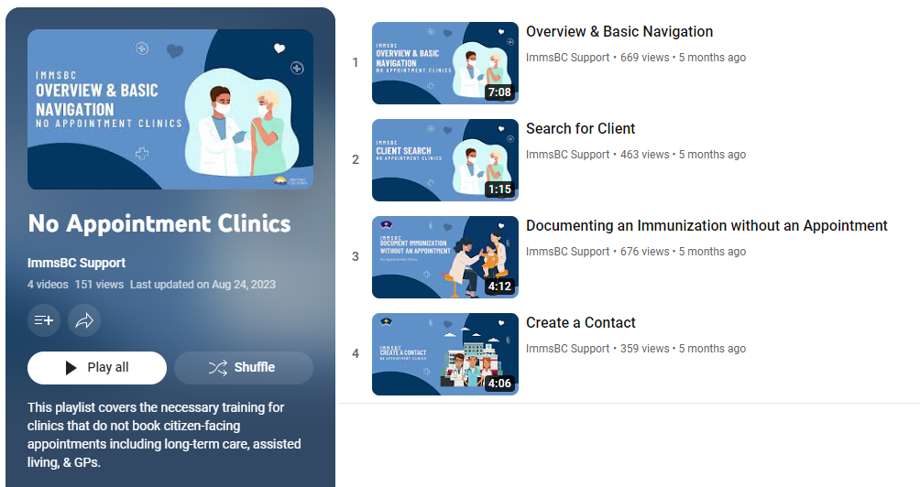
Step 1: Complete Training
ImmsBC training is self-directed using online videos.
There are 4 videos listed below that you must watch before requesting access to ImmsBC. Please click on the links below to watch the required videos.
Overview and basic navigation (7min)
Finding your client (1min)
Documenting Immunization (4min)
Adding a contact (4min)

Slide 6
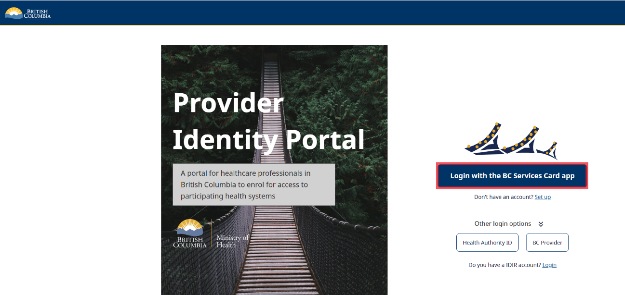
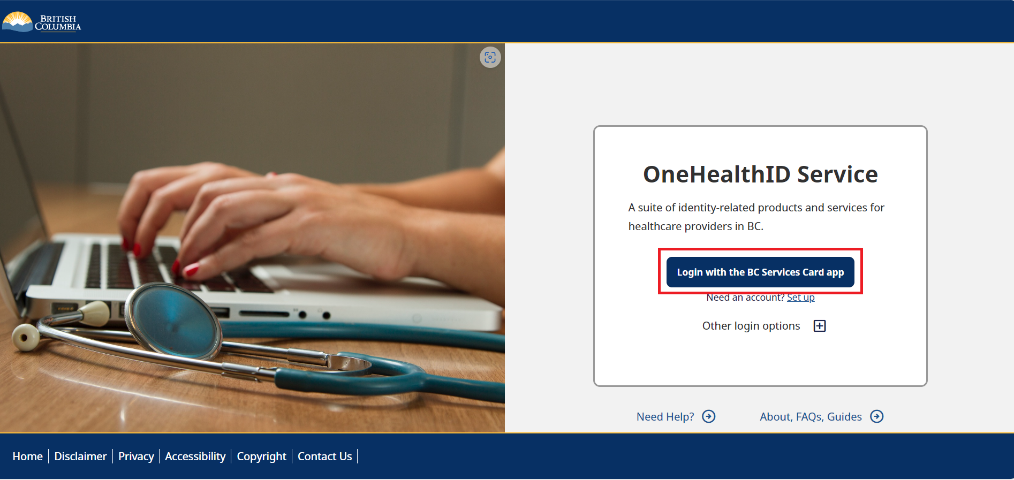
2.1 Logging Onto the OneHealthID Portal for the First Time
Step 2- User Provisioning
Begin by navigating to https://healthprovideridentityportal.gov.bc.ca.
Note: Now is also a great time to bookmark the website for ease of access in the future!
On the landing page, select Login with the BC Services Card app. (For LTC if you do not have a BC Services Card, or cannot get one, call the Command Center)
Details for Command Center on the last slide

Slide 7
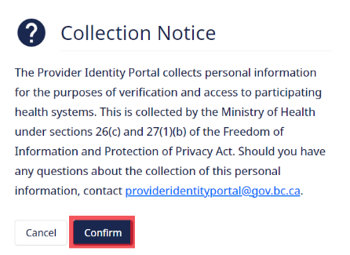
2.2 A notification about collection of personal information will appear. Click Confirm to continue

Slide 8
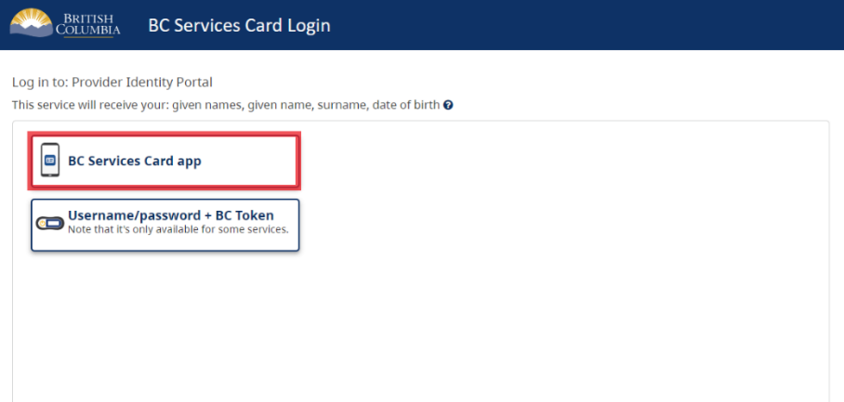
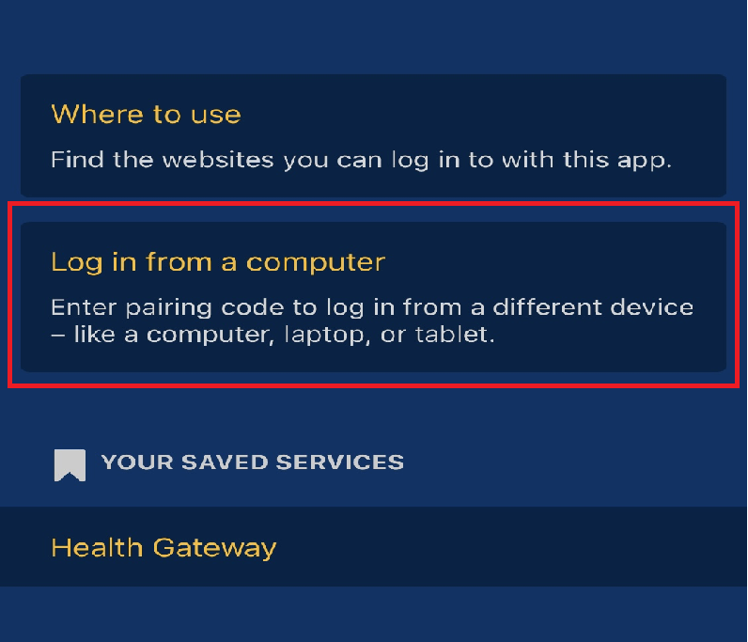
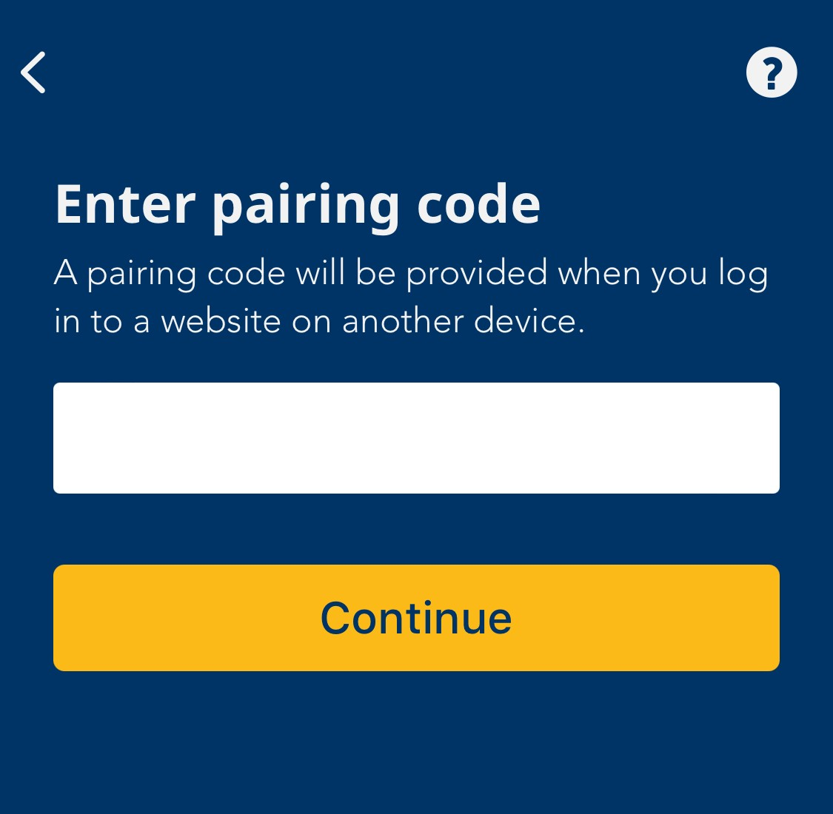
2.3 From the list of options, select BC Services Card app
A Pairing Code will display on the screen. Enter this code into the BC Services Card app to finish logging in.
Note: Instructions on how to enter the Pairing Code into the BC Services Card app can be found by scrolling down on the same webpage as the code (shown above).
*In order to complete this portion, all intended users are required to have the BC Services Card app. If the intended users do not have the BC Services Card app, please follow this link and allow 72 hours for the process to complete: https://healthprovideridentityportal.gov.bc.ca
On your mobile device, open BC service card app and click log in from a computer to enter the pairing code.

Slide 9
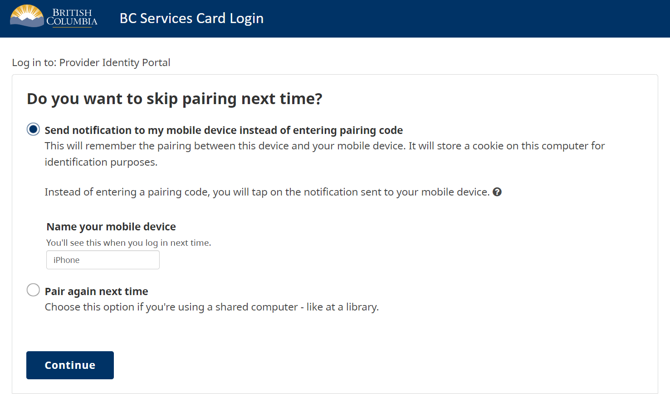
2.4 Pairing Option
A screen may appear asking if you’d like to skip this step the next time you connect.
If you would like to skip the pairing process each time you connect, you can select the first option and provide a nickname for your mobile device.

Slide 10
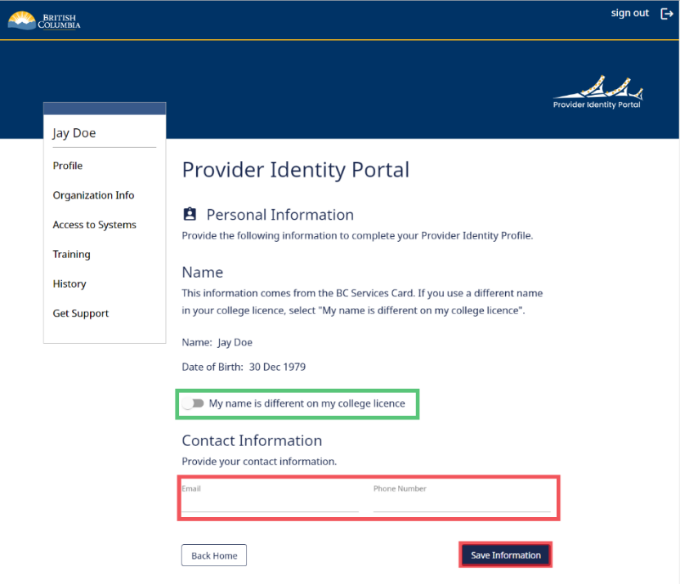
2.5 When login is completed, Provide a contact Email and Phone Number
Review the information displayed to ensure it is correct and provide a contact Email and Phone Number.
You can also indicate whether your name is different on your college license, and provide that information if required.
Click the Save Information button to save and return to the portal dashboard.
Use the email linked to your BC services card. This may be your personal email, but a new email will be provided for future log in

Slide 11
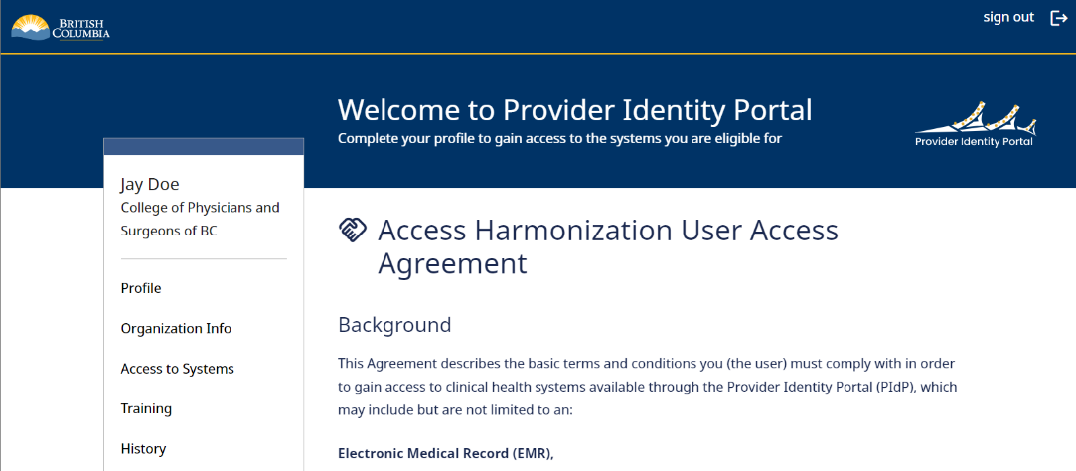
2.6 User Access Agreement
Once you have submitted the contact details, The User Access Agreement page will display. Take some time to scroll and read through the agreement.

Slide 12
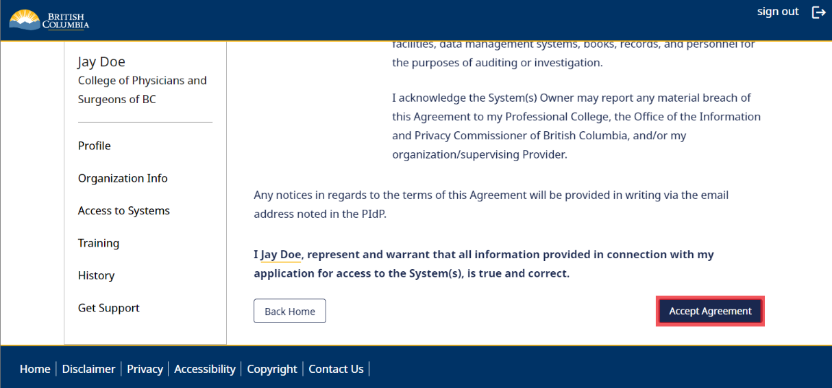
2.6.1 User Access Agreement
When you have finished reading the agreement, click the Accept Agreement button

Slide 13
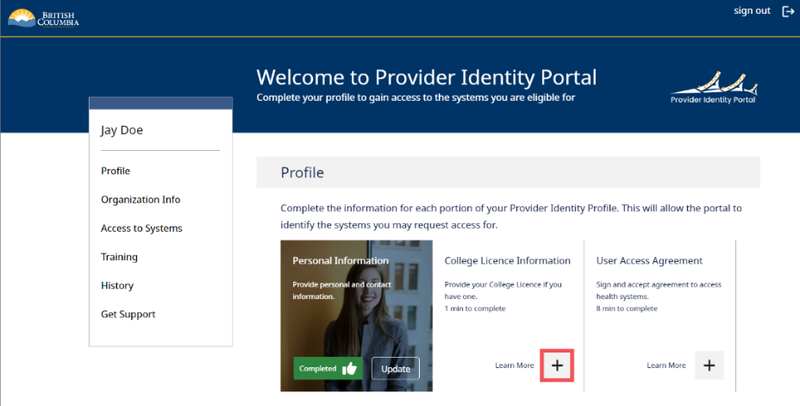
2.7 Provide College Licence
If you are not a registered with a college (e.g clerk) please skip this step
Once you have provided your contact information, the next step is to provide your college license and agree to the user access agreement.
For unlicensed practitioners and other staff, this step must still be completed in order to complete your profile and access the Provider Experience Portal.
Note: If you have already accessed the OneHealthID portal in the past, some steps may show as completed already. When this occurs, simply proceed to the next step.
On the home page, click the + button on the College License Information tile

Slide 14
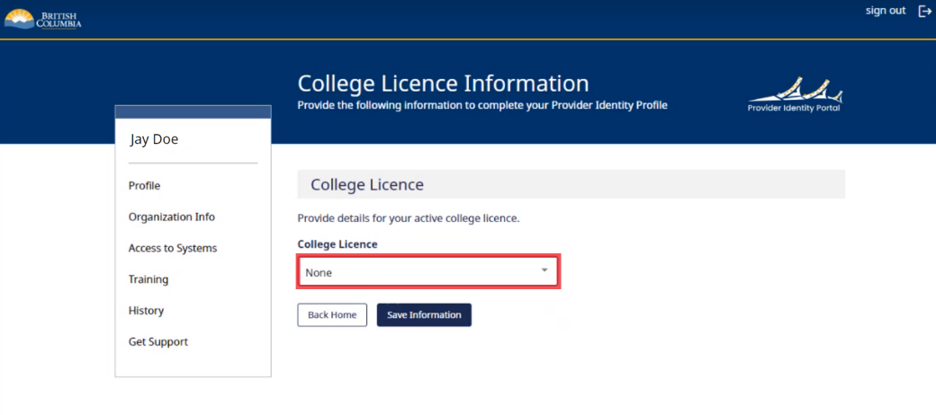
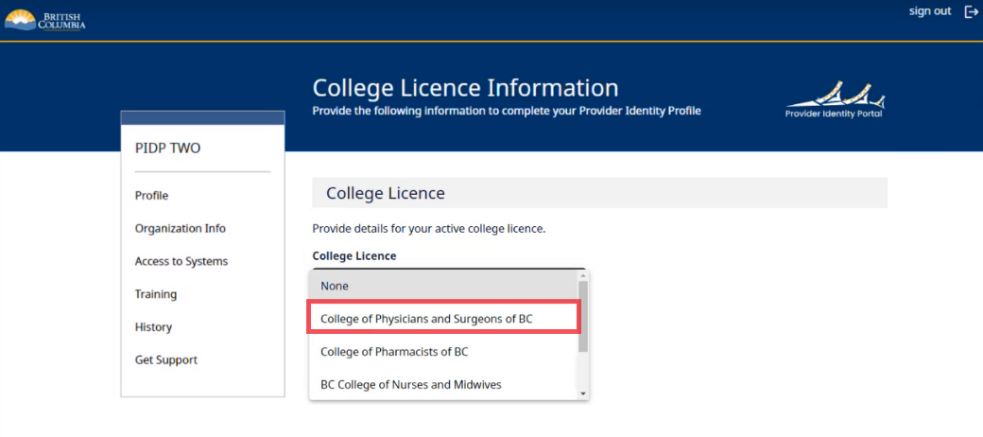
2.7.1 Provide College License Information
Click the College License drop-down list
Select the correct college license from the College License drop-down list.
Note: Unlicensed practitioners and other staff must select None

Slide 15
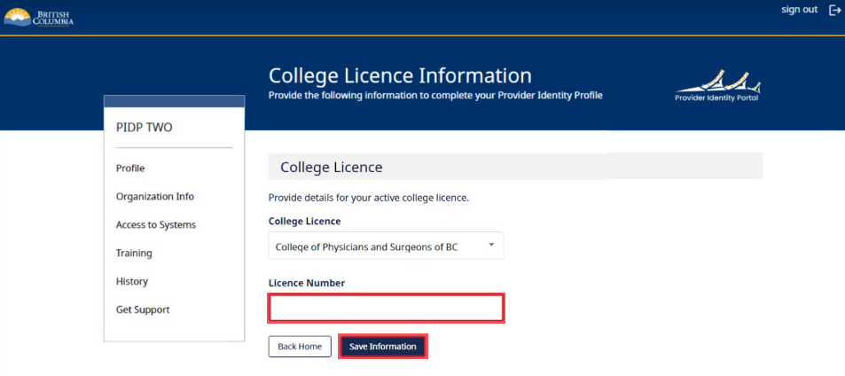
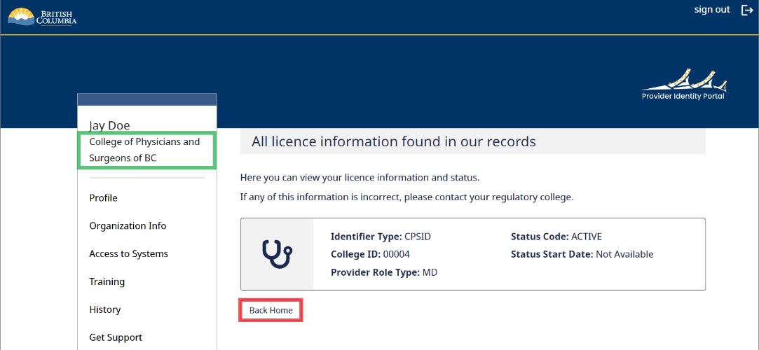
2.7.2 Provide College License Information
In the College License field, enter your license number and
then click save Information button.
The license information will display on the screen, as well as under your name on
the left-hand side. Click the Back Home button to return to the portal dashboard.

Slide 16
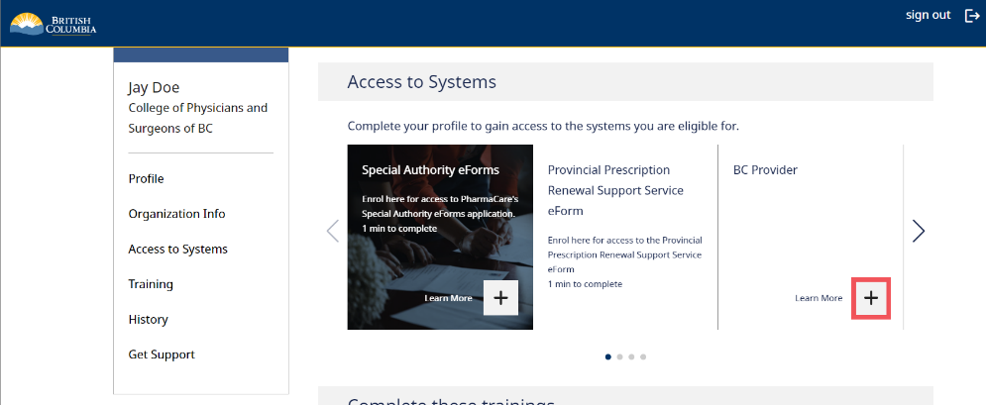
2.8 Create OneHealthID
On the home page, scroll down to Access to Systems and select the + button on the BC Provider tile
Once the preceding steps have been completed, the user can create their OneHealthID and password. This is done via the BC Provider tile on the OneHealthID Portal.
Note: Any OneHealthID Portal user can create a OneHealthID, however only users who have provided license information or been endorsed can access the Provider Experience Portal.

Slide 17
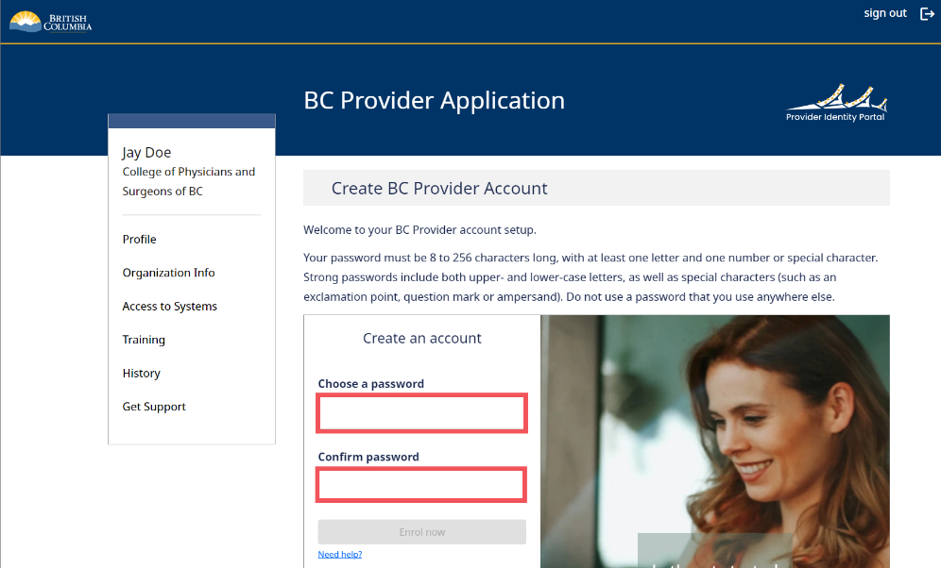
2.8.1 Create OneHealthID
Choose a password for your BC Provider Portal account, noting the password requirements listed on the page. Enter the password into both password fields.

Slide 18
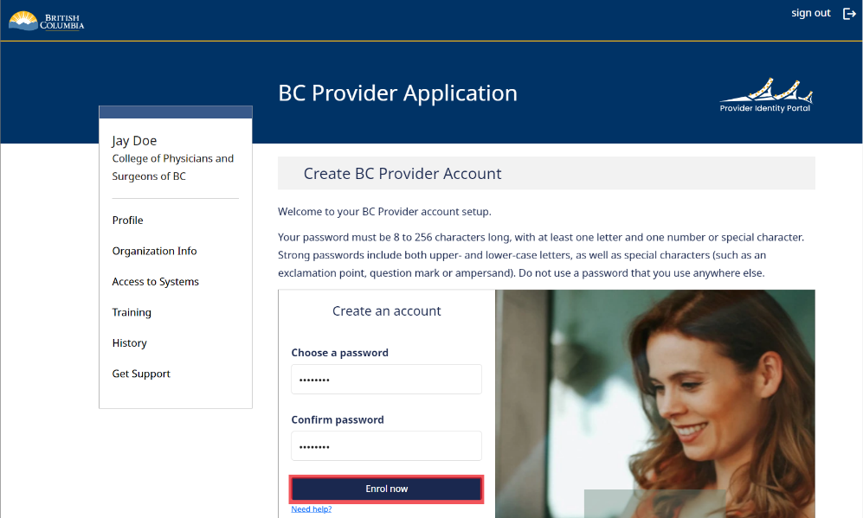
2.8.2 Create OneHealthID
Click the Enrol now button to generate the OneHealthID.
The email and password will be emailed to the user at the contact email address provided on the OneHealthID Portal.
Note: This page can also be used to reset a password if the user has forgotten it.

Slide 19
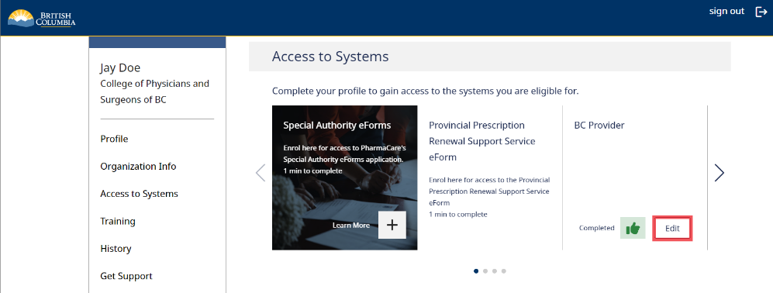
2.8.3 Create OneHealthID
You will be returned to the portal dashboard. If you scroll down, you can see that the Access to Systems section now shows Completed on the BC Provider tile.
Click the Edit button..

Slide 20
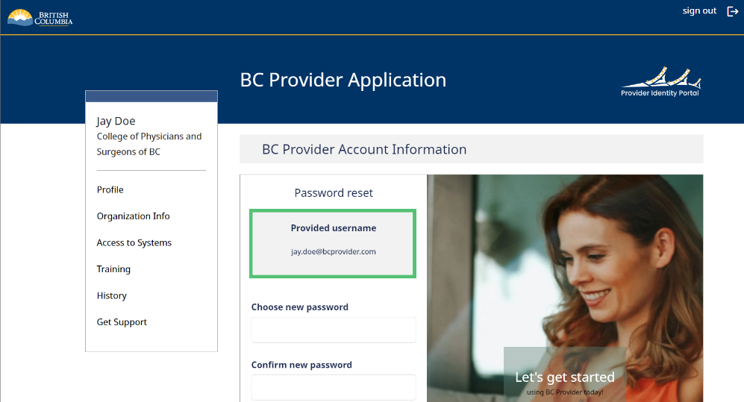
2.8.4 Create OneHealthID
The BC Provider Application screen will display showing your username to log into the BC Provider Portal, as well as the option to choose a new password in the future.
An email with your username and password will be sent to the email address you provided.
Note: Once your OneHealthID has been created, you will not need to enroll again. Although the formatting of OneHealth ID is similar to an email address, it is used as a log-in name only and there is no email component.

Slide 21
2.9 Email Command Center
Once you have completed the steps above please send an email to the Command Center (bcvax-support@gov.bc.ca) so that they can finalize your access. Please consider using the template below to expedite your request.
Subject: LTC access request final step
Name:
BC Provider ID: [provided through the provider identity portal)
Organization: [name of facility] [select one: LTC/AL/GP]
I have completed the required steps in the Provider Identity Portal. Please add my job title to the directory [select one: clinician/clerk].

Slide 22
2.10 Logging in to ImmsBC
Please follow up with the Command Centre if no response in 2 business days
Once Command Centre has confirmed, log in to ImmsBC confirm access
For all Contracted and Private sites, login with BC Providers External User (formerly Pharmacy Portal)
Please log in minimum once every 3 months to prevent inactivity
  Inactivity will result in denied access and re-access efforts
  If you have been denied access, please contact the Command Centre

Slide 23
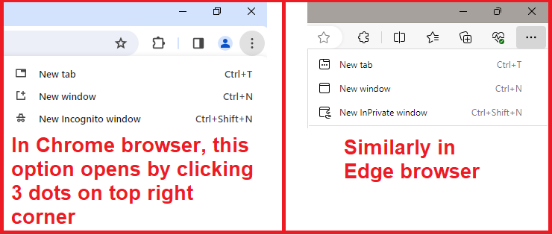
2.10.1 ImmsBC Log-in steps
Right click and copy this link using the menu option
On shared computers, we recommend to use private browsing mode, called Incognito window in Google Chrome Browser, or InPrivate window in Microsoft Edge. Paste and go to above hyperlink

Slide 24
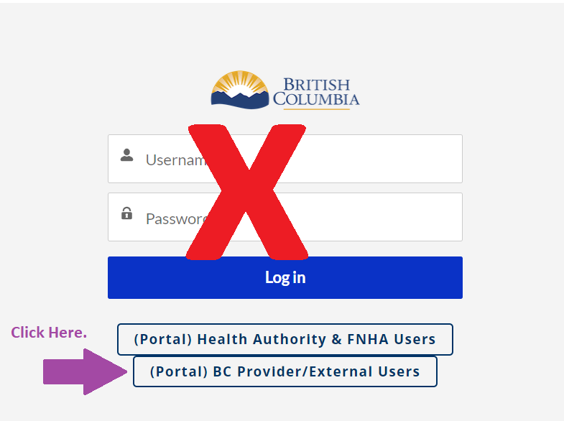
2.10.2 Portal selection
When we go to community portal link, landing page asks us which type user we are logging in as. Non-Health Authority users will select BC Provider/External Users

Slide 25
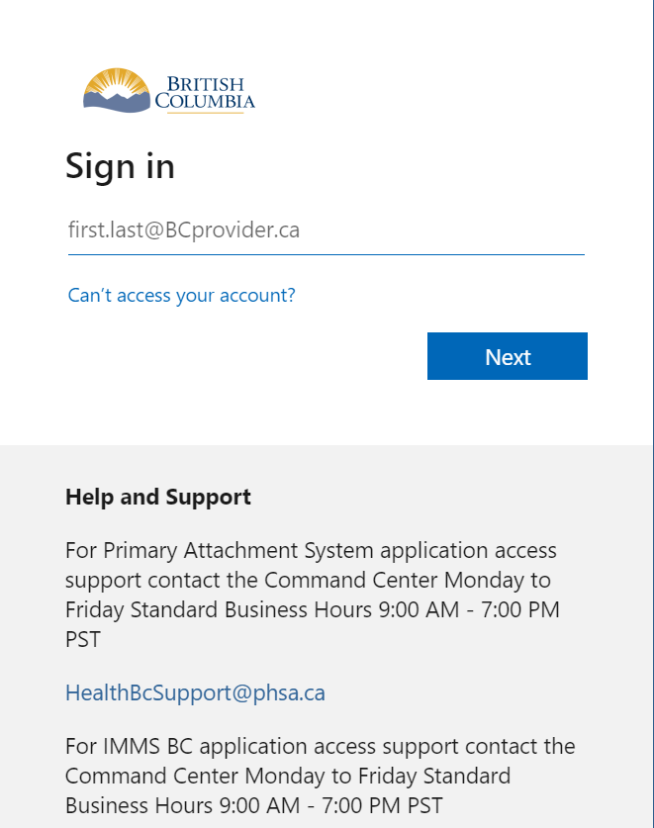
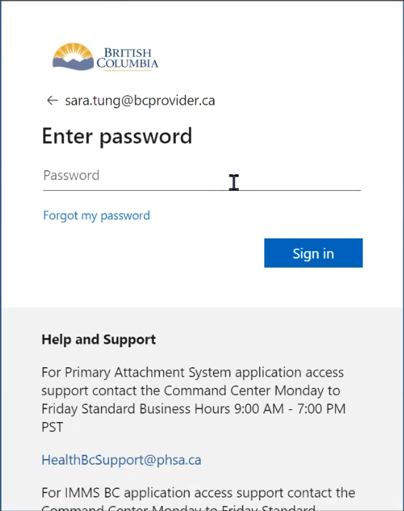
2.10.3 Enter Username and Password
Enter the Password and Click on Sign in.
Enter your BC PROVIDER USERNAME, click next
Note: The password will be the same as the one you entered while creating your BC Provider Account.

Slide 26
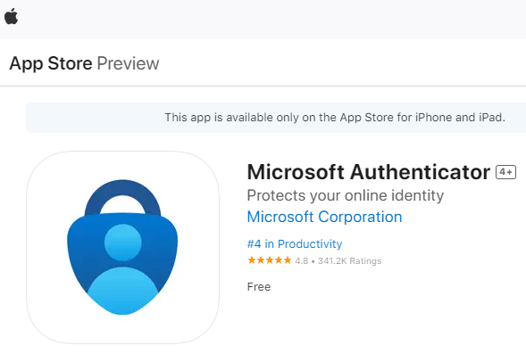
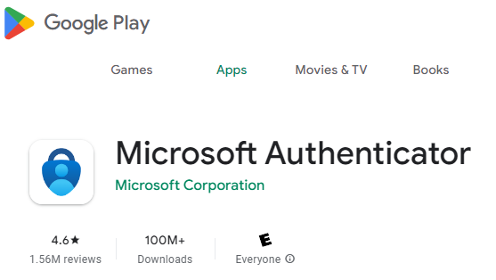
2.10.4 Download Microsoft Authenticator
You will need to install this app on phone for next steps. It is used to authenticate log-ins. For BC Provider linked log-in, Microsoft Authenticator is used for authenticating by either-:
  Using a code from the app and entering on computer
  Receiving a notification on the app and clicking approve

Slide 27
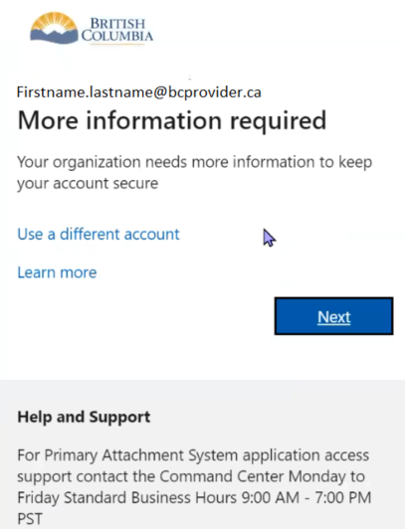
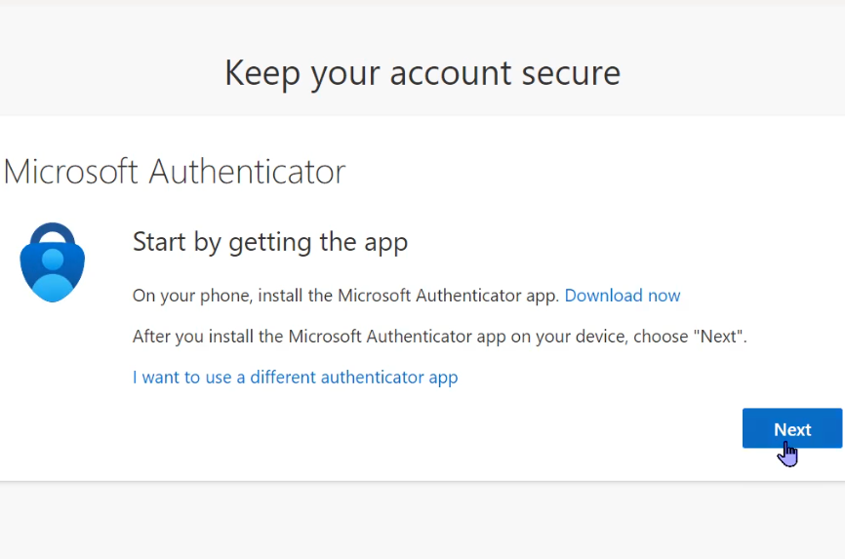
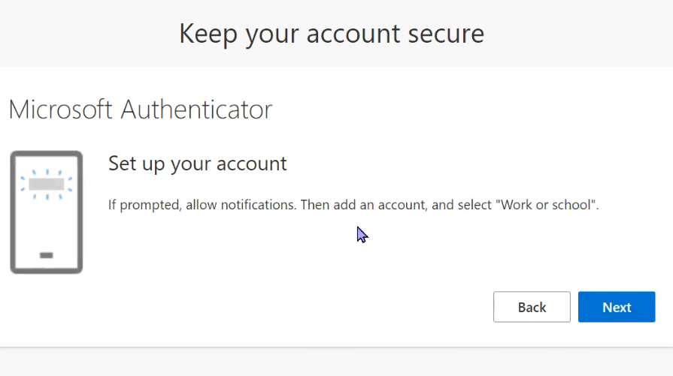
2.10.5 Authenticator setup
On your computer screen, click Next. You will see instructions to allow notifications on your mobile device, if prompted. Click Next.

Slide 28
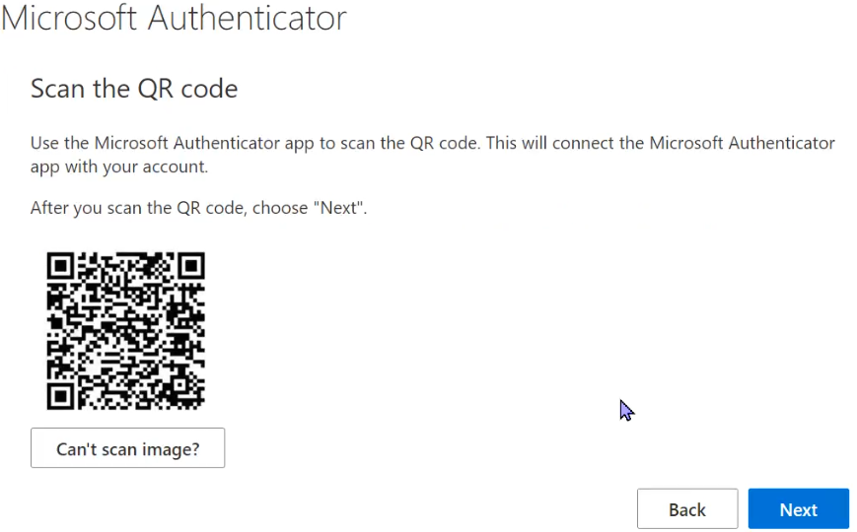
2.10.6 Authenticator setup cont..
On your mobile device in Microsoft Authenticator app, select Scan QR code.
Note: (If you have previously set up Microsoft Authenticator, add a new work account first. Open app, click on 3 dots on top-right and select + Add Account, Add Work or School account)
If prompted on your mobile device, allow notifications and allow the app to access your camera. Point your mobile device’s camera at the QR code on your computer screen.

Slide 29
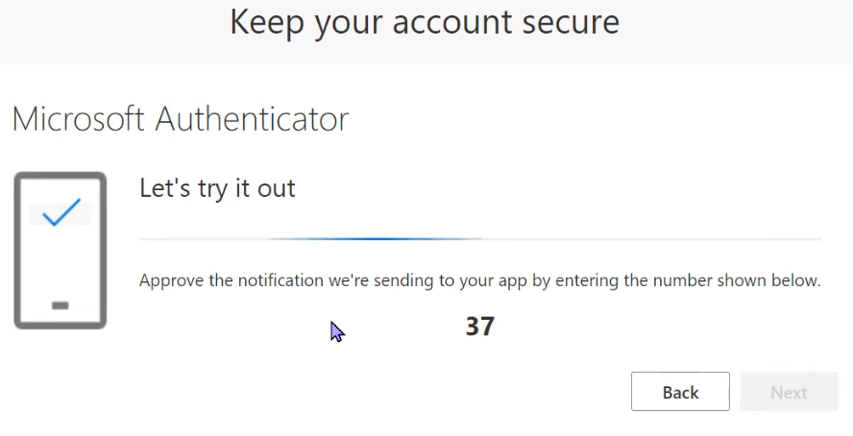
2.10.7 Authenticator setup final
The system will prompt you to test out if your device has been paired properly. Enter the number mentioned on the screen in your authenticator notification.
This will complete pairing successfully. You will be required to use it every time you sign in to ImmsBC.

Slide 30
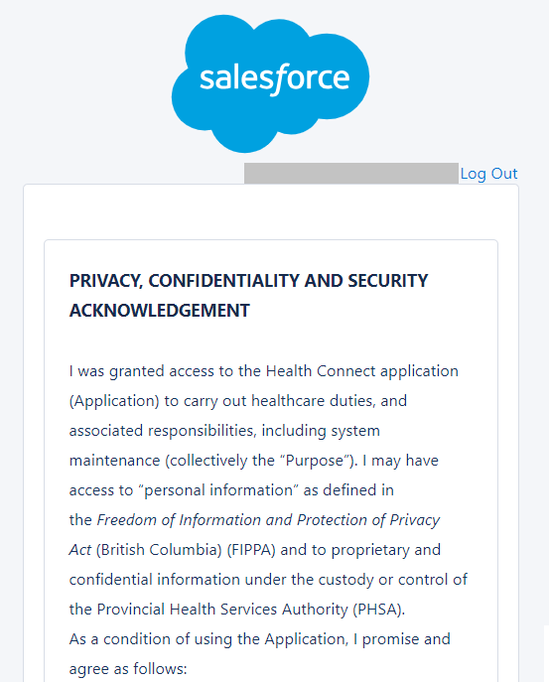
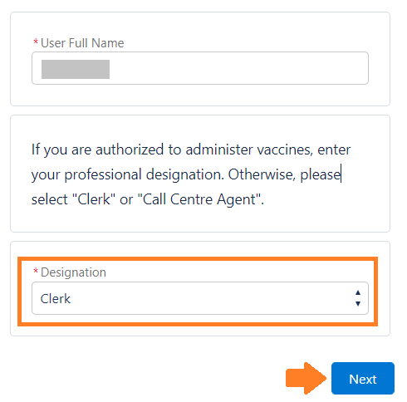
2.10.8 ImmsBC Acknowledgment
The first time you log into ImmsBC, read the Privacy, Confidentiality, and Security Acknowledgement.
Type your first and last name. Then select your Designation from the picklist to identify your role in the system and click Next.
Note: Most LTC/AL users will select Clerk/Clinician as their designation based on their role at the facility.

Slide 31


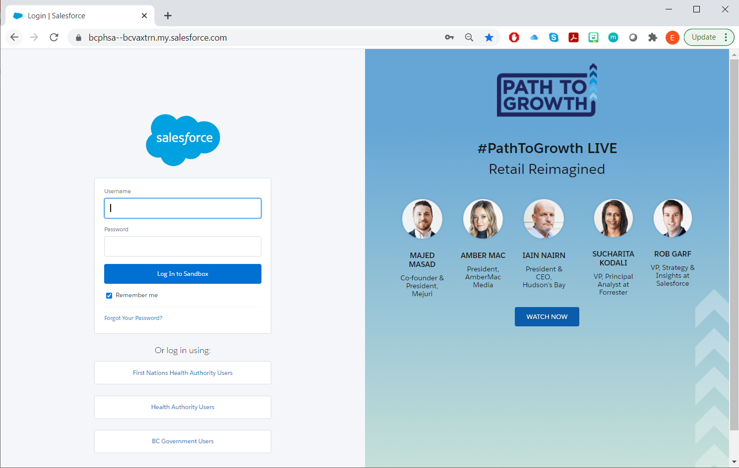


If you have any questions during this process, please reach out to the Command Center (contact information below)
Hours
9am to 7pm
Subject to change to align with call centre and
clinic hours
Email
BCVAX-Support@gov.bc.ca
Zoom / Phone
https://zoom.us/j/93003034945?pwd=L3lkL0VqdEJvTjZ2cWMxelB3R3ppdz09
Meeting ID: 930 0303 4945
Passcode: 548989
Phone: +1 778 907 2071
One tap mobile: +17789072071,,93003034945#,,,,*548989# Canada

