Slide 1
Sexual Health Education Professional Development Workshops
School Health Promotion – by VCH Public Health, for teachers in the VCH region
Public Health
Last update: Dec 5, 2024

Slide 2
Sexual Orientation & Gender Identity (SOGI)
Sex, gender & sexual orientation
Impact of sex and gender on personal identity and relationships
Gender-based discrimination & violence
Public Health
Healthy Sexuality
Notes:
Script Instructions
Each slide comes with key speaking and instructional information for PHNs in the ‘presenter notes’ part of the powerpoint.
The regular, unitalicized sections are suggestions of words you could say verbally for the slide.
The font in italics include instructions and notes that are not meant to be read out loud.
Script
Hi, my name is ______, I use pronouns _______. I am your school’s Public Health Nurse.
I am here today because… (e.g. when we completed the learning needs assessment together, you indicated sexual orientation and gender identity was an area you wished to learn more about).

Slide 3
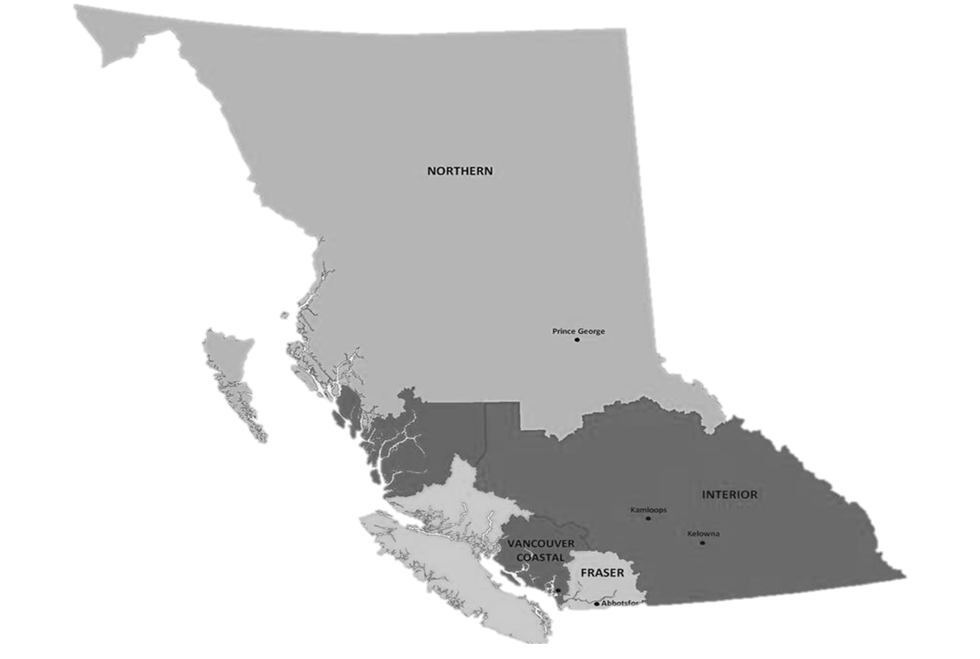
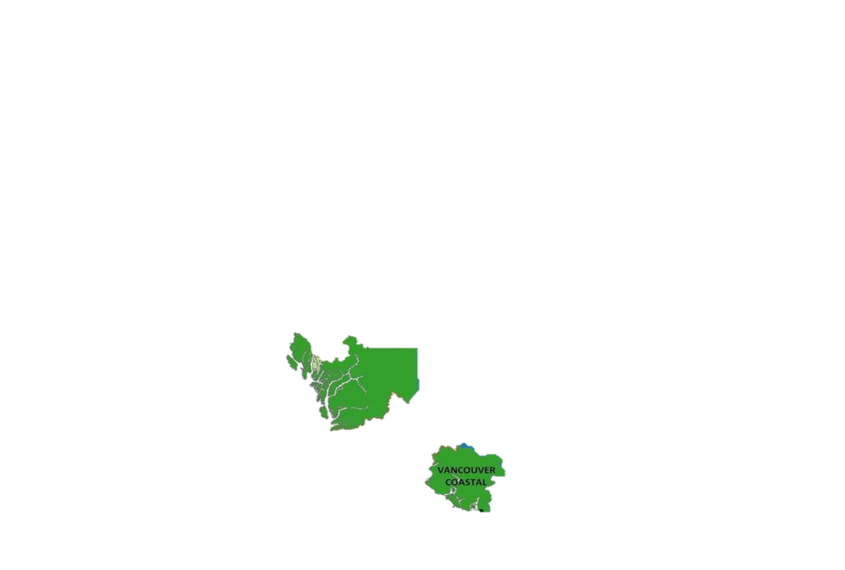
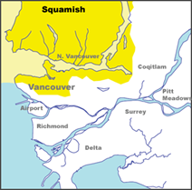
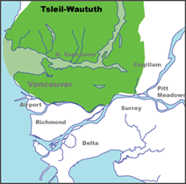
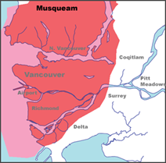

Territorial Acknowledgment
We wish to acknowledge that the land on which we gather is the traditional and unceded territory of the Coast Salish Peoples, including the Musqueam, Squamish, and Tsleil-Waututh Nations.
Vancouver Coastal Health is committed to delivering exceptional care to 1.25 million people, including the First Nations, Métis and Inuit, within the traditional territories of the Heiltsuk, Kitasoo-Xai'xais, Lil'wat, Musqueam, N'Quatqua, Nuxalk, Samahquam, shíshálh, Skatin, Squamish, Tla'amin, Tsleil-Waututh, Wuikinuxv, and Xa'xtsa.
Notes:
Script
Before we get started, I wish to acknowledge… (read slide).
Notes
If the land on which you are joining from is on the traditional and unceded territory of one of these peoples, please acknowledge those peoples directly.
If explanation is needed for teachers, advise that Territorial acknowledgements during gatherings of people are standard practice in VCH and uphold our pillar and policy of Indigenous Cultural Safety.

Slide 4


This material has been adapted from teachingsexualhealth.ca
Copyright 2023 Alberta Health Services ("AHS") with the permission of AHS.
AHS is not responsible for any inaccuracies in content different from the content of the original English edition. All acts of copyright infringement including reproduction, translation, transmission, republication, and distribution of this material without written permission of Vancouver Coastal Health and AHS are prohibited.
Public Health
Healthy Sexuality
Notes:
Script
We have adopted some of this workshop’s material with permission, from teachingsexualhealth.ca (TSH)
NOTE: VCH has a signed Permission to Use Copyright Agreement with TSH that allows us to use and adapt their material. This legal statement is intended for organizations looking at widespread distribution, not for teachers accessing and adapting materials for personal use. Teachers altering for personal use was understood by AHS to be occurring with our materials when we spoke with them. However, it does mean that if a teacher was looking at licensing the materials (e.g. starting a paid program where they created content for other teachers) they would need to seek the permission of AHS.

Slide 5
Purpose & Background
THIS PROFESSIONAL DEVELOPMENT WORKSHOP was developed by VCH Public Health to support VCH-region teachers to become more comfortable in teaching the sexual health education components of BC’s Grade 8-10 PHE Curriculum.
FOR LESSON PLANS, please use our accompanying Lesson Plans & Teaching Resources
A VCH PARENT/GUARDIAN LETTER OF SUPPORT for sexual health education is available to send home before lessons with your parent/guardian notification.
I am here to help should you or your students have any questions.
Public Health
Healthy Sexuality
Notes:
Script
Read slide
After second bullet: Teaching Sexual Health is our main source of lesson plans. All TSH lesson plans are available in French. They also have a set of specialized lesson plans for students with differing abilities.
After last bullet: This workshop will take approximately one hour.
Feel free to ask questions as we move along.
Notes
PHE= Physical & Health Education Curriculum

Slide 6

Learning Goals
TEACHERS WILL LEAVE TODAY’S WORKSHOP WITH
the foundational knowledge needed to teach the grades 8-10 PHE curriculum topics related to Sexual Orientation & Gender Identity.
1 Sex, gender, and sexual orientation
2 Impact of sex and gender on personal identity and relationships
3 Gender-based discrimination and violence
4 Strategies to protect self and others from gender-based violence
Public Health
Healthy Sexuality
Notes:
Script
Read slide
Let’s do a round table of introductions, starting to my (left). Please let me know your name and role in the school. If you feel comfortable to share, please also let me know how long you’ve been teaching sexual health, and how comfortable you are teaching it.

Slide 7


Sexual Orientation & Gender Identity in the curriculum
GRADES 8–10 PHE
Factors and influences that shape personal identities and relationships, including social and cultural factors and physical changes (including sexual and gender identity)
Nature and consequences of bullying, stereotyping, discrimination, and violence based on gender identity/ expressions and sexuality
Strategies for students to protect themselves and others from potential abuse, exploitation, and harm, including identifying gender-based violence
Public Health
Healthy Sexuality
Notes:
Script
You may be asking yourself what you need to teach, this is what the curriculum outlines
Read slide
Notes
Grade 10 “evaluate”
Ref: https://curriculum.gov.bc.ca/curriculum/physical-health-education/8/core

Slide 8

Before you begin delivering content
PLEASE REVIEW
your School District’s protocols, which may include notifying your administrator, counsellor, and/or district before you begin.
PLEASE REACH OUT TO
your School District’s healthy sexuality lead and/or safe school coordinator if you have one. They can support you in the delivery of this content.
Public Health
Healthy Sexuality
Notes:
Script
Read slide
Keep in mind that today we’ll be covering information about sexual health topics, but we won’t cover any of your district’s protocols.
Is anyone aware of whether there is healthy sexuality lead or coordinator in this district?
Notes
PHNs are encouraged to find out who the healthy sexuality leads/sexual health educators are and provide this information to teachers during the workshop.

Slide 9
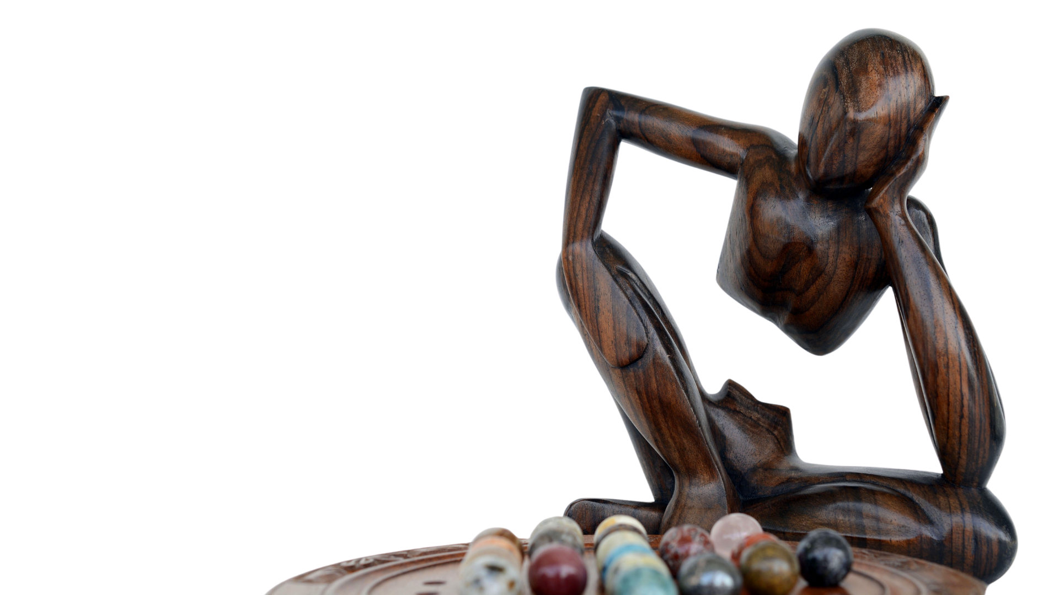
Consider…
…ways you can include sex and gender diverse students.
…how to avoid imposing your personal beliefs and values on your students
…ways you can include Indigenous and other worldviews.
…if it’s possible for to add movement breaks into your lessons
…having health clinic information readily available.
…that people who have experienced trauma may be triggered by some lessons in the Health curriculum.
Public Health
Healthy Sexuality
Notes:
Script
Read slide
1st bullet: Like using inclusive language, relationship scenarios, literature and other resources.
2nd bullet: For example, not assuming peoples’ gender always matches the sex they were assigned at birth.
3rd bullet: Honour culture by asking questions and inviting students to share.
4th bullet: To help students physically self-regulate.
5th bullet: So students can follow up on their health care needs.
Last bullet: Be mindful some of your students may be sex or gender diverse and may be experiencing gender-based violence at school or other areas of their lives. Provide advance notice of sensitive topics and monitor yourself and your students’ behaviour throughout the lesson. Develop a safety plan for students who may need to leave the room. For more information, refer to our Getting Started workshop.
Notes
If Trauma Informed Practice (TIP) discussed further:
Preview videos and other content before showing to your students.
If possible, try to plan your lessons before a break (recess or lunch) and not a major school break (winter, spring, summer) so students can speak to you in private or follow up with a school counsellor or other professional if needed.
Ref:
Supporting Student Health Guide: https://curriculum.gov.bc.ca/sites/curriculum.gov.bc.ca/files/pdf/subject/phe/Supporting_Student_Health_Secondary.pdf

Slide 10

These materials were informed by partners with lived experience and subject matter expertise
Public Health
Healthy Sexuality
Notes:
Script
I want to acknowledge that I do not have personal lived experience with all of the material we will be discussing today; perhaps you don’t either.
In VCH we are lucky to have partnered and co-created these materials with people with lived experience and subject matter expertise in transgender health (Transgender Health Specialist, VCH Prism – Parker Hewes) and Indigenous sex and gender (Indigenous Sex & Gender Lead, Indigenous Health - Jessy Dame) to ensure these materials are comprehensive and thorough.

Slide 11
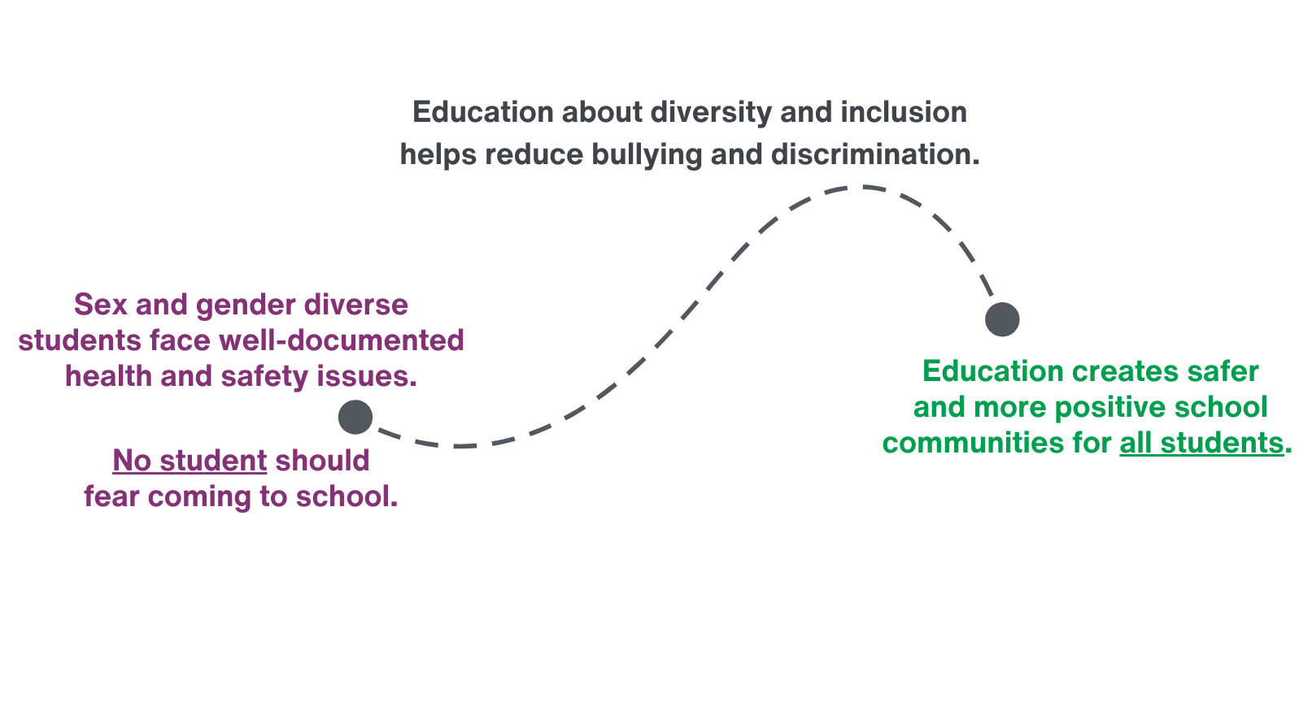
Teaching about sexual orientation & gender identity matters
Public Health
Healthy Sexuality
Notes:
Script
Read first paragraph: These issues are not intrinsic to their identity, but a result of the unfriendly and non-accepting environment in which they are forced to function. Bullying and harassment contribute to classrooms, hallways, and change rooms becoming unsafe spaces, leading to high levels of anxiety and depression, and decreased school connectedness. This culminates in a ranges of health harms including substance use, self-harm, suicide attempts, and completed suicides.
Read rest of slide
Ref:
VCH Parent/Guardian Letter of Support for Sexual Health Education (2024)

Slide 12


A lot of BC youth identify as 2SLGBTQIA+
Sexual orientation
75% Straight
25% Not Straight
6% Mostly straight
2% Gay or lesbian
10% Bisexual or pansexual
2% Asexual
5% Not sure
4% Something other than listed
Gender identities
5% Non-binary
1% Transgender
94% Gender identity matches
sex assigned at birth
Source: 2023 BC Adolescent Health Survey
Public Health
Healthy Sexuality
Notes:
Script
In 2023’s BC Adolescent Health Survey, youth were asked about their gender identity and sexual orientation. They reported… read slide
Notice that these numbers are not small – a lot of BC youth identify as 2SLGBTQIA+!
NOTE: Percentages in each column do not add up to 100% due to rounding.
Refs
Day, J. K., Ioverno, S., & Russell, S. T. (2019). Safe and supportive schools for LGBT youth: Addressing educational inequities through inclusive policies and practices. Journal of school psychology, 74, 29-43.
https://www.actioncanadashr.org/resources/sexual-health-hub/sex-ed/why-does-sex-ed-matter-because-science-says-so
https://www.who.int/news-room/questions-and-answers/item/comprehensive-sexuality-education
Stanger-Hall KF, Hall DW. Abstinence-only education and teen pregnancy rates: Why we need comprehensive sex education in the US. PloS one. 2011 Oct 14;6(10):e24658.

Slide 13
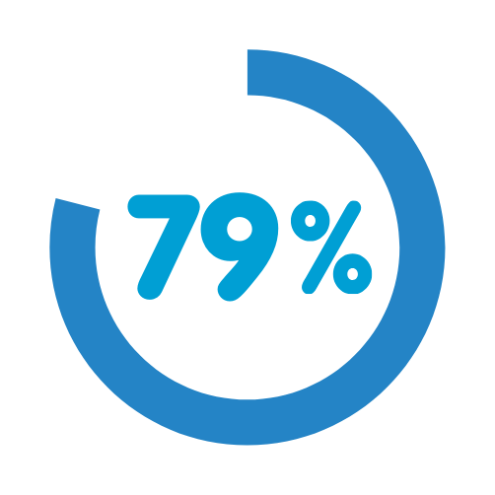
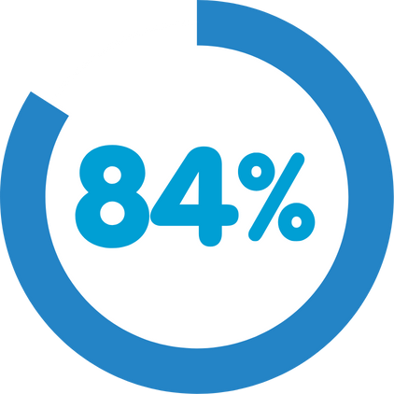
When students report receiving sexual health education at school…
feel it is relevant for their gender identity
feel it is relevant to their sexual orientation
Source: 2023 BC Adolescent Health Survey
Public Health
Healthy Sexuality
Notes:
Script
Read slide
These statistics are encouraging; however, we should note these stats may reflect the higher number of responses from cis-gender and straight students. Overall, we do think these stats demonstrate the amazing efforts of many educators to improve the relevancy of their sexual health education materials for gender and sexually diverse students – and shows we have room to improve.
Our hope is that you can use what you learn today to consider how you structure the sexual health education you deliver to your students.
Ref
McCreary Centre Society (2024). The Big Picture: An overview of the 2023 BC adolescent health survey provincial results. Retrieved from https://mcs.bc.ca/pdf/2023_bcahs_the_big_picture.pdf

Slide 14
Sex, gender, and sexual orientation
GRADES 8–10 PHE
Students will learn about factors and influences that shape personal identities and relationships, including social and cultural factors and physical changes (including sexual and gender identity).
Public Health
Healthy Sexuality
Notes:
Script
Let’s start with the basics and frameworks of sex, gender, and sexual orientation.
Read slide

Slide 15
Words matter: Sex, gender, and sexual orientation 101
Sex
A person’s emotional and sexual attraction to others It can change over time. May or may not be related to sexual behaviour or activity.
Sexual orientation
How a person expresses their gender Can include appearance, social behaviour, chosen name, and pronouns (e.g., he, she, they).
Gender/Gender identity
A person’s internal sense of identity As a boy/man, girl/woman, non-binary, Two-Spirit, etc.
Not necessarily related to their sex
Gender expression
Biological assignment as male, female or having differences in sex development (DSD) Determined by characteristics such as sexual and reproductive anatomy and genetic makeup.
Public Health
Healthy Sexuality
Notes:
Script
This is an animated slide. Read the first definition, then leave a moment for audience to guess which term it fits, then click forward – a line will connect to the correct term.
Let’s do a quick review about sex, gender identity and sexual orientation. In this activity, I will read out the definitions for each of the 4 terms on the left and ask you to match them. Remember this is a safe space, we are all learning, and it is ok to guess and make mistakes!
Read once gender identity is defined: For many people, their gender is the same as the sex they were assigned at birth based on body parts (cisgender). For some people, their gender identity is different from the sex they were assigned at birth. They may use terms like transgender, trans, non-binary, gender fluid, gender queer, agender or others, to describe their gender identity.
Read once sex is defined: There are natural variations in bodies that don’t fit neatly into male or female categories. Some people have differences in sex development (DSD) where their reproductive sexual, or genetic biology is not exclusively male or female or otherwise does not fit within medical definitions of male or female. Some people with DSD identify as intersex and some don’t. Some people may learn they have DSD at birth or later in life.
Notes
Additional resources: Trans Care BC Glossary: https://www.transcarebc.ca/glossary
Trans Care BC Gender Diversity Resource https://www.transcarebc.ca/sites/default/files/2024-03/Exploring_Gender_Diversity.pdf
Ref: https://teachingsexualhealth.ca/parents/information-by-topic/gender-identity-and-expression/
https://www.bctf.ca/classroom-resources/details/the-gender-spectrum-what-educators-need-to-know

Slide 16
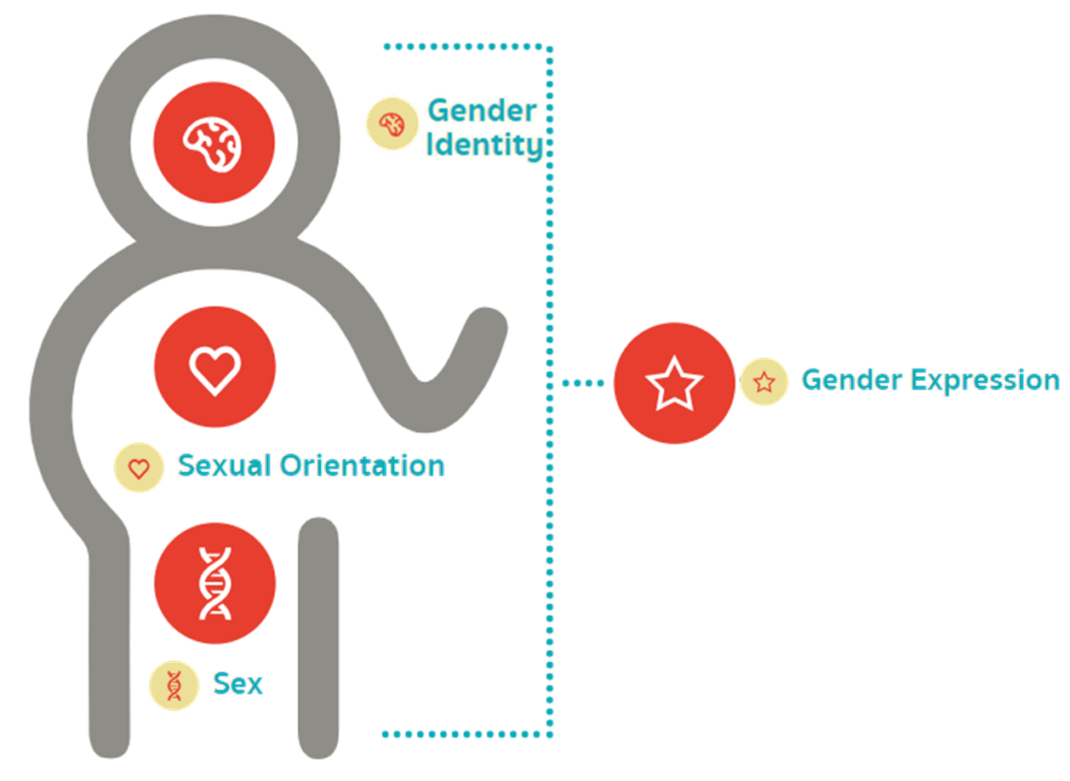
The “Every Body” introduces SOGI concepts
teachingsexualhealth.ca/parents/resources/gender-identity-learning-tool/
Public Health
Healthy Sexuality
Notes:
Script
There are a number of frameworks available to help us think about and understand sexual and gender identity and diversity. For example, you may be familiar with the Genderbread Person or the Gender Unicorn. This one is called the “Every Body” from teachingsexualhealth.ca. It is similar to the Genderbread person, but simpler. It is a good starting point for learners who are new to these concepts.
In this framework:
Gender identity is located next to the mind/brain, because it is connected to how we think about ourselves.
Sexual orientation is located next to the heart, because it is connected to our feelings of attraction for others
Sex is located next to our genitals and a DNA double helix, because it is connected to our biology
And Gender expression encompasses the whole outside of our body, because it is connected to how we present ourselves on the outside
Depending on where your students are at in their background knowledge of gender identity, you could use a more complex framework such as the Genderbread Person or Gender Unicorn. Keep in mind, these frameworks are evolving as discussions and understandings about gender advance.
Note: In case teachers ask about the Genderbread Person or Gender Unicorn, which they may be familiar with, we have included them as “hidden” slides next. If you wish, you can “unhide” these slides (right click on the hidden slide and select “unhide”) and discuss. In the script we have included perspective on the positives and drawbacks of those models. SOGI understandings are a work in progress and models will change over time as we learn more.
Ref
https://teachingsexualhealth.ca/parents/resources/gender-identity-learning-tool/

Slide 17
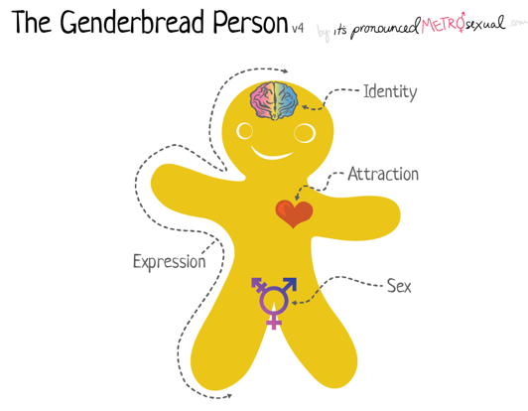
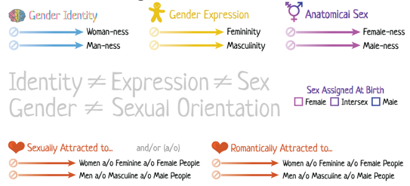
Public Health
Healthy Sexuality
Notes:
NOTE: This slide is kept in this PPT in case teachers ask about the Genderbread Person. You can “unhide” this slide by right-clicking on the slide in the menu, and choosing “unhide slide”. You can use the script below to discuss pros/cons of this model.
Script
Here is the Genderbread Person, which has the same characteristics and connections to body and mind, but also includes linkages between gender/sexual identity and binary terms. For example, gender identity = woman vs man, expression = femininity vs masculinity, and sex = female vs male.
However, it doesn’t clearly capture the people whose gender identity is neither woman nor man (non-binary), and so is considered by many to be outdated.
Ref
https://www.itspronouncedmetrosexual.com/2018/10/the-genderbread-person-v4/

Slide 18
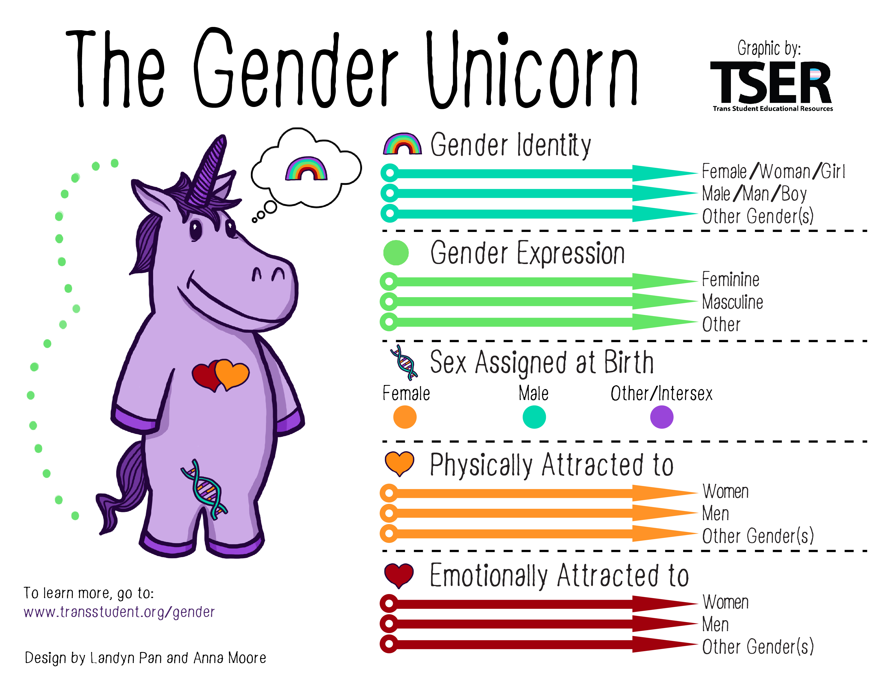
Public Health
Healthy Sexuality
Notes:
NOTE: This slide is kept in this PPT in case teachers ask about the Gender Unicorn. You can “unhide” this slide by right-clicking on the slide in the menu, and choosing “unhide slide”. You can use the script below to discuss pros/cons of this model.
Script
The Gender Unicorn was developed by a different set of authors, with the goal of updating the Genderbread Person. Their goal was to “more accurately portray the distinction between gender, sex assigned at birth, and sexuality.” Specifically, they wanted to recognize genders outside of the binary.
They also take issue with the term “biological sex”, as they argue biological sex is socially constructed, and moved to the term, “sex assigned at birth”.
Ref
Gender Unicorn - (transstudent.org) https://transstudent.org/gender/

Slide 19

Consider the learning needs of your students
Assess
Involve
Adapt
Gauge background content knowledge
Partner with them on learning needs
Revise lessons as necessary
Public Health
Healthy Sexuality
Notes:
Script
Students have different levels of background knowledge about many sexuality topics, including sexual orientation and gender diversity. The Supporting Student Health Guide (from the Ministry of Education) recommends gauging your class’ background knowledge and revising lessons as needed.
We also recommend to partner with them on their learning needs! Involving youth in planning and decision-making helps them feel heard and seen, and feel that their opinions matter, which can increase engagement!
Ref
Supporting Student Health Guide (Secondary) BC Ministry of Education and Child Care
Beyond the Birds and the Bees: Support Sexual & Health Education in BC – YouTube & Resource Document Students Commission of Canada, Commissioned by BC Ministry of Education and Child Care, 2023

Slide 20

Sexual orientation and gender identities develop throughout life
Gender identity begins forming as early as preschool and is explored throughout life
Sexual orientation and identity is explored at many different points in people’s lives
Puberty is a key time to explore identity as youth develop feelings of romantic and sexual attraction to others
Public Health
Healthy Sexuality
Notes:
Script
Read slide
Many know from an early age – as early as preschool - that their gender does not match the gender they were assigned at birth. There are many others who explore their gender later or throughout their life. The timing of one’s gender exploration is based on many factors, including cultural norms, openness, availability of information on gender diversity, and societal, community, and family acceptance.
For many people, gender identity, exploration, and the way we express our gender changes over time, and can feel more fluid than static.

Slide 21
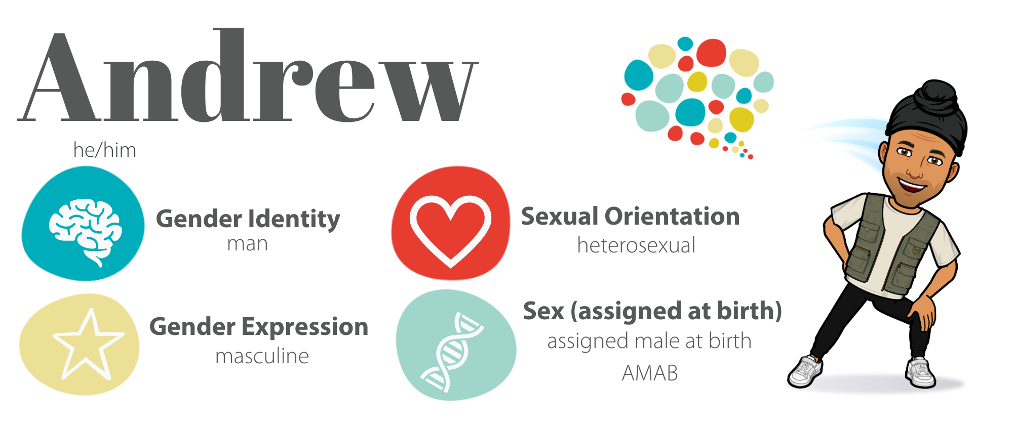
Public Health
Healthy Sexuality
Notes:
Script
Here are some examples of how people may identify or express themselves in terms of gender identity, expression, sexual orientation, and sex assigned at birth.
Andrew uses he/him pronouns, identifies as a man and was assigned male at birth, which means he is cis-gender, expresses his gender as masculine, and is heterosexual, meaning he is attracted to women.
One important note here - people often use the words ‘man’ and ‘male’ interchangeably - or – ‘woman’ and ‘female’ interchangeably. However, man/woman refers to gender identity, whereas male/female refers to biological/physical sex categories. It is most accurate to say someone identifies as a woman/man and their sex assigned as birth is male/female.
Ref
https://teachingsexualhealth.ca/parents/information-by-topic/gender-identity-and-expression/

Slide 22
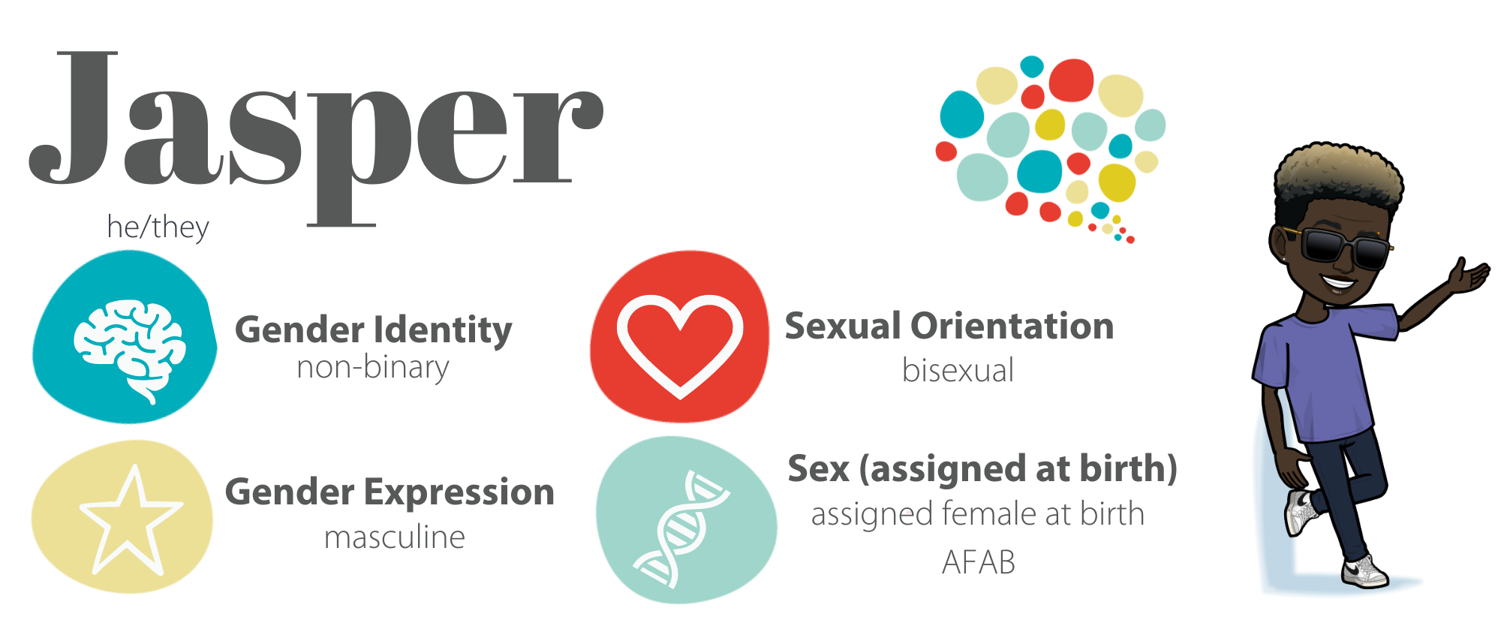
Public Health
Healthy Sexuality
Notes:
Script
Jasper uses he/they pronouns, identifies as non-binary, was assigned female at birth, expresses his gender as masculine, and is bisexual, meaning they are attracted to more than one sex.
Notice Jasper uses he/they pronouns, meaning they use both he/him and they/them pronouns. People choose what pronouns feel right for them
Ref
https://teachingsexualhealth.ca/parents/information-by-topic/gender-identity-and-expression/

Slide 23
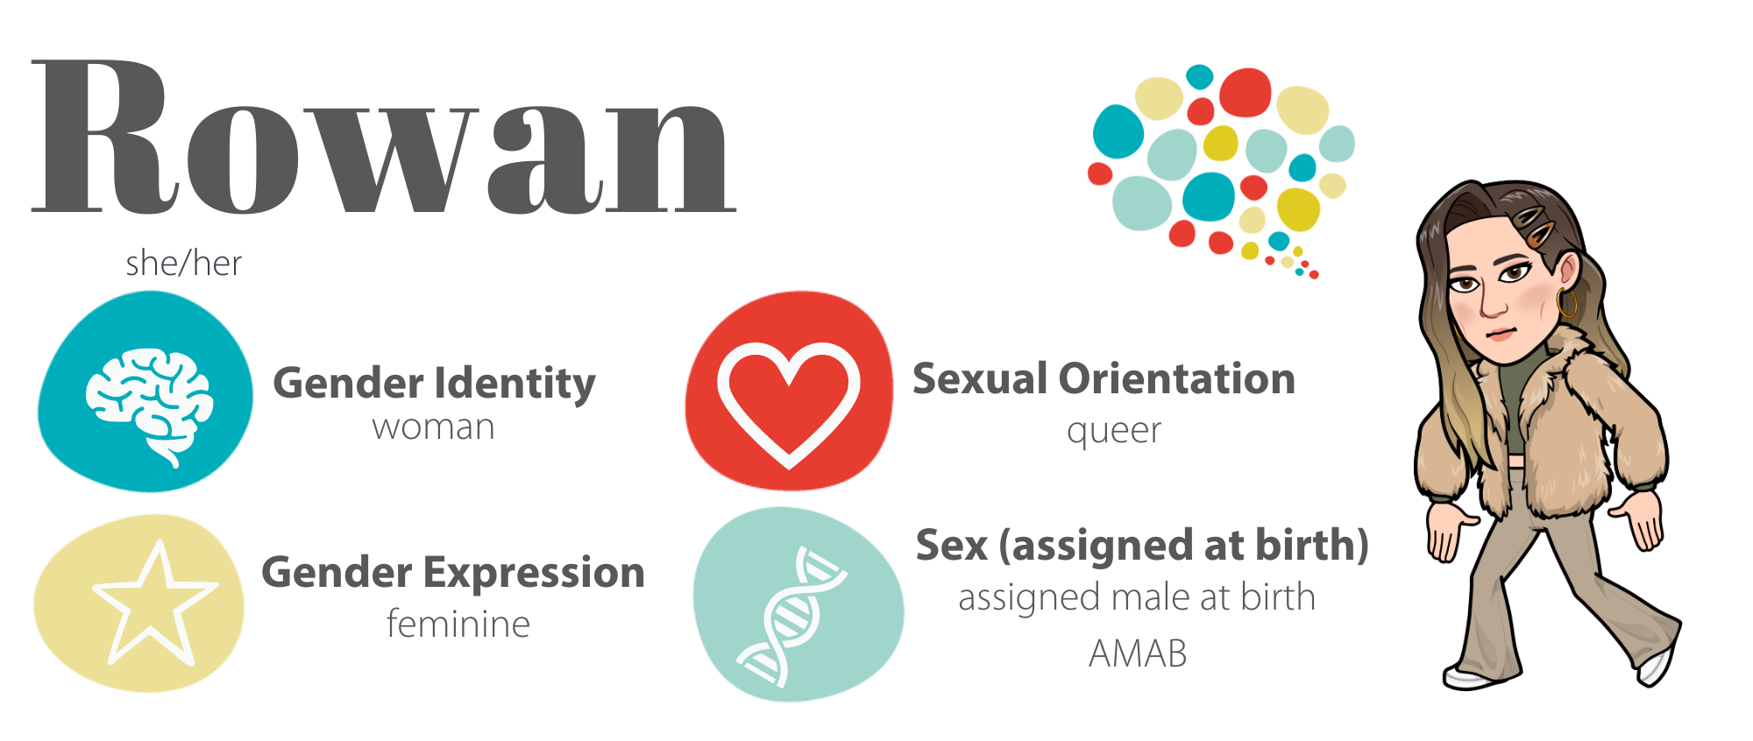
Public Health
Healthy Sexuality
Notes:
Script
Rowan uses she/her pronouns, identifies as a woman and was assigned male at birth, meaning she is a transgender woman, expresses her gender as feminine, and is queer, meaning she is open to many possibilities.
Ref
https://teachingsexualhealth.ca/parents/information-by-topic/gender-identity-and-expression/

Slide 24
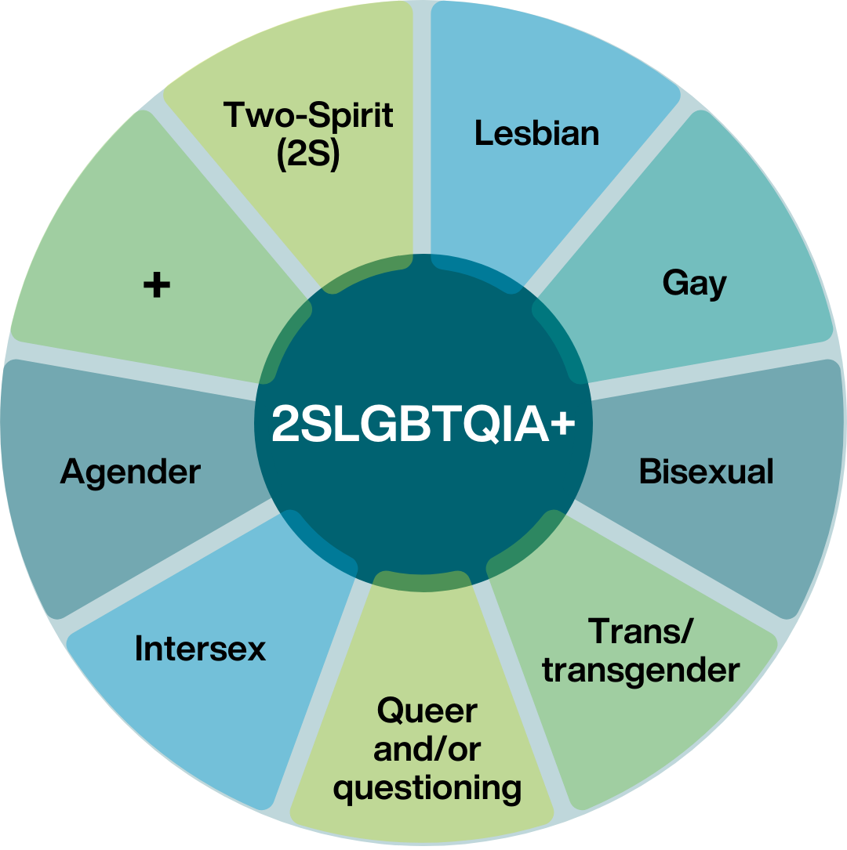
Public Health
Notes:
Script
First let’s start with the acronym 2SLGBTQIA+. Many of you may already be familiar with this term, or it’s predecessor, LGBT and LGBTQ, meaning lesbian, gay, bisexual, transgender, and queer or questioning. It’s been updated to include other gender and sexual identities, including Two-Spirit, an Indigenous identity we will discuss later on, intersex (also known as people with differences in sexual development), agender (someone who does not identify with a specific gender or have a recognizable gender expression) and + (which is sometimes indicated as a star * instead) which is to represent all the identities that aren’t spelled out in the acronym, like non-binary and pansexual.
Can anyone identify which of these terms refer to a sexual orientation? (Lesbian, Gay, Bisexual… may include Two-Spirit)
Can anyone identify which terms refer to gender identity? (Trans/transgender, Agender… may include Two-Spirit)
Can anyone identify which terms refer to biological sex? (Intersex)
Two-Spirit is an Indigenous-specific term that encompasses gender identity, sexual orientation, and cultural identity.
Queer is a term used to describe anyone within this acronym who wants to be included.

Slide 25
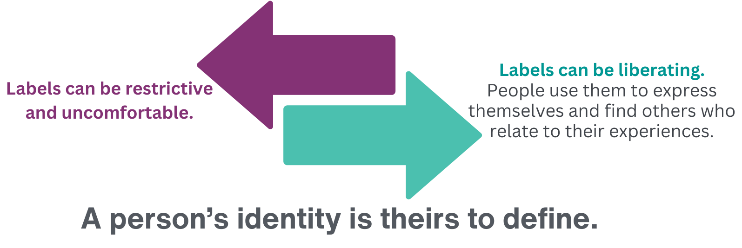
Labels matter
Source: www.thetrevorproject.org
A guide to being an ally to transgender and nonbinary youth
Public Health
Healthy Sexuality
Notes:
Script
It’s important to be sure that an individual self-identifies with a particular term before using it to describe them.
For many people, using labels consistent with their gender and/or sexual identity and diversity can be liberating, a way to express themselves and find others who relate to their experiences.
For some people, who are questioning or exploring their gender, or their gender is fluid, labels are uncomfortable.
There are many words to describe gender, because gender is complicated. Everyone’s identity is theirs to define.
Ref
https://www.thetrevorproject.org/resources/guide/a-guide-to-being-an-ally-to-transgender-and-nonbinary-youth/

Slide 26

Remember
A person’s sexual orientation, gender identity, and gender expression are a part of who they are.
You can’t know someone’s sexual orientation or gender identity just by looking at them.
Public Health
Healthy Sexuality
Notes:
Script
Read slide
Ref
https://teachingsexualhealth.ca/parents/information-by-topic/sexual-diversity/

Slide 27

Matching activity Sexual Orientation & Gender Identity (SOGI) Terms
Public Health
Healthy Sexuality
Notes:
NOTE:
This activity can either be completed using the following “hidden” slides or by using printed cards from the accompanying SOGI Terms Matching Activity (a separate file with instructions for this is available on the school health intranet page). We recommend using the printed cards if presenting in person, and the hidden slides if presenting online (post the list of the terms below in the chat to help them guess). The slides are animated: the definition will “fly in” first – to allow time for thinking and guessing - followed by the term. You can also provide teachers the Matching Activity electronic file for them to print and use in their classrooms with their students.
Script
We are going to complete a matching activity where we match SOGI terms to definitions. This is to help build your familiarity with terms you may hear.
If presenting online: I’ll post a list of terms in the chat, then read out a definition, and you can guess the term that matches.
Again, remember this is a safe space, we are all learning, and it is ok to guess and make mistakes!
SOGI Term List
Transition
Gender Diverse
Gender Binary
Intersex
Non-Binary
Queer
Questioning
Ally
Agender
Coming Out
Transgender / Trans
Cisgender / Cis

Slide 28

Agender
What does it mean?
Someone who does not identify with a specific gender or have a recognizable gender expression.
Public Health
Healthy Sexuality
Notes:
Ref
https://teachingsexualhealth.ca/parents/information-by-topic/gender-identity-and-expression/

Slide 29

Intersex
What does it mean?
People’s sex may be assigned this way when their body’s reproductive sexual biology or genetic biology is not exclusively male or female, not clear, or otherwise does not fit within traditional definitions of male and female.
May or may not be assigned at birth or assigned at all.
Some people may not use this term and instead use the term differences in sex development (DSD).
Public Health
Healthy Sexuality
Notes:
Ref
https://teachingsexualhealth.ca/parents/information-by-topic/gender-identity-and-expression/

Slide 30
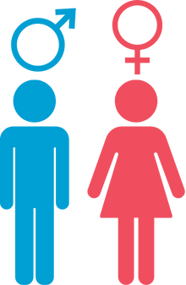
Gender Binary
What does it mean?
The classification of sex and gender into two distinct and separate states of masculine and feminine.
A social boundary that discourages people from crossing or mixing gender roles.
Public Health
Healthy Sexuality
Notes:
Ref
https://teachingsexualhealth.ca/parents/information-by-topic/gender-identity-and-expression/
Non-Binary – personal communication, Parker Hewes, VCH PRISM, Sept 10, 2024

Slide 31

Non-Binary
What does it mean?
An umbrella term that refers to diverse people whose gender identity falls outside of the traditional western binary and don’t exclusively identify as a woman or a man.
Public Health
Healthy Sexuality
Notes:
Ref
https://teachingsexualhealth.ca/parents/information-by-topic/gender-identity-and-expression/
Non-Binary – personal communication, Parker Hewes, VCH PRISM, Sept 10, 2024

Slide 32

Queer
What does it mean?
A term used by some people who identify as sexually and/or gender diverse.
It is a reclaimed term as it was previously used as a slur.
It is now a positive, inclusive term to describe individuals, communities, and social movements.
Public Health
Healthy Sexuality
Notes:
Ref
https://teachingsexualhealth.ca/parents/information-by-topic/gender-identity-and-expression/

Slide 33
Cisgender / Cis
What does it mean?
A person whose gender identity matches the sex they were assigned at birth.
Public Health
Healthy Sexuality
Notes:
Ref
https://teachingsexualhealth.ca/parents/information-by-topic/gender-identity-and-expression/

Slide 34

Gender Diverse
What does it mean?
Gender identities, roles and/or gender expressions that do not match social and cultural expectations.
Public Health
Healthy Sexuality
Notes:
Ref
https://teachingsexualhealth.ca/parents/information-by-topic/gender-identity-and-expression/
https://www.fraserhealth.ca/health-topics-a-to-z/school-health/sex-education-and-sexual-identity/gender-and-sexual-identity-in-schools

Slide 35

Transgender / Trans
What does it mean?
An umbrella term for people whose gender identity differs from the sex they were assigned at birth.
Public Health
Healthy Sexuality
Notes:
Ref
https://teachingsexualhealth.ca/parents/information-by-topic/gender-identity-and-expression/
https://qmunity.ca/wp-content/uploads/2023/01/Queer-Glossary_2022_Digital.pdf

Slide 36

Transition
What does it mean?
The processes during which trans and other gender diverse people change their gender expression and/or bodies.
Can include name and pronoun change, wardrobe or hairstyle, medical care, etc.
It is better understood as a personal journey to support someone’s health and happiness.
Also called "Gender-Affirmation".
Public Health
Healthy Sexuality
Notes:
Ref
https://teachingsexualhealth.ca/parents/information-by-topic/gender-identity-and-expression/
https://qmunity.ca/wp-content/uploads/2023/01/Queer-Glossary_2022_Digital.pdf

Slide 37

Questioning
What does it mean?
A person exploring, or unsure of, their sexual orientation or gender identity.
Public Health
Healthy Sexuality
Notes:
Ref
https://teachingsexualhealth.ca/parents/information-by-topic/gender-identity-and-expression/

Slide 38

Coming Out
What does it mean?
Telling people about one’s sexual orientation or gender identity.
Also known as ‘coming out of the closet’.
Public Health
Healthy Sexuality
Notes:
Ref
https://teachingsexualhealth.ca/parents/information-by-topic/gender-identity-and-expression/

Slide 39

Ally
What does it mean?
A person who advocates for the human rights of sexually and gender diverse people by challenging discrimination and heterosexism.
Public Health
Healthy Sexuality
Notes:
Ref
https://teachingsexualhealth.ca/parents/information-by-topic/gender-identity-and-expression/

Slide 40
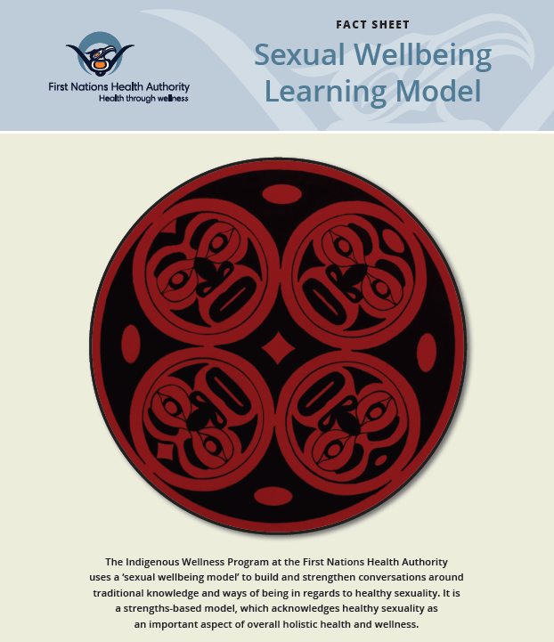
Sexual and Gender Identity:
Learning from Indigenous voices
Public Health
Healthy Sexuality
Notes:
Script:
Sexual and gender identity is influenced by and connected to culture. Over the next few slides, we’re going to explore Indigenous perspectives on sex and gender. A note here: If this is new topic for you, we encourage you to use this material as a starting point on your learning journey. The best way to deepen your understanding is through Two-Spirit people or resources developed by Two-Spirit people. One option is the Indigenous Gender Diversity Course from TransCare BC – we will briefly discuss this course later, and we have it linked in our Teaching Resources.
Here is the First Nations Health Authority Sexual Wellbeing Learning Model, developed by First Nations Health Authority to build and strengthen conversations around traditional knowledge and ways of being with regards to healthy sexuality.
Ref:
https://www.fnha.ca/WellnessSite/WellnessDocuments/FNHA-IWP-Sexual-Wellbeing-Learning-Model-Fact-Sheet.pdf

Slide 41
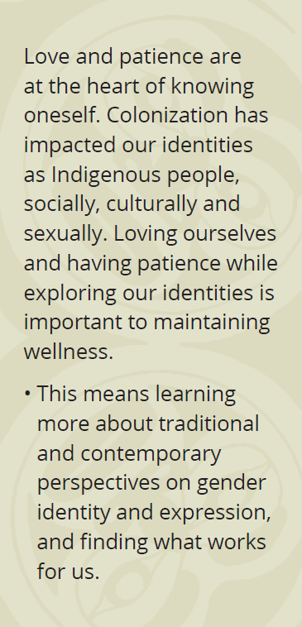
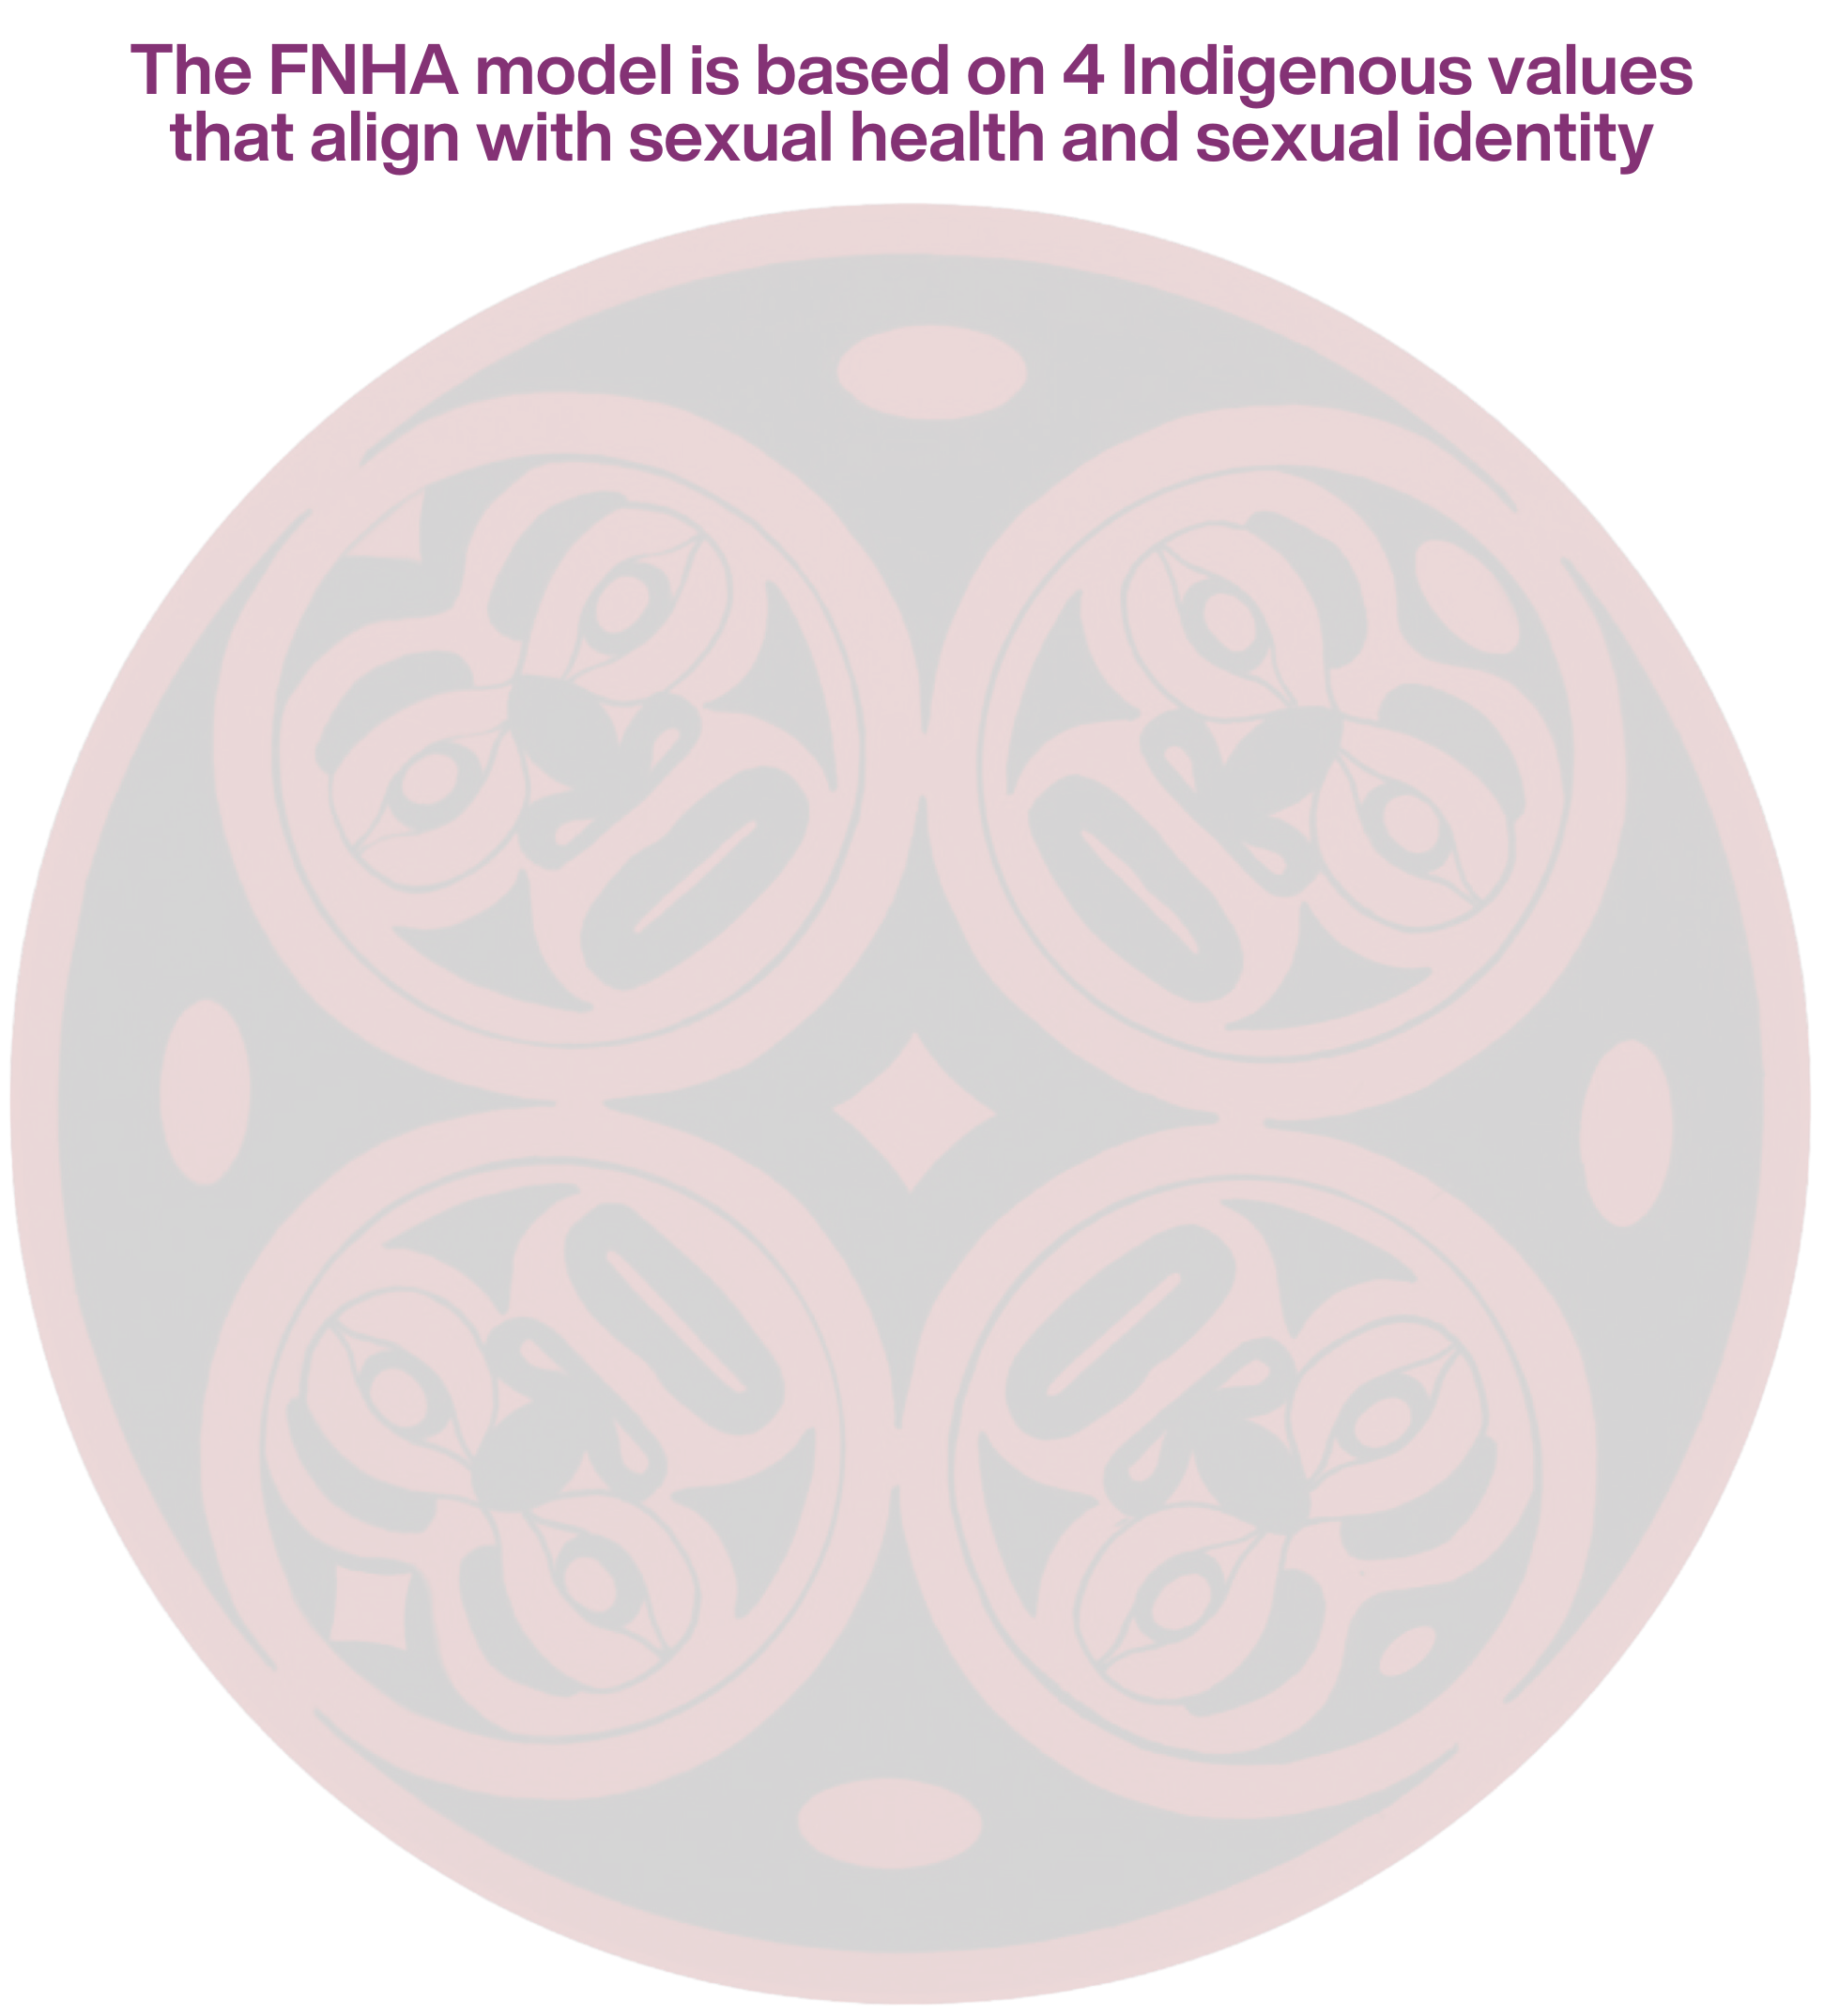
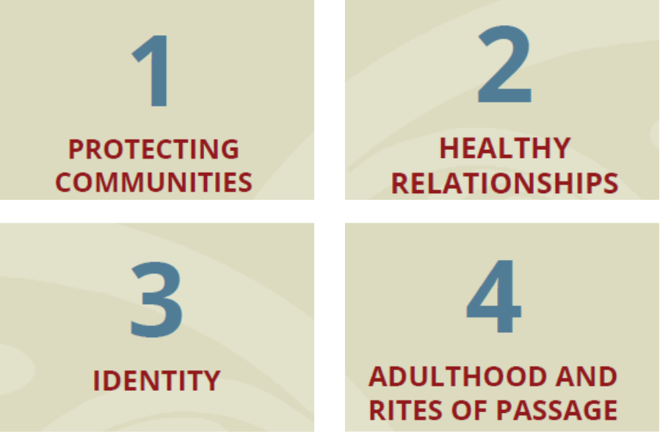
Identity within Indigenous Sexual Wellbeing
Public Health
Healthy Sexuality
Notes:
Script
There are 4 Indigenous values identified within the model: Protecting Communities, Healthy Relationships, Adulthood and Rites of Passage, and Identity. Let’s take a closer look at the value of Identity.
Read Identity quote.
Non-judgment, inclusion, and celebrating differences are learning components for this value.
Note: If questions arise re: the other values listed on this slide:
Protecting Communities – Identifies that cooperation and respect are essential to protecting our communities for future generations. Protecting one’s community means protecting oneself. In a sexual health context, that means protecting oneself and one’s community from STI transmission.
Healthy Relationships – Kindness and balance are fundamental First Nations’ teachings for living life in a good way; this value includes healthy relationships with others as well as ourselves.
Adulthood and rites of passage – traditionally and historically, First Nations people did not perceive sexuality as shameful, and was seen as a holistic part of health. Many nations celebrate rites of passage ceremonies to honor transition from adolescence to adulthood, and the independence and responsibilities, including in relationships, that accompany this transition.

Slide 42

Pre-colonial Indigenous perspectives recognized diverse identities
Indigenous views on sexuality were not rooted in heteronormativity
Many cultures traditionally had more complex non-binary concepts of gender and sexuality
Sources:
MMIWGSLGBTQQIA National Action Plan Final Report
Health Professionals working with First Nations, Inuit, and Metis Consensus Guideline
Public Health
Healthy Sexuality
Notes:
Script
Read first paragraph. Categories of gender, sex, and sexuality were introduced to Indigenous Peoples through colonial processes and institutions.
Ref
https://mmiwg2splus-nationalactionplan.ca/eng/1670511213459/1670511226843
mMIWGSLGBTQQIANationalActionPlanFinalReport_1674664681658_eng%20(3).pdf
Health Professionals working with First Nations, Inuit, and Metis Consensus Guideline (2013). https://www.aboriginalsexualhealth.ca/documents/gui293CPG1306E.pdf
Reviewed and edited by Jessy Dame, RN, VCH Indigenous Health, Sept 10, 2024

Slide 43
Two-Spirit people were here before colonization
Two-Spirit people existed among many Indigenous nations prior to contact with European colonizers
Two-Spirit people often carried unique roles and responsibilities that were vital to their communities’ well-being and survival
Source:
MMIWGSLGBTQQIA National Action Plan Final Report
Public Health
Healthy Sexuality
Notes:
Script
Read first paragraph. “More than two-thirds of the 200 Indigenous languages spoken in North America have terms used to identify individuals who are neither men nor women.”
Read second paragraph. Research and oral histories reflect the widespread respect and honour Indigenous people held for Two-Spirit people. Important roles held by Two-Spirit people included teachers, knowledge keepers, healers, herbalists, child minders, spiritual leaders, interpreters, mediators and artists.
Ref
https://mmiwg2splus-nationalactionplan.ca/eng/1670511213459/1670511226843
mMIWGSLGBTQQIANationalActionPlanFinalReport_1674664681658_eng%20(3).pdf

Slide 44

Two-Spirit is a concept deeply rooted in Indigenous culture
May be used to describe North American Indigenous people who identify as LGBTQIA+
Helps facilitate re-connection with pre-colonial cultural expressions and roles of gender and sexual diversity for Indigenous Peoples
May refer to sexual orientation, gender, or sex, but is not limited to these characteristics
Source:
MMIWGSLGBTQQIA National Action Plan Final Report
Public Health
Healthy Sexuality
Notes:
Script
Read 1st and 2nd circles.
For example, it:
Encompasses an even broader range of Indigenous sexual and gender identities
Does not make clear distinctions between gender, sex and sexualities
Recognizes that categories of gender, sex and sexuality were introduced through colonial processes and institutions
Includes Indigenous roles and responsibilities in community and ability to choose life pathways not influenced by gender expectations.
Is also a social justice and advocacy movement lead by Indigenous Peoples.
Is best understood from within Indigenous frameworks and understandings.
Read 3rd circle. Each Nation has their own expressions, roles, and traditional language for sex and gender diversity.
Indigenous LGBTQIA+ people may or may not identify as Two-Spirit; some may identify as an Indigenous trans woman or man, Indigiqueer, or use a term specific to their Nations’ language and culture.
Ref
https://mmiwg2splus-nationalactionplan.ca/eng/1670511213459/1670511226843
mMIWGSLGBTQQIANationalActionPlanFinalReport_1674664681658_eng%20(3).pdf
MEET THE METHODS SERIES: “WHAT AND WHO IS TWO-SPIRIT” IN HEALTH RESEARCH Harlan and Travis

Slide 45

Notes:
NOTE: This video is long – almost 10min. To keep the workshop under an hour, we recommend playing the first 2-3 speakers, then stopping the video. Internet connectivity is required to play this video – skip if you do not have time or internet access.
Script
This is a 10minute video from TransCare BC (PHSA) called “Personal reflections on Two-Spirit identities, histories, and cultural contexts”. It features community members discussing “how Two-Spirit people were historically respected, the diversity that exists across Nations, and some differences in the current understandings between being Two-Spirit and being lesbian, gay, bisexual, transgender, or queer (LGBTQ).”
Let’s watch.

Slide 46
2SLGBTQIA+
recognizes that 2S (Two-spirit) is different and unique from other LGBTQ+ identities.
Public Health
Healthy Sexuality
Notes:
Script
2S has been added to the LGBTQIA+ acronym to recognize Two-Spirit as an Indigenous identity that is different and unique from other LGBTQIA+ identities.
Two-Spirit should be added to the front of the 2SLGBTQIA+ acronym to recognize that Two-Spirit people were the first sexually and gender diverse people in these lands. It is also a way to centre Indigenous voices within this community.
Ref
Personal communication, Jessy Dame, RN, VCH Indigenous Health, Sept 10, 2024

Slide 47
Gender-based discrimination and violence
GRADES 8–10 PHE
Students will cultivate an awareness of the nature and consequences of bullying, stereotyping, discrimination, and violence based on gender identity/expressions and sexuality.
Public Health
Healthy Sexuality
Notes:
Script
Let’s move on to talk about gender-based discrimination and violence.
Read slide

Slide 48
Let’s discuss gender stereotypes
What is a stereotype?
A belief about specific types of people or certain ways of doing things that may or may not accurately reflect reality.
What is a gender stereotype?
Something that people think is true about how others look, act, think, talk or feel because they are a certain gender. There are specific meanings associated with “acting like a boy” or “acting like a girl”.
How does it feel to be stereotyped? Why?
Usually negative. You aren’t being seen the way you really are. You are being judged by what someone else thinks.
Source: Gender, Body Image & Social Influences Lesson Plan (Gr 7)
https://teachingsexualhealth.ca/teachers/lesson-plans-resources/resource-finder/
Public Health
Healthy Sexuality
Notes:
Script
NOTE This is an animated slide. Read each question as they ‘fly in’. Allow discussion. Then advance forward and read the definition/info it ‘flies in’.
Let’s start with a discussion learning activity from teachingsexualhealth’s Gender, Body Image & Social Influences Lesson Plan. We have this lesson plan linked in our Lesson Plans & Teaching Resources.
Read slide
Ref
https://teachingsexualhealth.ca/app/uploads/sites/4/Gr7LP3-Gender-Body-Image-Social-Influences-ENGLISH-FINAL.pdf

Slide 49
Let’s consider some gender stereotype scenarios
Tshepo is babysitting a little boy named Ramone, age 6. Ramone’s favourite toy is a Barbie doll he got from a cousin. Tshepo isn’t sure if Ramone should be playing with a doll.
Why do you think Tshepo is unsure about letting Ramone play with a doll? What beliefs do people have about boys and dolls?
Jaya has a new friend this year, named Cam. They both love skateboarding, have the same taste in music and comics, and have fun hanging out after school. Cam is non-binary and uses they/them pronouns. Jaya’s parents say that people are either boys or girls and that is it, and don’t want Jaya to spend any time with Cam.
Why do you think Jaya’s parents are worried about Jaya spending time with Cam?
Source: Gender, Body Image & Social Influences Lesson Plan (Gr 7)
https://teachingsexualhealth.ca/teachers/lesson-plans-resources/resource-finder/
Public Health
Healthy Sexuality
Notes:
Script
NOTE This is an animated slide. Read each scenario, and then the related questions as they ‘fly in’. Allow discussion. There are no “answers” for this activity – it is intended to create opportunities for reflection.
Here are a few scenarios from the same teachingsexualhealth.ca lesson plan.
Ref
https://teachingsexualhealth.ca/app/uploads/sites/4/Gr7LP3-Gender-Body-Image-Social-Influences-ENGLISH-FINAL.pdf

Slide 50
Sexism is harmful to everyone
Sexism harms women and girls because it is used to belittle them.
Sexism is defined as: Prejudice or discrimination based on sex, usually against women and girls.
Based on the assumption that women and girls are “lesser” than men and boys.
Sexism also harms men, boys, and gender diverse people because it is used to bully them about their masculinity.
Sexism limits our ability to be our authentic selves and diminishes safety and belonging.
Public Health
Healthy Sexuality
Notes:
Script
NOTE This is an animated slide with info rather than discussion.
Stereotypes of sex and gender-based social roles foster sexist behaviour and attitudes. Sexist comments include examples like, “Why are you wearing pink, dude” and “That’s so gay.”
Read definition and assumption (on left). Then advance forward and read each info statement as they ‘fly in’.
It places people into rigid gender boxes, limits expressions of masculinity and femininity, and ignores gender diversity.
Ref
https://open.alberta.ca/dataset/dc476f90-e1f3-44f8-a689-555359a018bd/resource/b9e51319-920d-4827-931b-edbc87581be4/download/positive-impacts-of-gsasqsas-hmjwb.pdf

Slide 51

This right is legally protected.
All people have the right to be free from discrimination against their sex, gender, sexual orientation, gender identity and gender expression.
Article 2 of the UN Convention on the Rights of the Child
Canadian Charter of Rights and Freedoms
Canadian Human Rights Act
BC Human Rights Code
Public Health
Healthy Sexuality
Notes:
Script
Read slide
All of us who work in schools have a legal – and ethical and professional responsibility - to ensure that all students, including those who are sexually or gender diverse, are provided with safe, caring, welcoming learning environments that respect and affirm their identities and experiences.
We thought exploring human rights laws would be an interesting student learning activity, so we developed one. I’m happy to share this with you if you’re interested!
NOTES:
The UN Convention on the Rights of the Child is an international treaty Canada signed in 1991 that stipulates the rights of all children are to be respected without discrimination of any kind - including gender.
The Canadian Charter of Rights and Freedoms states that all Canadians have the right to equality, equal opportunity, fair treatment, and an environment free of discrimination on the basis of sex, sexual orientation, gender identity or expression (added in 2017).
The Canadian Human Rights Act stipulates all Canadians have the right to equality, equal opportunity, fair treatment, and an environment free of discrimination - including on the basis of sex, sexual orientation, gender identity or expression.
The BC Human Rights Code prohibits discrimination in public spaces based on personal characteristics - including sex, sexual orientation, gender identity or expression.

Slide 52
Gender diverse youth experience transphobia
Many face challenges as a direct result of transphobia
In unsupportive contexts, youth may face bullying, harassment, and/or discrimination.
Public Health
Healthy Sexuality
Notes:
Script
Read slide
Unsupportive contexts are those lacking family, community, and societal support. Youth may be afraid of how their families and friends will react if they’re open about their trans identity. This is particularly difficult for young people who can’t support themselves financially because some may be forced to leave their homes after coming out.
On the other hand, not coming out can also pose serious safety risks as a result of isolation, mental health distress, and lack of supports.
NOTE:
Transphobia definition: fear and/or hatred of people who are trans. Often shown through prejudice, discrimination, bullying, intimidation or acts of violence.
Ref
https://teachingsexualhealth.ca/parents/information-by-topic/gender-identity-and-expression/

Slide 53
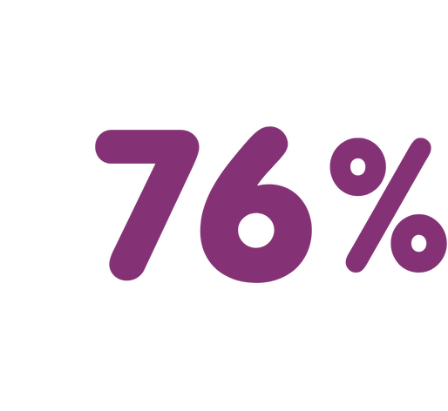
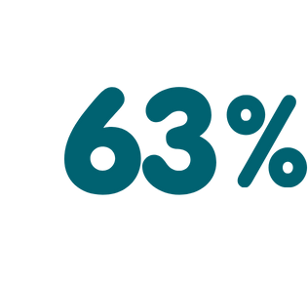
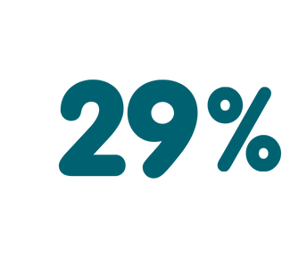
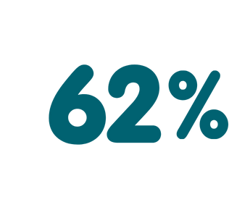
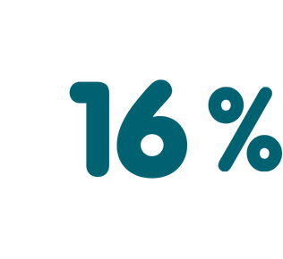
Gender diverse youth have negative school experiences
harassed about gender expression
physically harassed or assaulted at school
felt unsafe at school
excluded due to their identity
heard transphobic comments daily or weekly
Source: egale.ca/awareness/still-in-every-class/
Public Health
Healthy Sexuality
Notes:
Script
In a 2021 survey of Canadian students in Grades 8-12, researchers found that among 2SLGBTQ students … read slide
Ref
https://teachingsexualhealth.ca/parents/information-by-topic/gender-identity-and-expression/
Still In Every Class In Every School - Egale

Slide 54
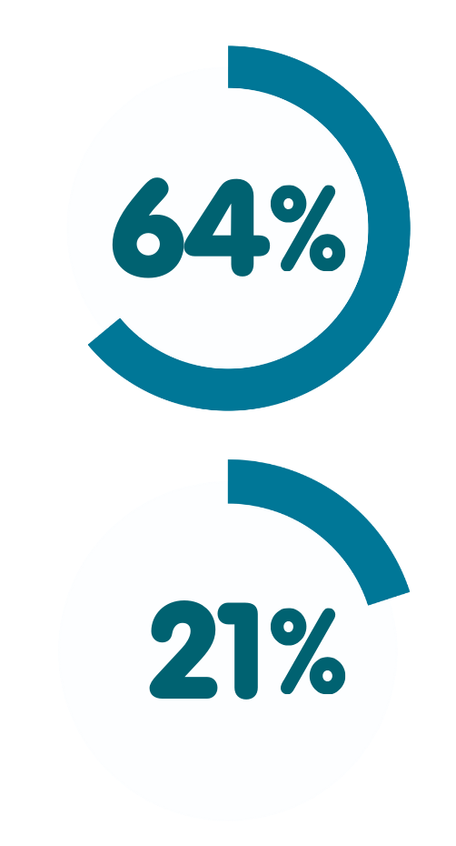
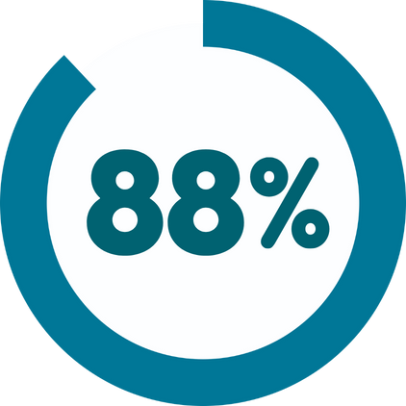
Gender diverse youth mental health is affected by discrimination
seriously considered suicide in the past year
indicated a chronic mental health condition such as depression or anxiety
have attempted suicide
Source: Being Safe, Being Me, 2019: apsc-saravyc.sites.olt.ubc.ca/files/2020/03/ Being-Safe-Being-Me-2019_SARAVYC_ENG.pdf
Public Health
Healthy Sexuality
Notes:
Script
In a 2019 study of trans and non-binary Canadian youth, researchers found… read slide
These are very sobering statistics.
https://apsc-saravyc.sites.olt.ubc.ca/files/2020/03/Being-Safe-Being-Me-2019_SARAVYC_ENG.pdf

Slide 55
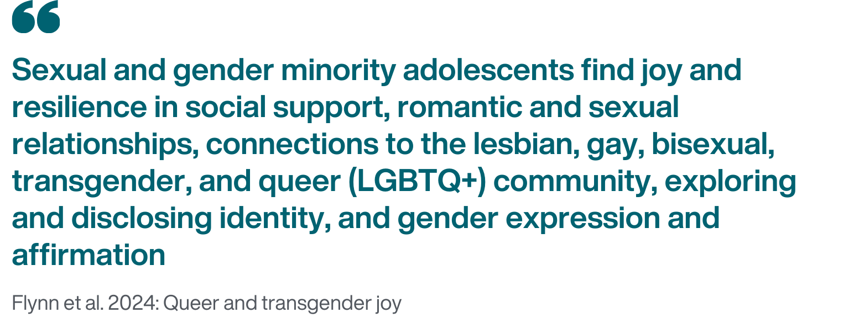
Gender diverse youth find joy and resilience
Source: Psychology of Sexual Orientation and Gender Diversity.
https://psycnet.apa.org/record/2024-75957-001
Public Health
Healthy Sexuality
Notes:
Script
While the conversation often focuses solely on gender diverse youth’s negative experiences, we want to highlight that there are also positive experiences, including celebration, support, and love…. read slide.
Ref
Flynn, S. S., Touhey, S., Sullivan, T. R., & Mereish, E. H. (2024). Queer and transgender joy: A daily diary qualitative study of positive identity factors among sexual and gender minority adolescents. Psychology of Sexual Orientation and Gender Diversity. Advance online publication
https://psycnet.apa.org/record/2024-75957-001

Slide 56
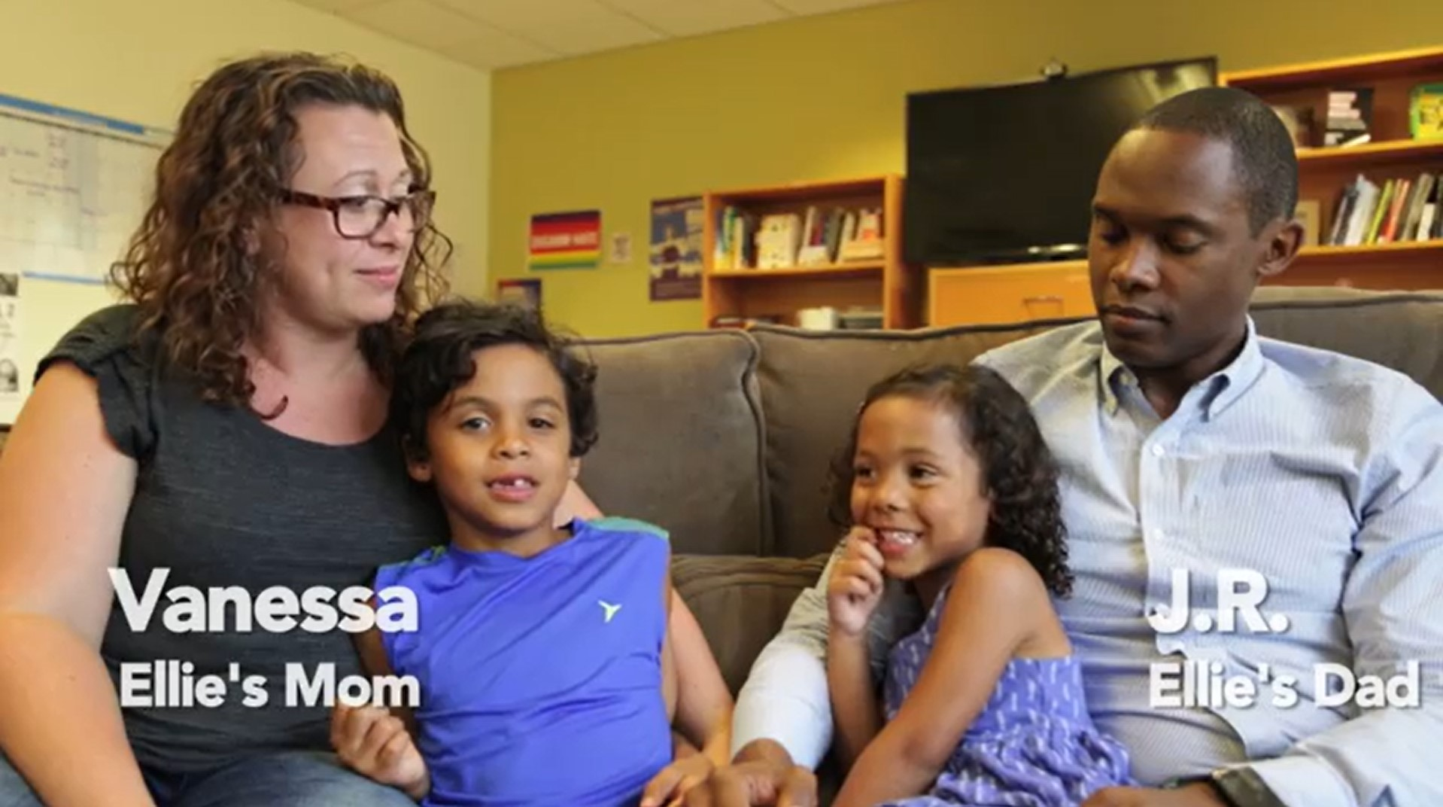
Notes:
Script
NOTE: Internet connectivity is required to play this video – skip if you do not have internet access. Video is 4 minutes long.
This video is called “An Introduction to Transgender People”. It is a resource in SOGI 123’s School Climate Map (bctf.ca) Lesson Plan, which is posted on TeachBC. We link to it in our Lesson Plans and Teaching Resources.
In this video, people share stories of experiencing transphobic violence and discrimination. If you need to take a break away, please do. The video is 4 minutes long.
Ref:
Advocates for Trans Equality: An Introduction to Transgender People (youtube.com)

Slide 57
Strategies to protect self and others Gender diverse youth
GRADES 8–10 PHE
Students will learn strategies to protect themselves and others from potential abuse, exploitation, and harm, which includes gender-based violence.
Public Health
Healthy Sexuality
Notes:
Script
Now that we have an understanding of what gender-based discrimination against women and sexual and gender diverse people looks like, and its consequences, let’s discuss strategies that can be used to protect both oneself and others.
Read curriculum

Slide 58

Protect oneself from inside and out
Choose inclusive environments where:
Identities are accepted and affirmed
Peer, adult, and community connection can be built
Resources and programming like GSAs are available and visible
Finding joy, resilience, support, and community are keys to buffering the negative impacts of
discrimination and bullying.
Public Health
Healthy Sexuality
Notes:
Script
NOTE This is an animated slide.
Read left side. Many gender diverse kids do well in their school environments and are proud of who they are. They have positive and productive coping strategies and can be role models and sources of support for other 2SLGBTQIA+ students.
Advance forward. Read right side. “GSAs” stand for “Genders & Sexualities Alliances” – we’ll discuss this more in a few slides.
Ref:
Parker Hewes, Prism Coordinator, Personal Communication, Oct 3, 2024

Slide 59
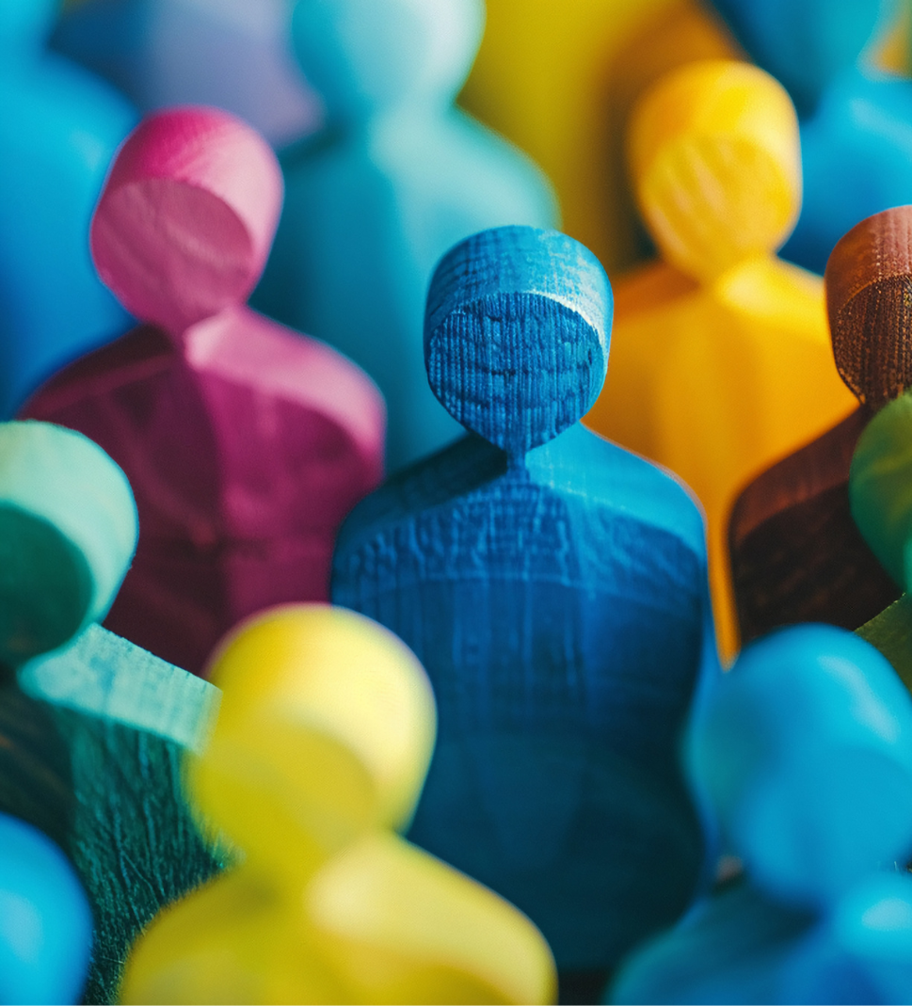
Support others through acceptance
Supportive families, schools, and communities play a crucial role in helping 2SLGBTQIA+ youth succeed at school and in their overall well-being.
Trans and gender diverse youth who reported gender identity acceptance from at least one
adult had 1/3 lower odds of reporting a suicide attempt
in the past year.
Source: Myeshia N. Price and Amy E. Green. Association of Gender Identity Acceptance with Fewer Suicide Attempts among Transgender and Nonbinary Youth. Transgender Health, 2023.
Public Health
Healthy Sexuality
Notes:
Script
NOTE This is an animated slide.
Read left side. When a school’s students, staff and parents ensure it is an inclusive space, 2SLGBTQIA+ students can feel safe and thrive. Kids and teens supported at home and school are more likely to stay in school, have stable living environments, and have better mental and physical health.
Advance forward. Read right side. Notice that this states at least 1 adult – in the study, this adult didn’t just include parents, it included teachers, school counsellors, social workers, and health care providers. You could be this adult for your students.
Ref
https://teachingsexualhealth.ca/parents/information-by-topic/gender-identity-and-expression/
Myeshia N. Price and Amy E. Green. Association of Gender Identity Acceptance with Fewer Suicide Attempts among Transgender and Nonbinary Youth. Transgender Health, 2023.

Slide 60

Support others with school guidelines
Schools with guidelines that support inclusion and diversity
improve health and wellbeing for gender diverse students.
Guidelines also lower the risk
of problem substance use, discrimination, and suicidality for all students.
Public Health
Healthy Sexuality
Notes:
Script
NOTE This is an animated slide.
Read Left side. Advance forward. Read right side.
Refs
VCH Letter of Support for Sexual Health Education
Proulx, Chelsea N., et al. "Associations of lesbian, gay, bisexual, transgender, and questioning–inclusive sex education with mental health outcomes and school-based victimization in US high school students." Journal of Adolescent Health 64.5 (2019): 608-614.
Marx, Robert A., and Heather Hensman Kettrey. "Gay-straight alliances are associated with lower levels of school-based victimization of LGBTQ+ youth: A systematic review and meta-analysis." Journal of youth and adolescence 45 (2016): 1269-1282.

Slide 61
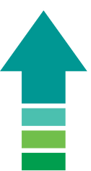
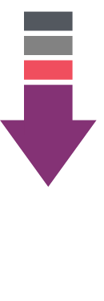
Support others with Genders & Sexualities Alliances (GSAs)
Increase
Sense of safety
School connectedness
Positive youth and identity development
School achievement
Decrease
Discrimination
Bullying
Depression and despair
Violence
Substance use
Suicidal ideation and attempts
HIV risk
School drop-out
Public Health
Healthy Sexuality
Notes:
Script
GSAs stand for Gay-Straight or Genders & Sexualities Alliances. They may also be known as Queer-Straight Alliances or Rainbow Clubs. GSAs are one way for schools to create supportive and safe environments for sexual and gender diverse youth. Research has found GSAs… Read slide
GSAs/QSAs can challenge stereotypes and help all students feel safe and respected by promoting a climate of gender inclusion, affirming diverse identities, and cultivating respect for differences. As a result, they can be an important tool for engaging the entire school community in addressing larger safety issues, including gender-related bullying, violence and harassment - making school safer for all students, staff and families.
Ref
Saewyc EM, Konishi C, Rose HA, Homma Y. School-based strategies to reduce suicidal ideation, suicide attempts, and discrimination among sexual minority and heterosexual adolescents in Western Canada. Int J Child Youth Family Stud. 2014;5(1):89-112.
Loverno S, Belser AB, Baiocco R, Grossman AH, Russell ST. The Protective Role of Gay-Straight Alliances for Lesbian, Gay, Bisexual, and Questioning Students: A Prospective Analysis. Psychol Sex Orientat Gend Divers. 2016 Dec;3(4):397-406. doi: 10.1037/sgd0000193.
https://teachingsexualhealth.ca/parents/information-by-topic/gender-identity-and-expression/
positive-impacts-of-gsasqsas-hmjwb.pdf (alberta.ca)

Slide 62
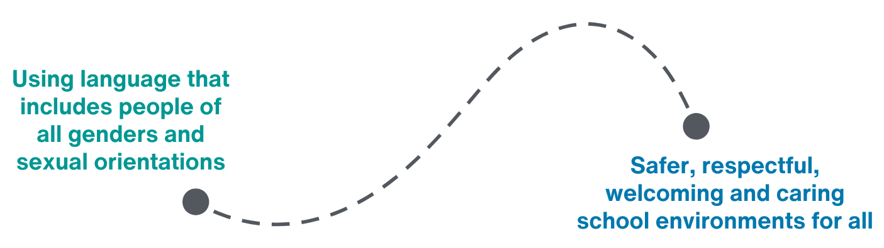
Support others with inclusive language
Source: Inclusive Language - Teachers | Teaching Sexual Health
Public Health
Healthy Sexuality
Notes:
Script
Read slide
Many people use words that assume everyone is heterosexual (straight) and cisgender (meaning, their gender matches the sex they were assigned at birth) without realizing it excludes sexual and gender diverse people. For example, using ‘boyfriend’ or ‘girlfriend’ instead of partner, or ‘mother’ and ‘father’ instead of “parents or guardians”.
Inclusive language includes using gender neutral words and terms until you know the words people use to describe themselves and the people in their lives (e.g. family members, significant others).
See our “Getting Started Workshop” for more information on using gender inclusive language.
Ref: Inclusive Language - Teachers | Teaching Sexual

Slide 63



Mistakes can be opportunities to learn
Apologize briefly
Use the correct word, term, name, or pronoun
Move on
Source: https://www.transcarebc.ca/sites/default/files/2024-03/Making_Mistakes.pdf
Public Health
Healthy Sexuality
Notes:
Script
Many people worry they’ll make a mistake in choice of words, terms, names, or pronouns. It’s important not to let fear of making mistakes stop you from building relationships because relationship building is key to providing positive experiences. Mistakes are inevitable. It’s more important to learn from our mistakes.
If you make a mistake, apologize briefly, use the correct word, term, name, or pronoun, and move on. If you make repeated mistakes, spend time practicing - and check in with the person to apologize and give space for their feelings.
Ref
https://www.transcarebc.ca/sites/default/files/2024-03/Making_Mistakes.pdf

Slide 64
Support others with inclusive spaces
Seek information
Identify and address
Listen supportively
Support GSAs
Integrate 2SLGBTQIA+
Model
about sexual and gender diversity
teasing, bullying, and harassment
to people who come out or confide in you
and other inclusion initiatives
literature into class, library, assignments, and readings. Use inclusive images and examples.
inclusive behaviours and language
Public Health
Healthy Sexuality
Notes:
Script
Teachers play an important role in helping students develop and show respect for sexual and gender diversity. To support your 2SLGBTQIA+ students, families and colleagues… read slide.
After last bullet: For example, offering your pronouns when you introduce yourself and referring to people as “they” (instead of he/she) until you know their pronouns. Don’t ask students for their pronouns; let them share their pronouns with you when they are ready. If you would like to learn more about inclusive language, we recommend our Getting Started Workshop.
Ref:
https://teachingsexualhealth.ca/teachers/sexual-health-education/information-by-topic/sexual-health-education-information-by-topic-sexual-orientation/

Slide 65
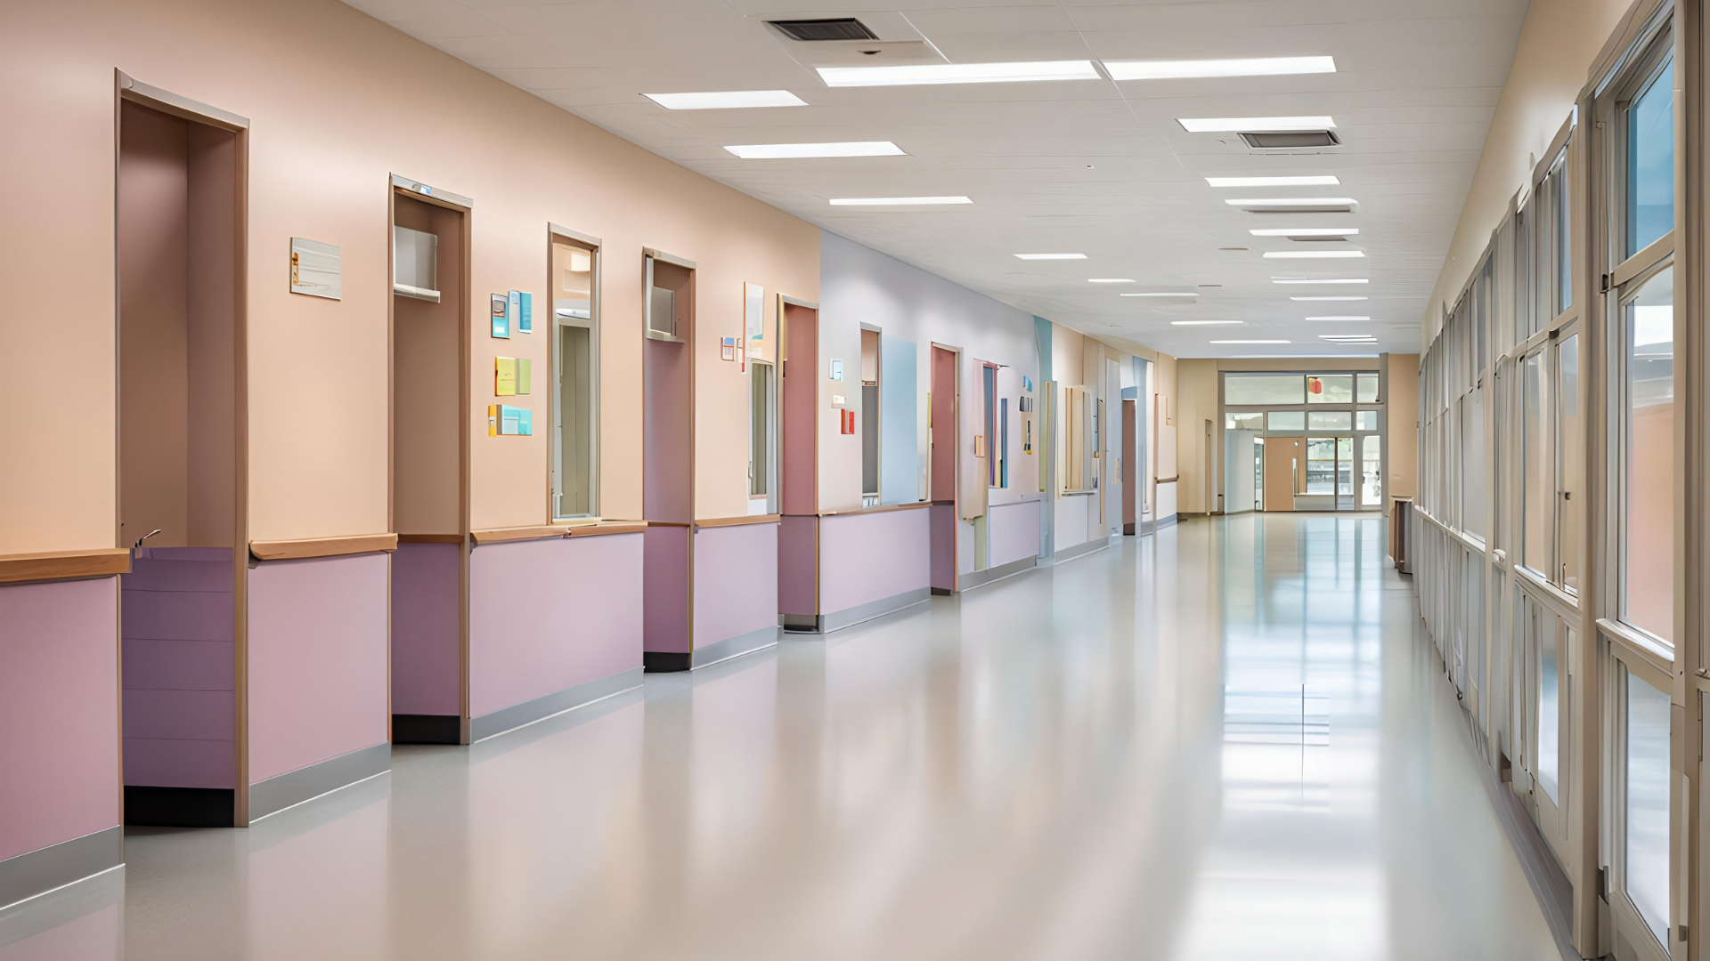
LEARNING ACTIVITY: School Climate Map
Create a map of your high school that evaluates how inclusive and welcoming its spaces are for trans, Two-Spirit and gender diverse students.
School Climate Map Lesson Plan (SOGI 123 on TeachBC)
8/9 Physical and Health Education – Gender Identity | SOGI 123
Public Health
Healthy Sexuality
Notes:
Script:
We’re now going to create a school climate map on gender diversity activity. It will take about 5-10 min. This activity is from the SOGI 123 School Climate Map lesson plan we have linked in our Lesson Plans and Teaching Resources. It’s also available on Teach BC. Today you’ll learn the activity as a participant; after today you’ll be able to use it with your own students if you wish!
Read slide.

Slide 66
Create a school climate map
1. Draw a map of your school
2. Label the spaces
3. Colour code the spaces:
How might trans, Two-Spirit, and gender diverse students feel in these spaces? Why?
4. Discuss the climate map
It’s OK to be approximate.
Library, hallways, cafeteria, washrooms, guidance office, gym, locker rooms, sports fields, classrooms (draw one to represent all in the school).
Green - most safe and welcomed
Yellow - sometimes uncomfortable being themselves
Red - often feel uncomfortable
What actions can we take to improve the school climate for trans, Two-Spirit, and gender diverse students?
Public Health
Healthy Sexuality
Notes:
Script
Read slide
NOTE: Ask teachers to complete the activity up to #3. You can either have them brainstorm together while you record their ideas on poster paper, chalk or whiteboard, or you can have them draw their own maps in small groups and share ideas back with the full group at the end. See script in the next slide for ideas if teachers need prompting. Then have teachers come back together for #4 – discussion.

Slide 67
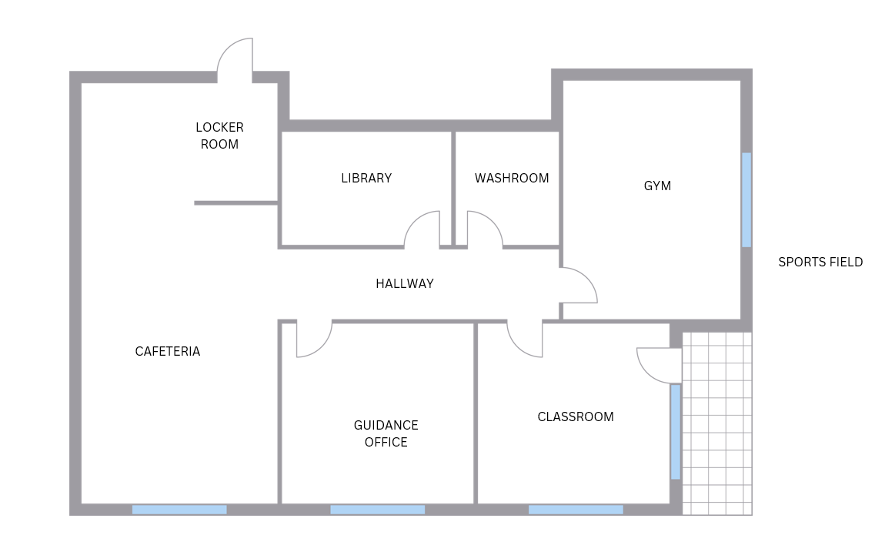
Green - most safe and welcomed
Yellow - sometimes uncomfortable being themselves
Red - often feel uncomfortable
Notes:
Script
NOTE This is an animated slide. Read each space in the school as the circle flies over that location. Each side of the slide flies in separately.
Facilitator ideas you can share if prompts are needed. These are not the “correct” answers, these are just intended for ideas and guidance if needed.
Hallways – Gender diverse people may or may not feel sometimes uncomfortable or not, depending on the school. Consider adding posters with diverse representation. Make sure to identify and address teasing, bullying and harassment.
Library - May be a safe space given a library’s behavioural expectations of quiet introspection and potential lack of bullies. Consider 2SLGBTQIA+ representation in books, especially those on display.
Cafeteria - May be either a place of social isolation or peer connection. Consider ways to increase peer connection and community for 2SLGBTQIA+ students. Consider GSAs.
Guidance office - Sense of safety depends on non-judgemental adults who accept, listen, and support. Consider posting an 2SLGBTQIA+ flag on doors of trained adults.
Gym/Sports fields - Instead of separating PE classes based on gender, consider groupings based on student skill level or learning interests.
Washrooms/Locker Rooms - These are highly gendered spaces that also lack adult supervision. Single stall gender-neutral washrooms or change rooms are ideal; inclusion signs may be used.
Classrooms - See slide #65 “Support others with inclusive spaces” for ideas.
Overall - Consider inclusive posters with diverse people represented, inclusive forms/announcements, presence of GSAs and other inclusion events

Slide 68
Health Resources
Public Health
Healthy Sexuality
Notes:
Script
We are nearing the end of today’s workshop. Let’s discuss some health resources you may find helpful for both you and your students.

Slide 69
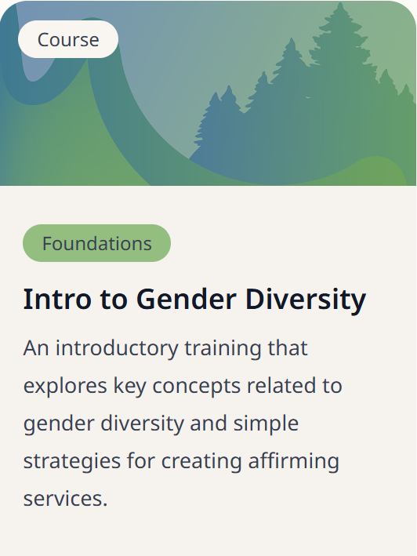
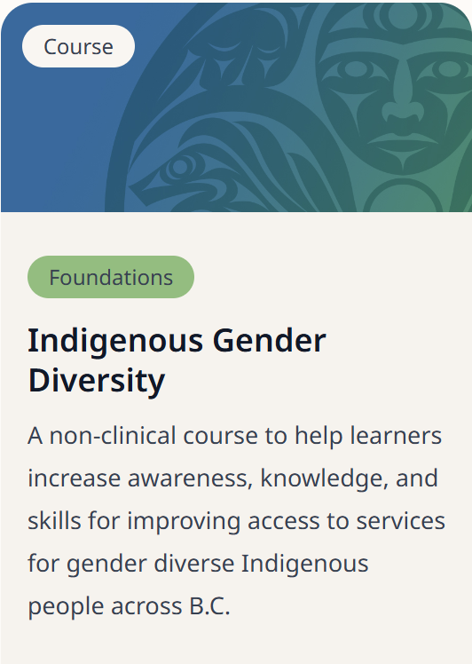
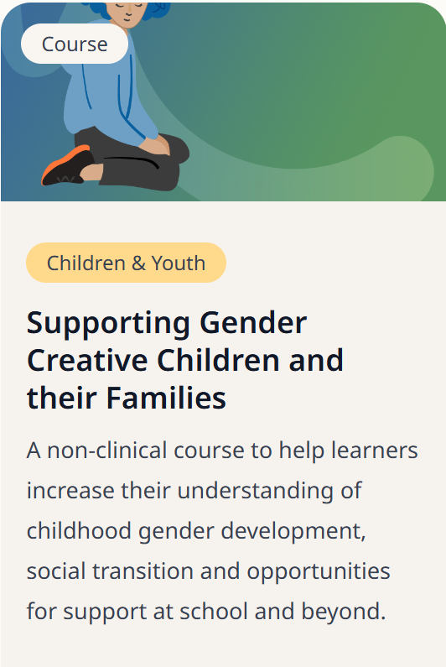
Support students by learning more about gender diversity
www.transcarebc.ca/education-centre
Public Health
Healthy Sexuality
Notes:
Script
To further your learning after today, we recommend the following online courses from TransCare BC.
We have these courses linked in our Teaching Resources. Anyone – you or your students – can access them for free by registering on their website.

Slide 70
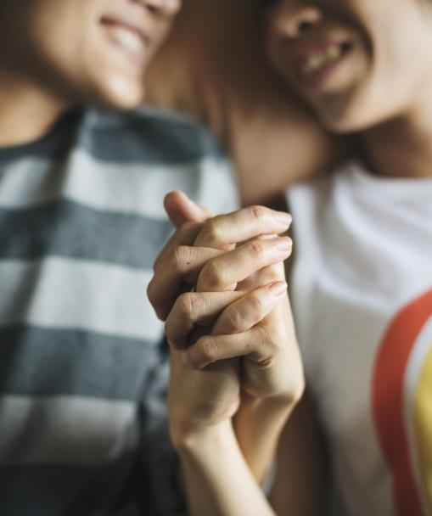
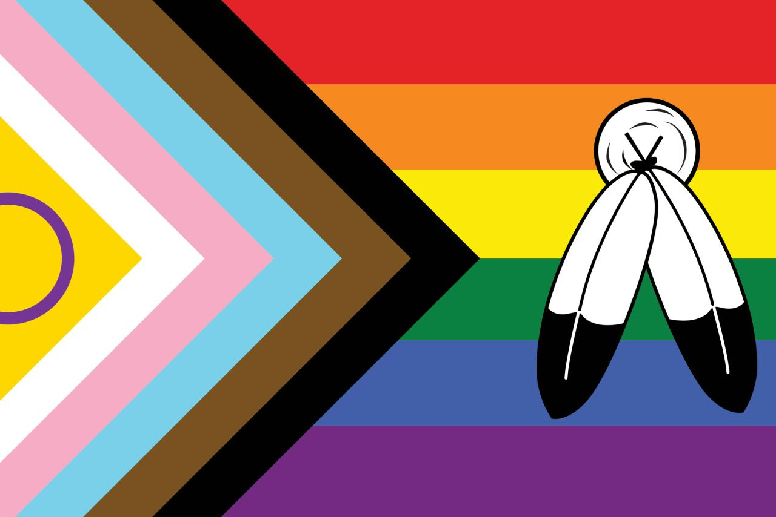
VCH 2SLGBTQIA+ resources
2SLGBTQIA+ health
www.vch.ca/en/health-topics/2slgbtqia
Two-Spirit wellness
www.vch.ca/en/two-spirit-wellness-resources
Public Health
Healthy Sexuality
Notes:
Script
For health information and services, here are two 2SLGBTQIA+ VCH webpages we recommend.

Slide 71




Youth-friendly health clinics
Youth and Sexual Health clinics
vch.ca/en/health-topics/sexual-health
getcheckedonline.com
foundrybc.ca
optionsforsexualhealth.org/care/
Public Health
Healthy Sexuality
Notes:
Script
We also recommend these youth-friendly health clinics.
VCH Youth and Sexual Health clinics (across the VCH region) and Options for Sexual Health clinics offer sexual and reproductive health care services, including STI testing and contraception.
Foundry offers primary care and mental health counselling services for youth aged 12-24.
Get Checked Online is an easy way to test for STBBIs without visiting a health care provider.
These health resources would be great to discuss with your class – this page can also be printed and posted for your class or for around the school.

Slide 72


Youth-friendly sexual health information sources
SEX SENSE
1-800-739-7367
optionsforsexualhealth.org/sex-sense
smartsexresource.com
Public Health
Healthy Sexuality
Notes:
Script
And here are two youth-friendly online and telephone sources of health information.
Sex Sense is a resource from Options for Sexual Health. They have great evidence-based information on their website. They also take questions by phone or online.
Smart Sex Resource was developed by the BC Centre for Disease Control. It provides comprehensive sexual health information and links to services for British Columbians of all ages. They have a large library with more than 1000 questions from the public on various sexual health related topics.

Slide 73

Public Health
Healthy Sexuality

Slide 74

Public Health
Healthy Sexuality

