Slide 1
Sexual Health Education Professional Development Workshops
School Health Promotion – by VCH Public Health, for teachers in the VCH region
Public Health
Last update: Dec 5, 2024

Slide 2
Sexually Transmitted and Blood Borne Infections (STBBIs)
STBBI Definitions, Descriptions and Types
STBBI Transmission, Testing and Treatment
STBBI Prevention
Public Health
Healthy Sexuality
Notes:
Script Instructions
Each slide comes with key speaking and instructional information for PHNs in the ‘presenter notes’ part of the powerpoint.
The regular, unitalicized sections are suggestions of words you could say verbally for the slide.
The font in italics include instructions and notes that are not meant to be read out loud.
If you would like to use the STBBI activity with a group, please print and laminate in advance (separate document available for this).
Script
Hi, My name is ________. I am your school’s Public Health Nurse. My pronouns are:
I am here today because you identified this was an area of sexual health education you wish to learn about.
The topic of the workshop is Sexually Transmitted and Blood Borne Infections or STBBIs for short.

Slide 3
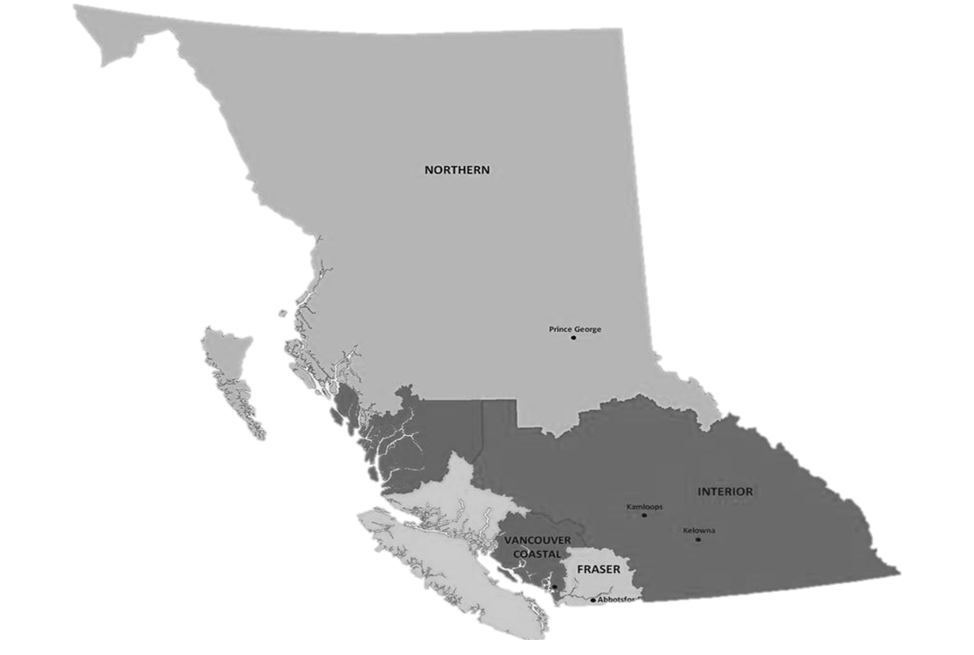



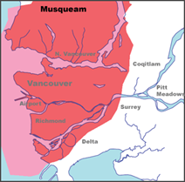

Territorial Acknowledgment
We wish to acknowledge that the land on which we gather is the traditional and unceded territory of the Coast Salish Peoples, including the Musqueam, Squamish, and Tsleil-Waututh Nations.
Vancouver Coastal Health is committed to delivering exceptional care to 1.25 million people, including the First Nations, Métis and Inuit, within the traditional territories of the Heiltsuk, Kitasoo-Xai'xais, Lil'wat, Musqueam, N'Quatqua, Nuxalk, Samahquam, shíshálh, Skatin, Squamish, Tla'amin, Tsleil-Waututh, Wuikinuxv, and Xa'xtsa.
Notes:
Script
Before we get started, I wish to acknowledge… (read slide).
Notes
If the land on which you are joining from is on the traditional and unceded territory of one of these peoples, please acknowledge those peoples directly.
If explanation is needed for teachers, advise that Territorial acknowledgements during gatherings of people are standard practice in VCH and uphold our pillar and policy of Indigenous Cultural Safety.

Slide 4


This material has been adapted from teachingsexualhealth.ca
Copyright 2023 Alberta Health Services ("AHS") with the permission of AHS.
AHS is not responsible for any inaccuracies in content different from the content of the original English edition. All acts of copyright infringement including reproduction, translation, transmission, republication, and distribution of this material without written permission of Vancouver Coastal Health and AHS are prohibited.
Public Health
Healthy Sexuality
Notes:
Script
We have adopted some of this workshop’s material with permission, from teachingsexualhealth.ca (TSH)
NOTE: VCH has a signed Permission to Use Copyright Agreement with TSH that allows us to use and adapt their material. This legal statement is intended for organizations looking at widespread distribution, not for teachers accessing and adapting materials for personal use. Teachers altering for personal use was understood by AHS to be occurring with our materials when we spoke with them. However, it does mean that if a teacher was looking at licensing the materials (e.g. starting a paid program where they created content for other teachers) they would need to seek the permission of AHS.

Slide 5
Purpose & Background
THIS PROFESSIONAL DEVELOPMENT WORKSHOP was developed by VCH Public Health to support VCH-region teachers to become more comfortable in teaching the sexual health education components of BC’s Grade 8-10 PHE Curriculum.
FOR LESSON PLANS, please use our accompanying resource Lesson Plans & Teaching Resources.
A VCH PARENT/GUARDIAN LETTER OF SUPPORT for sexual health education is available to send home before lessons with your parent/guardian notification.
I am here to help should you or your students have any questions.
Public Health
Healthy Sexuality
Notes:
Script
Read slide
After second sentence: Teaching Sexual Health is our main source of lesson plans. All TSH lesson plans are available in French. They also have a set of specialized lesson plans for students with differing abilities.
After last bullet: This professional development workshop will take approximately one hour.
Feel free to ask questions as we move along.
Notes
PHE= Physical & Health Education Curriculum

Slide 6

Learning Goals
TEACHERS WILL LEAVE TODAY’S WORKSHOP WITH
the foundational knowledge needed to teach the grades 8-10 PHE curriculum topics related to Sexually Transmitted and Blood Borne Infections (STBBIs).
1 STBBI Definitions, Descriptions and Types
2 STBBI Transmission, Testing and Treatment
3 STBBI Prevention
Public Health
Healthy Sexuality
Notes:
Script
Read slide
Let’s do a round table of introductions, starting to my (left). Please let me know your name and role in the school. If you feel comfortable to share, please also let me know how long you’ve been teaching sexual health, and how comfortable you are teaching it.

Slide 7


Sexually Transmitted and Blood Borne Infections (STBBIs)
in the curriculum
GRADES 8–10 PHE
Making healthy sexual decisions, including protection from sexually transmitted infections (and BBIs)
Short- and long-term consequences of health decisions
Sources of health information
Public Health
Healthy Sexuality
Notes:
Script
You may be asking yourself what you need to teach, this is what the curriculum outlines.
Read slide
Ref: https://curriculum.gov.bc.ca/curriculum/physical-health-education/10/core
https://curriculum.gov.bc.ca/sites/curriculum.gov.bc.ca//files/curriculum/physical-health-education/en_physical-health-education_10_core_elab.pdf

Slide 8

Before you begin delivering content
PLEASE REVIEW
your School District’s protocols, which may include notifying your administrator, counsellor, and/or district before you begin.
PLEASE REACH OUT TO
your School District’s healthy sexuality lead and/or safe school coordinator if you have one. They can support you in the delivery of this content.
Public Health
Healthy Sexuality
Notes:
Script
Read slide
Keep in mind that today we’ll be covering information about sexual health topics, but we won’t cover any of your district’s protocols.
Is anyone aware of whether there is healthy sexuality lead or coordinator in this district?
Notes
PHNs are encouraged to find out who the healthy sexuality leads/sexual health educators are and provide this information to teachers during the workshop.

Slide 9

Consider…
…ways you can include sex and gender diverse students.
…how to avoid imposing your personal beliefs and values on your students
…ways you can include Indigenous and other worldviews.
…if it’s possible for to add movement breaks into your lessons
…having health clinic information readily available.
…that people who have experienced trauma may be triggered by some lessons in the Health curriculum.
Public Health
Healthy Sexuality
Notes:
Script
Read slide
1st bullet: Like using inclusive language, relationship scenarios, literature and other resources.
2nd bullet: For example, E.g., people must be married to have sex and have children.
3rd bullet: Honour culture by asking questions and inviting students to share.
4th bullet: To help students physically self-regulate.
5th bullet: So students can follow up on their health care needs.
Last bullet: Be mindful some of your students may have experienced a STBBI and may feel shame and have felt stigmatized as a result. Provide advance notice of sensitive topics and monitor yourself and your students’ behaviour throughout the lesson. Develop a safety plan for students who may need to leave the room. For more information, refer to our Getting Started workshop.
Notes
If Trauma Informed Practice (TIP) discussed further:
Preview videos and other content before showing to your students.
If possible, try to plan your lessons before a break (recess or lunch) and not a major school break (winter, spring, summer) so students can speak to you in private or follow up with a school counsellor or other professional if needed.
Ref: Supporting Student Health Guide: https://curriculum.gov.bc.ca/sites/curriculum.gov.bc.ca/files/pdf/subject/phe/Supporting_Student_Health_Secondary.pdf

Slide 10
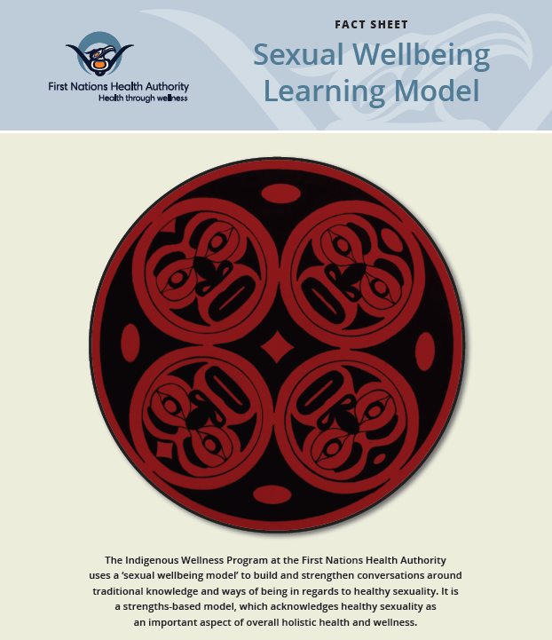
Sexual Wellbeing:
Learning from Indigenous Voices
Public Health
Healthy Sexuality
Notes:
Script:
Creating a safe(r) space includes welcoming and honouring culture by considering Indigenous and other worldviews, asking students questions, and inviting them to share as was mentioned in the previous slide.​
Here is the First Nations Health Authority Sexual Wellbeing Learning Model. Our Indigenous Health team reviewed this model and feel this is an excellent framework incorporating indigenous values.
Ref:
https://www.fnha.ca/WellnessSite/WellnessDocuments/FNHA-IWP-Sexual-Wellbeing-Learning-Model-Fact-Sheet.pdf

Slide 11
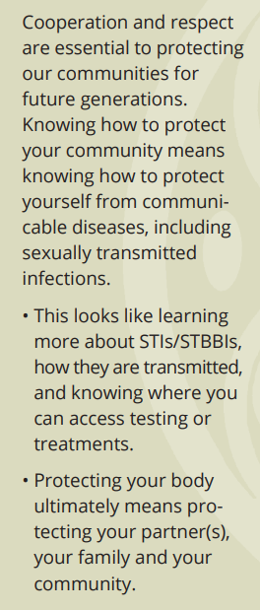

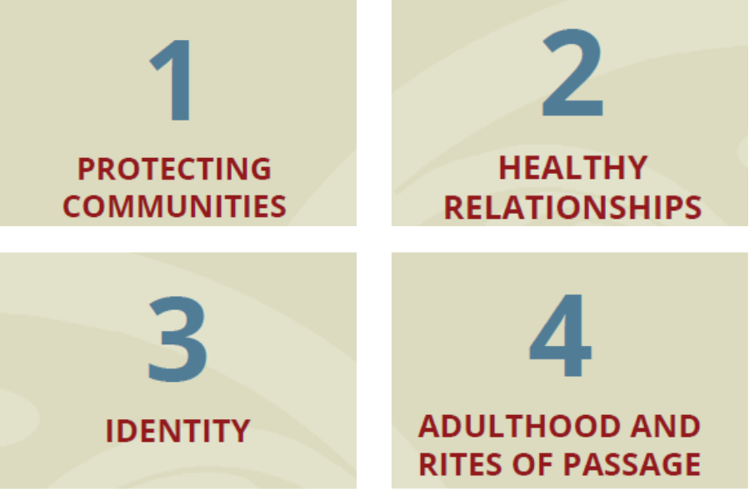
Protecting communities within Indigenous Sexual Wellbeing
Public Health
Healthy Sexuality
Notes:
Script
Read script- not slide: There are 4 Indigenous values identified within the model: Protecting Communities, Healthy Relationships, Identity and Adulthood and Rites of Passage
The value of Protecting Communities identifies that read out right hand text

Slide 12
STBBI Definitions, Descriptions and Types
Public Health
Healthy Sexuality
Notes:
Script
Now that we have covered some of our foundations, let discuss STBBI definitions, descriptions and types

Slide 13
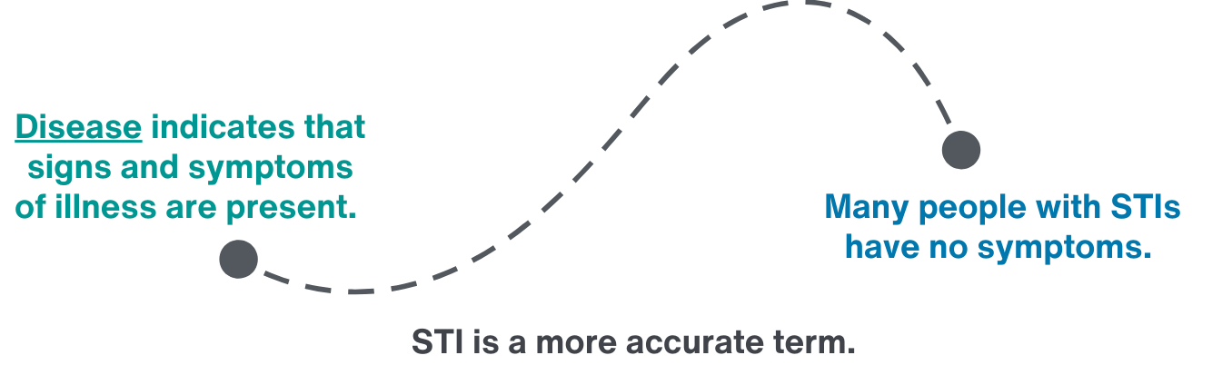
The term STI has replaced STD (sexually transmitted disease)
Public Health
Healthy Sexuality
Notes:
Script
Read script only
In the past, we used the term STD or sexually transmitted disease (and you will still see this term in many American resources). We moved to using the term STI or sexually transmitted infection. This is because the word “disease” indicates that symptoms of illness are present, but, many people with STIs have no symptoms. The word “infection” is more accurate because it reflects that symptoms may or may not be present. Also, the word “disease” has negative connotations because it suggests the condition is stuck with the person. But many STIs are actually curable infections.
We also use the term STBBI which means “sexually transmitted and blood-borne infections” and is an umbrella term which includes both STIs and BBIs.
Ref: https://www.canada.ca/en/health-canada/services/health-concerns/diseases-conditions/sexually-transmitted-infections.html

Slide 14


Sexually transmitted infections (STIs) are…
passed from one person to another during sex or intimate contact.
This includes unprotected oral, vaginal, penile, or anal sex and skin-to-skin contact.
Public Health
Healthy Sexuality
Notes:
Script
Read slide
Ref: http://www.bccdc.ca/health-info/diseases-conditions/sexually-transmitted-infections-(stis)

Slide 15

Blood borne infections (BBIs) are…
passed from one person to another through an exchange of blood and other body fluids.
Human Immunodeficiency Virus (HIV), Hepatitis B (HBV), and Hepatitis C (HCV) are examples of BBIs.
Public Health
Healthy Sexuality
Notes:
Script
After reading slide: BBIs can be spread through sexual contact. They can also be spread through body fluid exchange, for example, in utero or through breast milk, or most commonly, through sharing substance use equipment.
Ref: https://teachingsexualhealth.ca/app/uploads/sites/4/Gr8LP2-STBBI-ENGLISH-FINAL.pdf

Slide 16
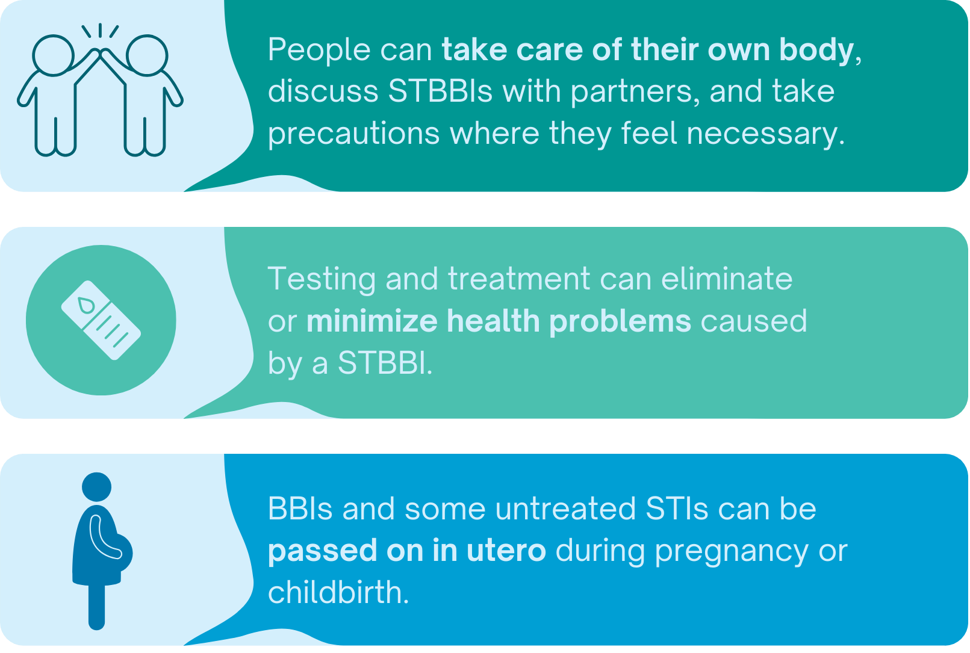
It's important to learn about STBBIs
Public Health
Healthy Sexuality
Notes:
Script
After second section: Untreated STBBIs can cause problems for a person's health and have long term ramifications.
After third section: Although with testing and treatment, this can be prevented.
Ref: https://teachingsexualhealth.ca/app/uploads/sites/4/Gr8LP2-STBBI-ENGLISH-FINAL.pdf

Slide 17




Stigma around STBBIs is…
rooted in societal views on sex, stereotypes on who gets STBBIs, and lack of information
a significant obstacle to effective prevention, management, and treatment of STBBIs
can be a cause of poor health and well-being
reduced by education and factual talk
Public Health
Healthy Sexuality
Notes:
Script
Stigma, shame, and fear associated with STBBIs is real and affects many people.
Read slide
After first point: this includes stereotypes about race, gender, sexual orientation and types of sexual activity. Society generally views sex as a taboo topic, and in doing so, those that contract an STI may be judged. Consider that people can contract other bacterial or viral infections like a strep throat or ear infection without judgment. Why judge someone with an STI?
After third point: Youth may fear getting tested due to fear of stigma if diagnosed with a STBBI. They can be reluctant to disclose STBBI status due to fear of rejection. In addition to this, those who chose to disclose, risk others finding out. Current/previous partner(s) and friends may spread this information to a wider audience.
Stigma is reduced After last point: Within sexual health education, we need to destigmatize STBBIs. Anyone who is sexually active can get and pass on a STBBI. They are very common. We need to avoid judgement and instead focus on helping youth know their own body and what’s normal for them, so they can recognize any changes and treat them early.
Ref: https://www.canada.ca/en/public-health/services/reports-publications/canada-communicable-disease-report-ccdr/monthly-issue/2018-44/issue-2-february-1-2018/article-5-stigma-sexually-transmitted-infections.html
https://www.actioncanadashr.org/sexual-health-hub/sexually-transmitted-infections-stis#:~:text=Stigma%20can%20come%20from%20a,type%E2%80%9D%20of%20person%20gets%20STIs
https://www.plannedparenthood.org/planned-parenthood-pacific-southwest/blog/taking-the-stigma-out-of-stis

Slide 18
Types of STBBIs, Transmission and Symptoms
Public Health
Healthy Sexuality
Notes:
Script
Now let’s discuss the different types of STBBIs, how they are transmitted and their symptoms.

Slide 19
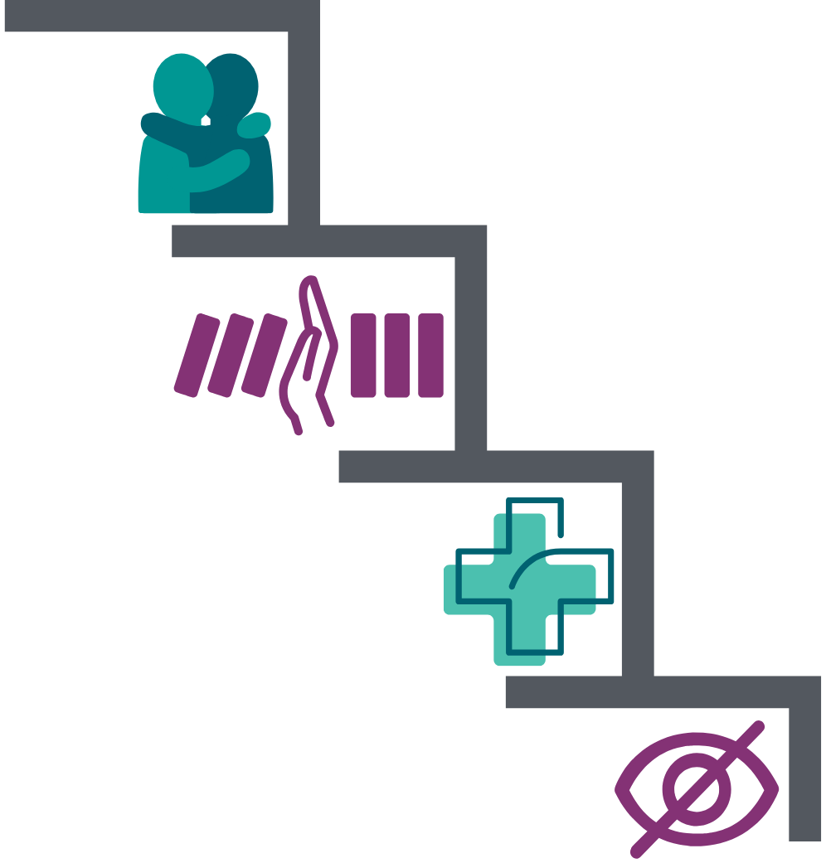
STBBIs can be bacterial, viral, or parasitic
STBBIs are transmitted through contact with body fluids, blood, and skin-to-skin contact
Transmission can be decreased by use of vaccines, certain medications, barriers such as condoms, and reducing number of partners
Many STBBIs are curable. Others are well managed with treatments.
STBBIs can be asymptomatic.
Public Health
Healthy Sexuality
Notes:
Script
After last section: Meaning there are no symptoms at all.

Slide 20

Bacterial STIs
can be treated and cured with antibiotic medication.
Examples
Chlamydia
Gonorrhea
Syphilis
Public Health
Healthy Sexuality
Notes:
Script
Let’s talk about bacterial STIs. As the name suggests, these are caused by bacteria.
Read slide
Ref: https://teachingsexualhealth.ca/app/uploads/sites/4/Gr8LP2-STBBI-ENGLISH-FINAL.pdf
http://www.bccdc.ca/resource-gallery/Documents/Statistics%20and%20Research/Statistics%20and%20Reports/STI/CPS%20Quarterly%20Surveillance%20Report%20-%20Q4%202023_FINAL.pdf
https://www.canada.ca/en/public-health/services/infectious-diseases/sexual-health-sexually-transmitted-infections/canadian-guidelines/sti-associated-syndromes/vaginitis.html
https://www.who.int/news-room/fact-sheets/detail/bacterial-vaginosis

Slide 21
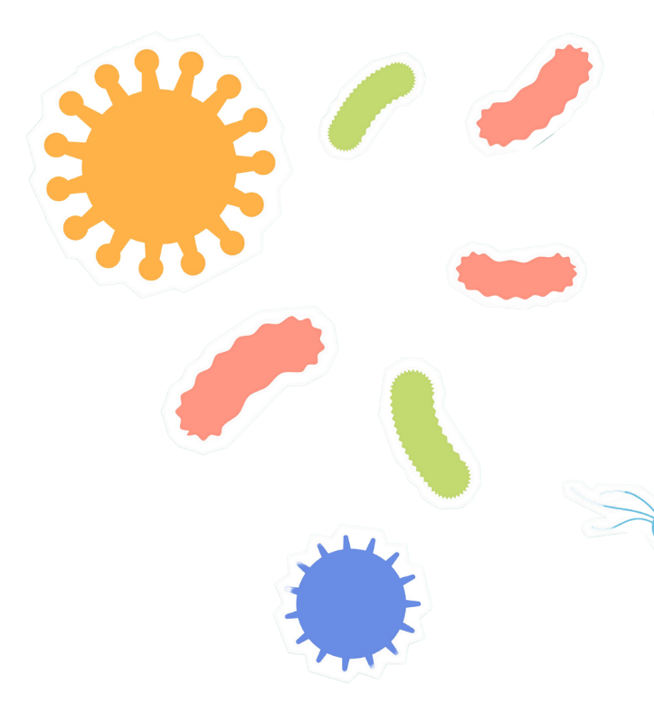
Viral STBBIs
can be well managed through treatment.
Some are curable.
Examples
Human papillomavirus (HPV)
Herpes simplex virus (HSV)
Mpox
Hepatitis A
Human Immunodeficiency Virus (HIV), Hepatitis B (HBV) and Hepatitis C (HCV) are viral blood-borne infections.
Public Health
Healthy Sexuality
Notes:
Script
Moving on to viral STBBIs. Viral STBBIs are caused by viruses.
Read slide
Note:
Mpox used to be referred to as monkeypox
Ref: https://teachingsexualhealth.ca/app/uploads/sites/4/Gr8LP2-STBBI-ENGLISH-FINAL.pdf

Slide 22

Parasitic STIs
can be treated and cured with medication.
Example
Trichomoniasis
Public Health
Healthy Sexuality
Notes:
Script
The last type of STI are parasitic STIs which are caused by parasites.
Read slide
Other parasitic infections includes scabies and pubic lice.
Ref: https://teachingsexualhealth.ca/app/uploads/sites/4/Gr8LP2-STBBI-ENGLISH-FINAL.pdf

Slide 23

Bacterial vaginosis is not an STI, but…
is an infection that can cause similar symptoms.
is a common reason for seeking care.
May increase the risk of acquiring STBBIs such as HIV, HPV and Chlamydia.
Treated and cured with antibiotics.
Public Health
Healthy Sexuality
Notes:
Script:
Read first: It is important to mention that bacterial vaginosis- a condition where the normal balance of micro-organisms in the vagina gets disrupted- is the most common cause of vaginal discharge.
Read slide
In next few slides, we will review each STBBI in further detail through an activity.
Ref: http://www.bccdc.ca/resource-gallery/Documents/Educational%20Materials/STI/Med%20Handouts/Care%20and%20Treatment%20Plan%20-%20Baterial%20Vaginosis.pdf

Slide 24

Matching activity STBBIs
Public Health
Healthy Sexuality
Notes:
NOTE:
This activity can either be completed using the following “hidden” slides or by using printed cards from the accompanying STBBIs Matching Activity (a separate file with instructions for this is available on the school health intranet page). We recommend using the printed cards if presenting in person, and the hidden slides if presenting online. The slides are animated: the information will “fly-in” first – to allow time for thinking and guessing – followed by STBBI. You can also provide teachers the Matching Activity electronic file for them to print and use in their classrooms with their students. Please note that the hidden slides wont show in the presentation mode and will need to be “unhidden” prior.
Script
•We are going to complete a matching activity where we match STBBIs to information related to them. This is to help build your familiarity with different types of STBBIs.
•If presenting online: I’ll post a list of STBBIs in the chat, then read out the information related to it, and you can guess the STBBI that matches.
NOTE
This activity can be done by going through the following slides or can be printed (a separate file with instructions for this is available on the school health intranet page). It is recommended that the activity is printed when done in a group. The matching activity was adapted from Teaching Sexual Health’s (TSH) birth control lesson plan -Birth Control Kit. By doing this activity during the workshop, it will allow teachers to familiarize themselves on how to use the activity in the classroom. Teachers can do the TSH activity or use our updated version.
Script
We are going to do a STBBI guessing activity which involves guessing the STBBI to the information related to it. (if doing the activity from the powerpoint) if not, please refer to STBBI Matching Activity document.
​
Note
These slides are only to be reviewed if printed matching activity is not available/used. ​
​

Slide 25
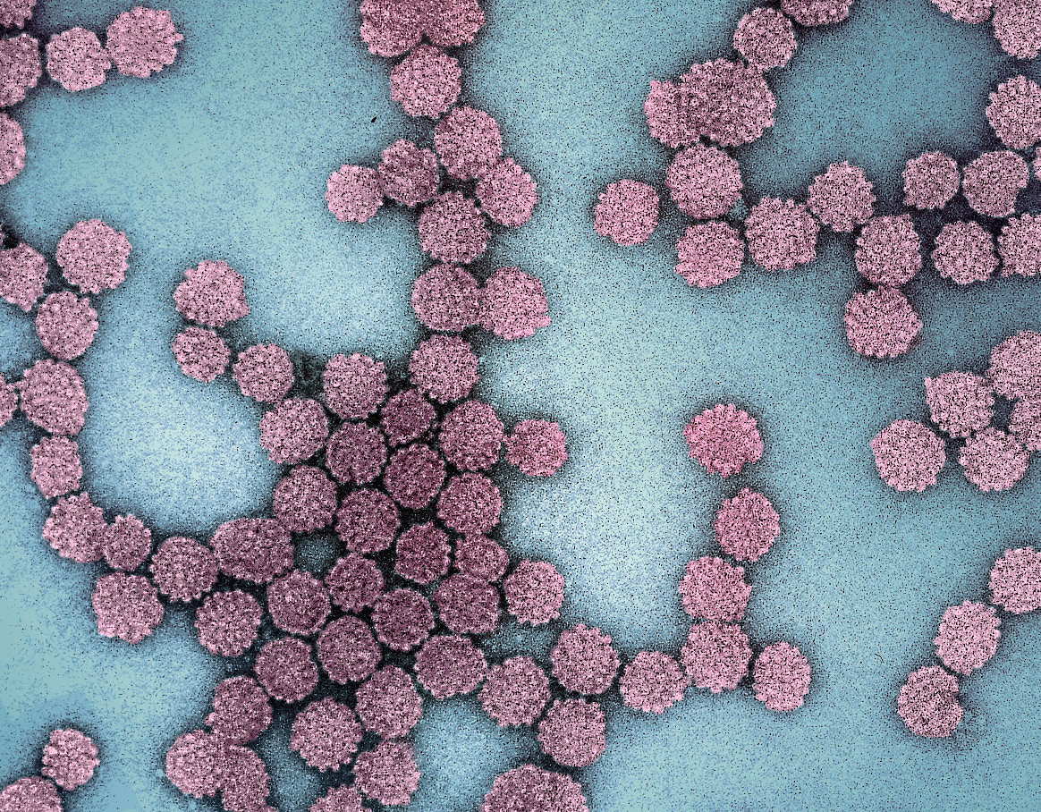
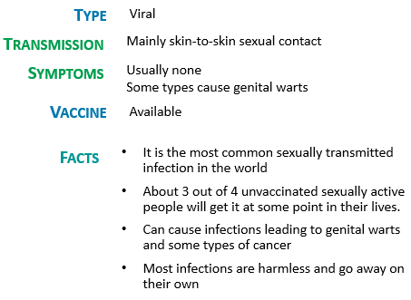
Human Papillomavirus (HPV)
Notes:
Script:
After reading slide:
There are 100+ strains of HPV.
Some strains of HPV can cause abnormal cells that lead to cancer of the cervix, anus, penis, vagina, vulva, mouth and throat.
If warts are present, treatment is available.
The vaccine is free in BC and typically given in grade 6.
Cervical screening starts at age 25 for those with a cervix. Screening checks for changes caused by HPV that may-if left untreated, turn into cervical cancer.
Ref:
http://www.bccancer.bc.ca/prevent/hpv
http://www.bccancer.bc.ca/prevent/hpv/the-science
https://www.canada.ca/en/public-health/services/publications/healthy-living/canadian-immunization-guide-part-4-active-vaccines/page-9-human-papillomavirus-vaccine.html
Image: https://www.britannica.com/science/human-papillomavirus

Slide 26
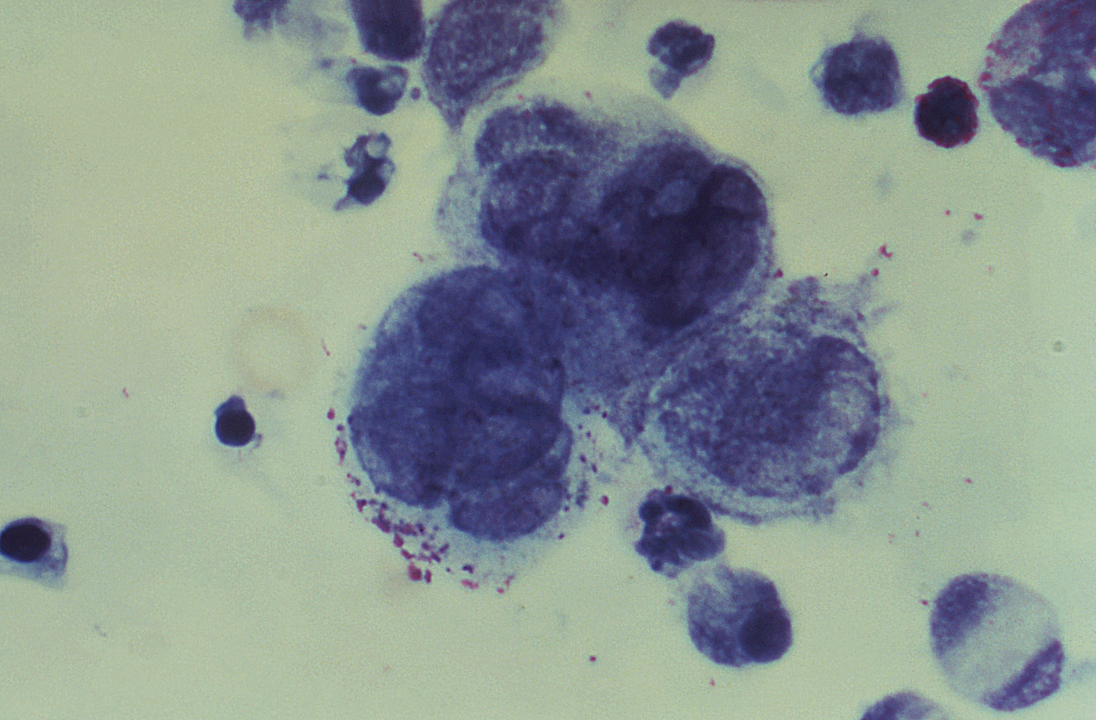
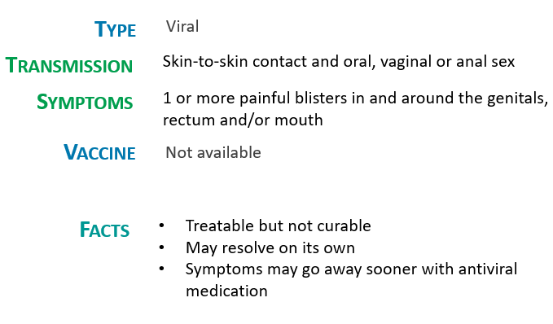
Herpes Simplex Virus (HSV)
Notes:
Script:
After reading slide: Some people experience an initial outbreak followed by less often outbreaks over time. Many do not experience any symptoms at all.
Ref: http://www.bccdc.ca/health-info/diseases-conditions/herpes-simplex-virus

Slide 27
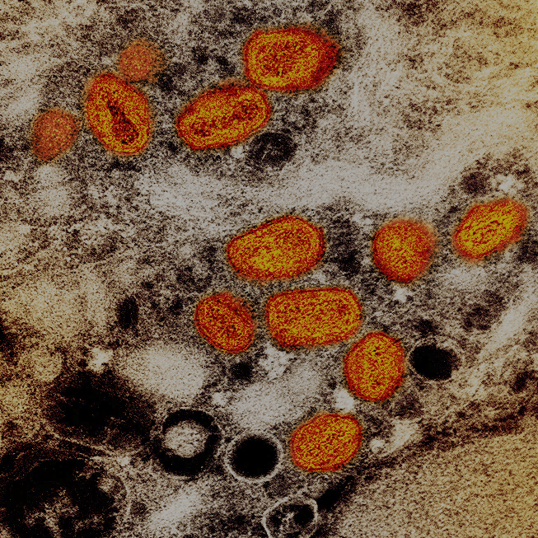
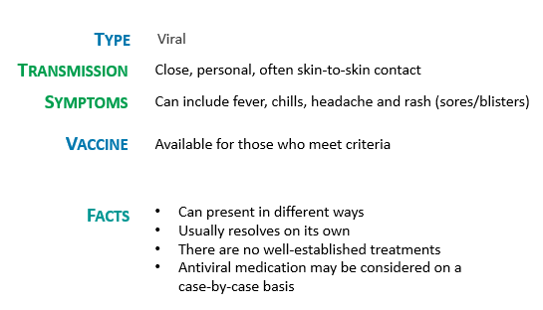
Mpox
Notes:
Script
After reading slide: Mpox is often but not always related to sexual activity.
Individuals should speak to their health care providers for further information about vaccine eligibility
Ref: http://www.bccdc.ca/health-info/diseases-conditions/mpox#symptoms
Image: https://phil.cdc.gov/Details.aspx?pid=22664 This image is in the public domain and thus free of any copyright restrictions

Slide 28
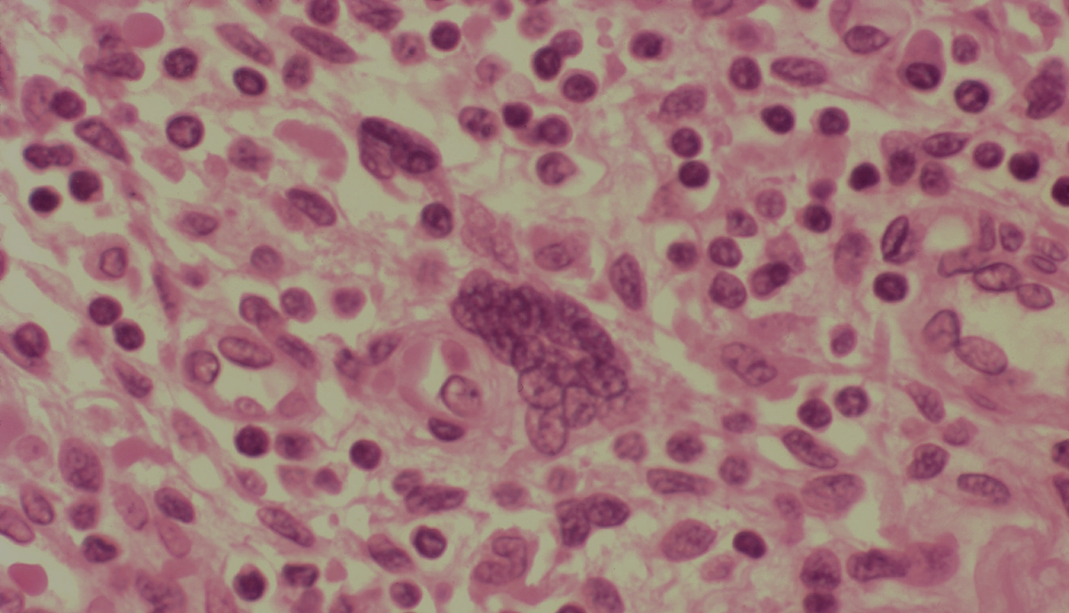
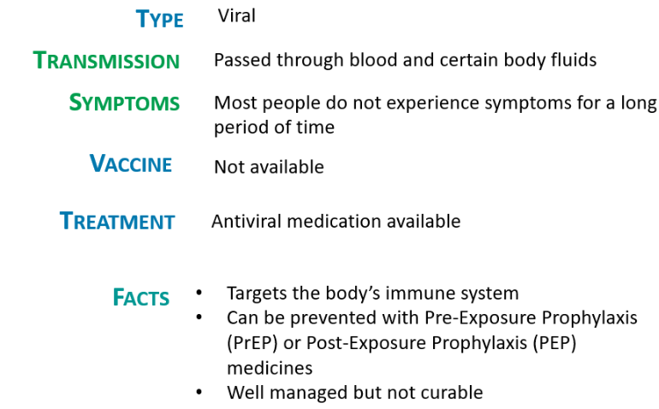
Human Immunodeficiency Virus (HIV)
Notes:
Script
After reading slide: Body fluids that may carry HIV include: semen, pre-ejaculate, vaginal fluids, anal fluids, and breast/chest milk.
More information on PrEP will be discussed later in the workshop.
Ref: http://www.bccdc.ca/health-info/diseases-conditions/hiv-aids
Image: https://www.hiv.va.gov/provider/image-library/microscopic.asp?post=1&slide=116

Slide 29
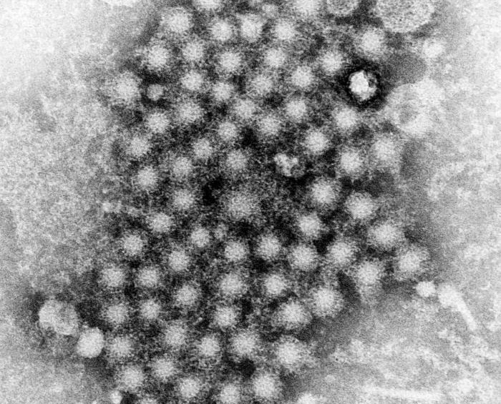
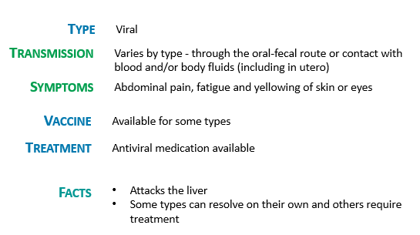
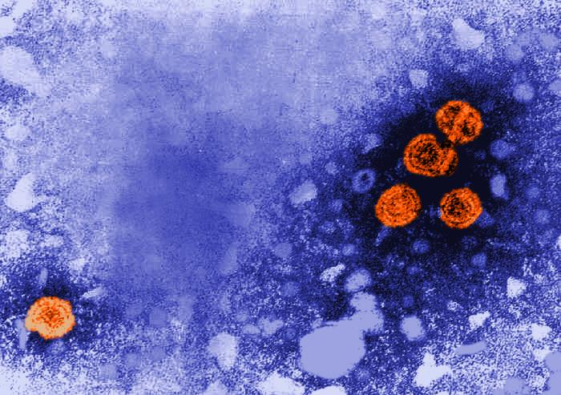
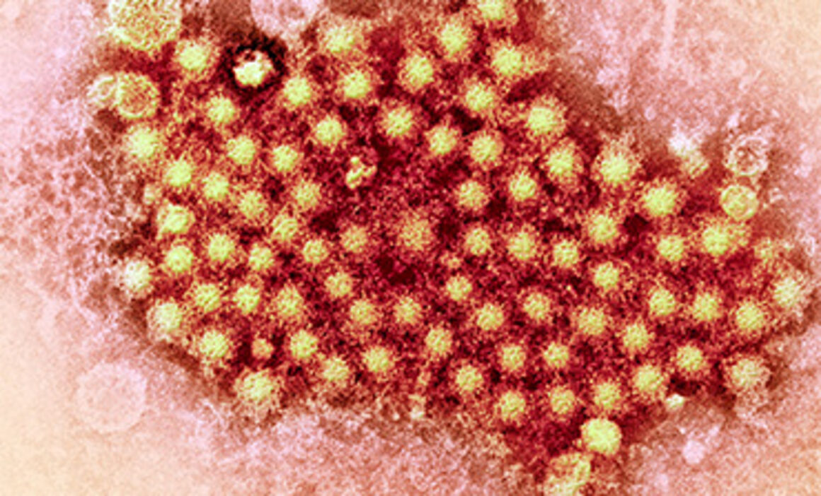
Hepatitis A, B and C
Notes:
Script
After reading slide:
Effects range from mild to severe depending on type.
Hepatitis A usually resolves on its own over time, no treatment is necessary. A vaccine is available to protect against infection.
Hepatitis B can resolve on its own, is treatable with antivirals but not curable. A vaccine is available to protect against infection.
Hepatitis C can resolve on its own, is curable most of the time with antiviral treatment. No vaccine is available at this time.
Both hepatitis B and C are leading causes of liver cancer.
Ref:
https://www.healthlinkbc.ca/tests-treatments-medications/medications/hepatitis-vaccine
https://www.healthlinkbc.ca/healthlinkbc-files/hepatitis-b-vaccine
https://www.healthlinkbc.ca/illnesses-conditions/hepatitis/hepatitis-c
Images:
https://www.cdc.gov/vaccines/vpd/hepa/public/photos.html Hep A
https://www.cdc.gov/vaccines/vpd/hepb/public/photos.html Hep B
https://www.ecdc.europa.eu/en/hepatitis-c Hep C

Slide 30
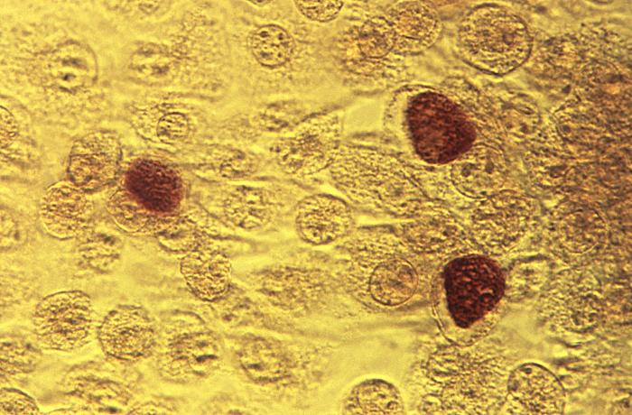
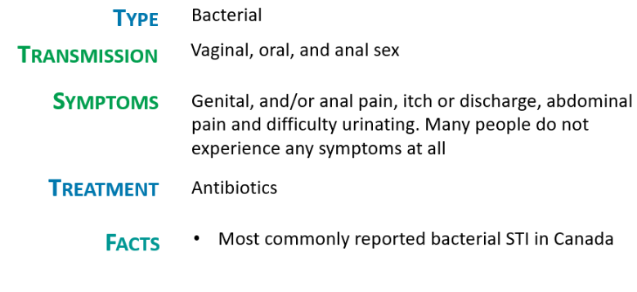
Chlamydia
Notes:
Script
After reading slide: Chlamydia is the most common STI among 15-24 year olds in BC.
Ref: http://www.bccdc.ca/health-info/diseases-conditions/chlamydia
http://www.bccdc.ca/resource-gallery/Documents/Statistics%20and%20Research/Statistics%20and%20Reports/STI/CPS%20Quarterly%20Surveillance%20Report%20-%20Q4%202023_FINAL.pdf
https://www.canada.ca/en/public-health/services/diseases/chlamydia.html
Image: https://phil.cdc.gov/details.aspx?pid=3802

Slide 31
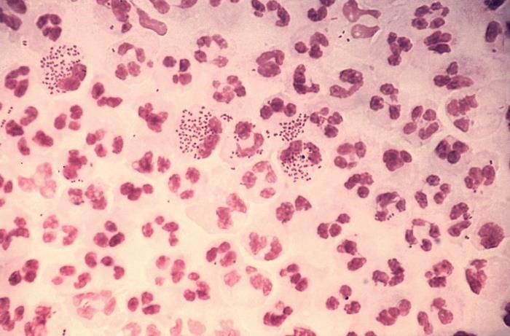
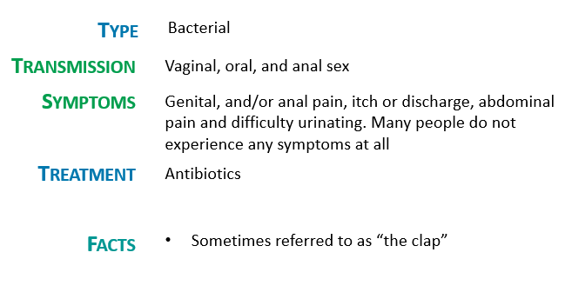
Gonorrhea
Notes:
Script
Read slide
Ref: http://www.bccdc.ca/health-info/diseases-conditions/gonorrhea
Image: https://phil.cdc.gov/details.aspx?pid=4085

Slide 32

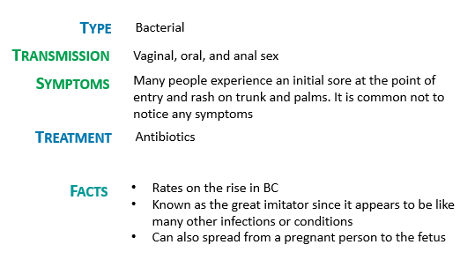
Syphilis
Notes:
Script
After reading slide: the point of entry and sore is usually at the genitals, mouth or anus.
Antibiotic treatment is usually via injection.
Ref: http://www.bccdc.ca/health-info/diseases-conditions/syphilis
Image: https://www.cdc.gov/syphilis/hcp/images/index.html

Slide 33
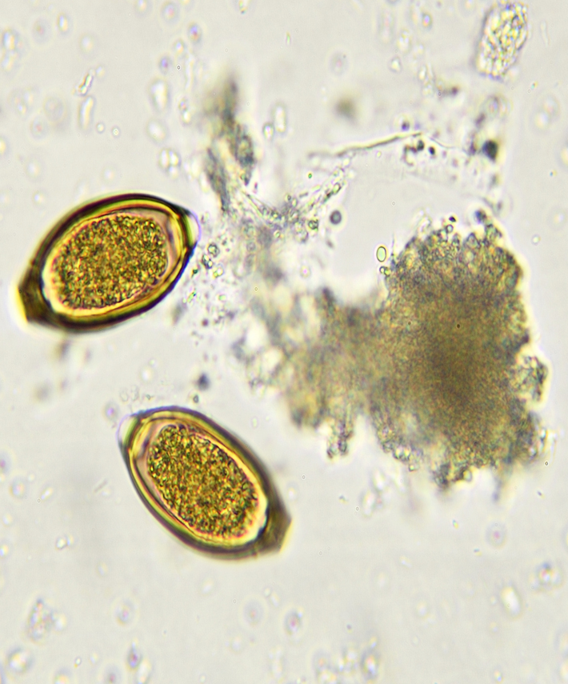
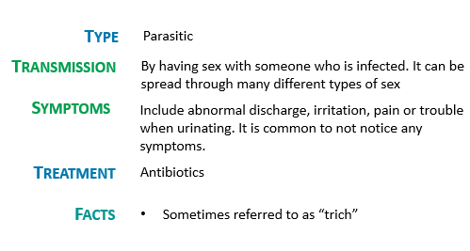
Trichomoniasis
Notes:
Script
Read slide
Ref: http://www.bccdc.ca/health-info/diseases-conditions/trichomoniasis
Image: Canva pro

Slide 34
STBBI Testing and Treatment
Public Health
Healthy Sexuality
Notes:
Script
Let’s discuss STTBI testing and treatment

Slide 35
STBBIs can lead to further complications
Certain untreated STBBIs
Increase risk of HIV
Complications in pregnancy and/or labour
Harm newborns
Cause infertility
Some types of HPV
Are not treatable
Can lead to certain types of cancer when they do not resolve on their own
Untreated Syphilis
Can progress to a stage with serious health problems and death
Untreated HIV can cause
Weakened immune systems
Acquired immune deficiency syndrome (AIDS)
Public Health
Healthy Sexuality
Notes:
Script
Why is testing important?
Because…. Read slide
Ref: https://www.canada.ca/en/public-health/services/infectious-diseases/sexual-health-sexually-transmitted-infections/canadian-guidelines/stbbi-prevention-guide.html
https://www.canada.ca/en/public-health/services/diseases/syphilis.html

Slide 36
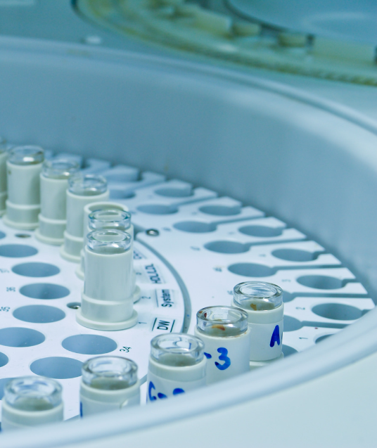
Testing is recommended when someone
STBBI testing
Testing is one of the best ways to prevent passing on STBBIs and avoid health issues that are caused by them.
STBBI testing is free in BC.
is sexually active
has new partner(s)
notices changes in their or their partner(s) body
had sexual contact with someone who has a STBBI
had unprotected sex or the condom broke
It is a good idea to test
yearly (if with the same partner)
every 3-6 months (if having new partners)
Public Health
Healthy Sexuality
Notes:
Script
Read slide
It is important to see a health care provider after a sexual assault for support and referrals.
Ref: https://www.canada.ca/en/public-health/services/sexual-health/getting-tested-sexually-transmitted-infections.html

Slide 37

STBBI tests have a window period
It is important to know when to test for the most accurate results
All STBBIs are captured after a 3-month window from exposure
It takes time (called a window period) before a STBBI will show up on a test
Public Health
Healthy Sexuality
Notes:
Script
After last bullet: Window periods are different for each STBBI, some can be detected in as little as a week.
Ref: https://smartsexresource.com/

Slide 38
Time from contact
STBBI
Test method
Gonorrhea
Chlamydia
HIV
Syphilis
Hepatitis C
1 week
2-6 weeks
3 weeks
3 months
5-10 weeks
Urine/swab (can be a self swab)
Urine/swab (can be a self swab)
Blood test
Blood test
Blood test
Public Health
Healthy Sexuality
Notes:
This slide is available for PHNs to use if teachers want more information about window periods
Script
After going over slide: There are other ways to test for HIV and syphilis.
Ref: https://smartsexresource.com/resources/calculating-hiv-window-periods/
http://www.bccdc.ca/resource-gallery/Documents/Communicable-Disease-Manual/Chapter%205%20-%20STI/HIV_Guidelines_Testing_FollowUp_Prevention.pdf

Slide 39

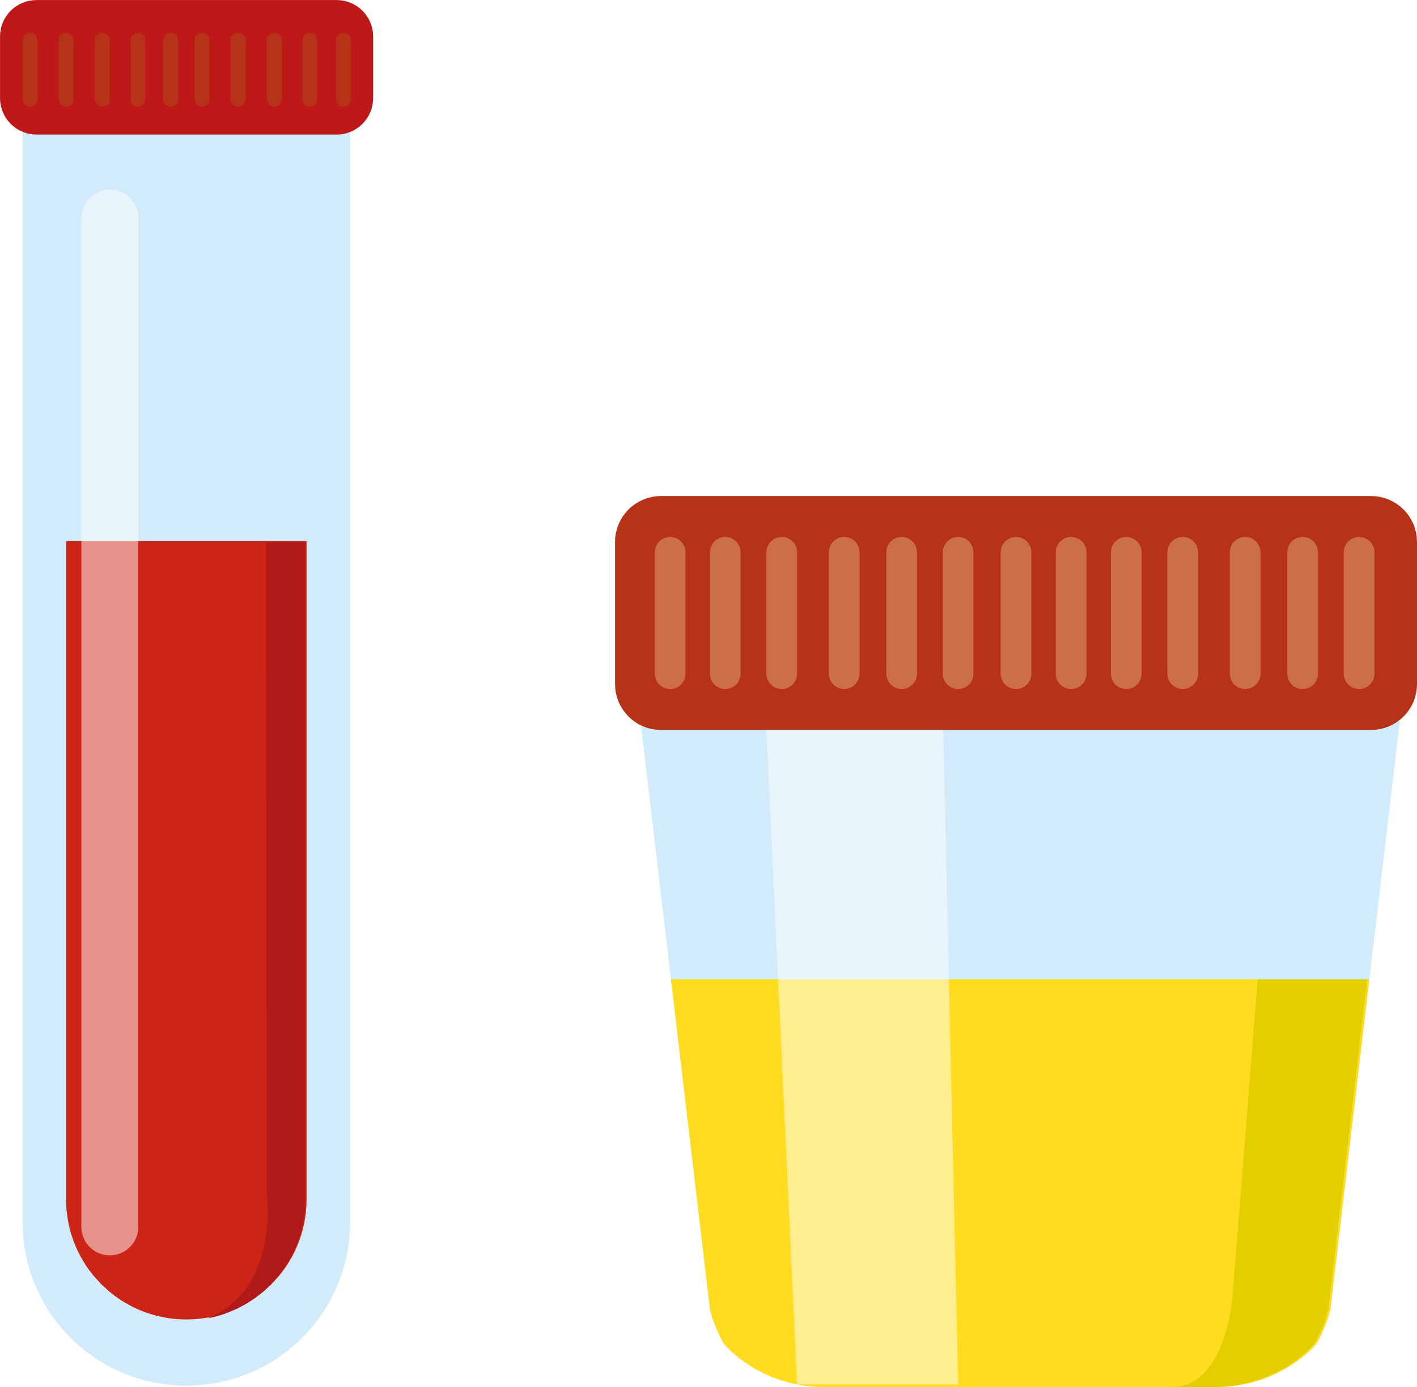
STBBIs are diagnosed through several methods
Common testing types:
urine swabs (can be self-collected) blood
Visual assessment by a health care provider:
May be needed to diagnose some STBBIs (such as genital warts)
Public Health
Healthy Sexuality
Notes:
Script
After swabs: collected in areas of exposure.
After last bullet: Some STBBI’s aren’t tested for unless there are symptoms (i.e. blisters due to Herpes simplex virus- which should be seen by a health care provider at as soon as possible to access treatment)

Slide 40
Many STBBIs are reportable
This means that positive lab tests must be reported to Public Health to take action to help prevent further transmission.
These infections are reportable in BC:
Syphilis
HIV
Chlamydia
Gonorrhea
Hepatitis A, B and C
Public Health
Healthy Sexuality
Notes:
Script
After reading slide: In Public Health, the actions we take are offering treatment, care coordination and follow-up with contacts.
Reporting is kept confidential.

Slide 41
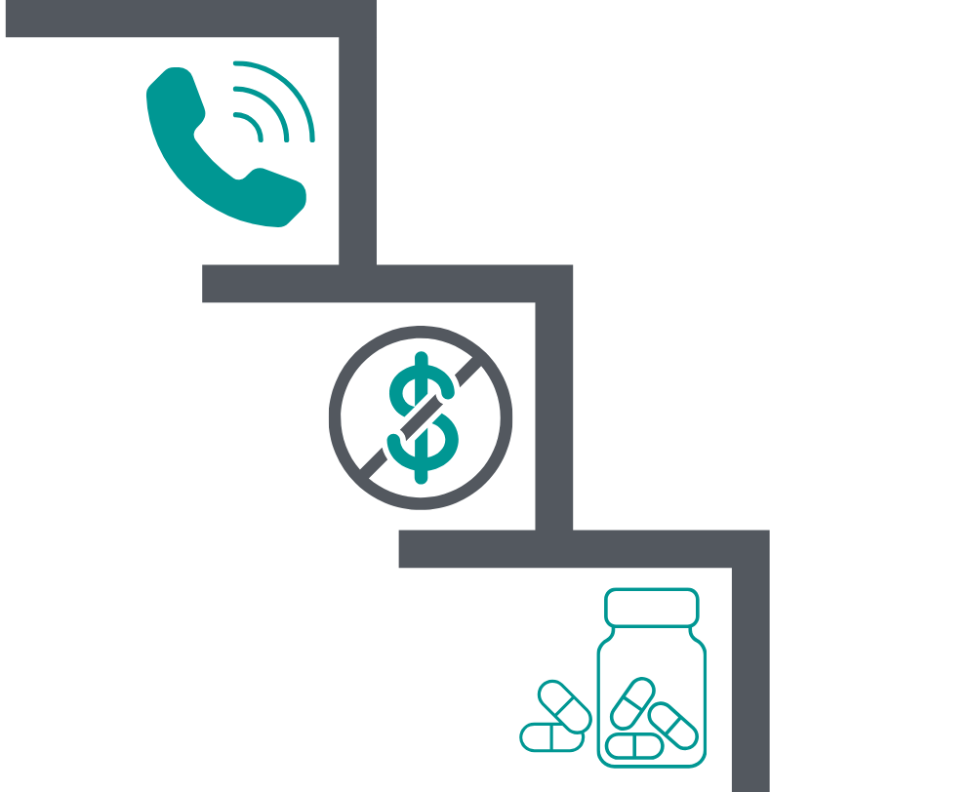
When tests are positive…
Clinics will typically call individuals to notify of a positive test result(s).
Treatment is provided free of charge in BC to those who test positive (and their partners) regardless of residency status.
Remember that most of the time, STBBIs are cured or well managed with medications
Public Health
Healthy Sexuality
Notes:
Script
Read slide

Slide 42

Sexual relationships and responsibilities
It is important to:
Get tested and treated
Protect one’s partners through communication
Public Health
Healthy Sexuality
Notes:
Script
Read slide
Remember back to the FNHA sexual wellbeing learning model and the Indigenous value about protecting one’s community? This also involves protecting one’s partner(s).
It is important to communicate to youth to seek testing for STBBIs and get treatment before becoming sexually active with someone new. It is also important for them to understand that if they test positive while in a relationship with someone, they need to communicate this to their partner so their partner can seek treatment too. If youth feel uncomfortable or unsafe to discuss a STBBI diagnosis with a partner, public health can take this on for them.

Slide 43
STBBI Prevention
Public Health
Healthy Sexuality
Notes:
Script
Let's discuss ways to prevent or reduce the risk of getting and passing STBBIs.

Slide 44
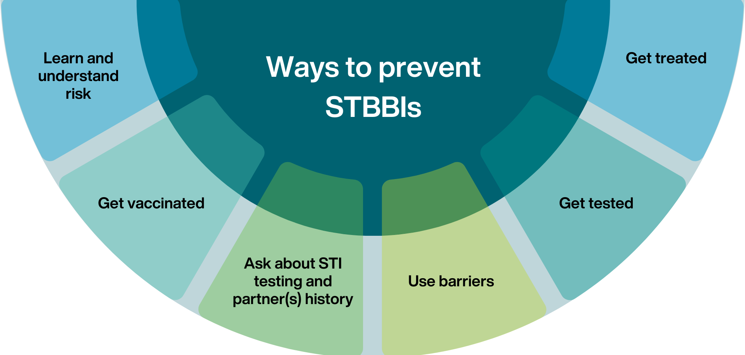
Public Health
Healthy Sexuality
Notes:
Script
There are many ways to prevent STBBIs. Some ways include: Read each section on slide
After reading all sections: there are also many lower risk sex practices such as kissing (not genitals), massage, masturbation, etc. that individuals can engage in.

Slide 45

STBBIs and Assertive Communication
Asking about STBBI testing, partner(s) history and negotiating barrier use requires assertive communication skills.
Youths need opportunities to learn and practice these skills.
We recommend Teaching Sexual Health’s Grade 9 Safer Sex lesson plan:
Communicating about protection activity
Public Health
Healthy Sexuality
Notes:
Script
Read slide
After last bullet: this is a great activity that allows students to learn/practice assertive communication skills when discussing and negotiating barrier use using scenarios.
Grade 9- Safer sex lesson plan
https://teachingsexualhealth.ca/app/uploads/sites/4/Gr9LP5-Safer-Sex-ENGLISH-FINAL.pdf

Slide 46
Examples
Having sex without using a barrier/condom
Having sex without asking a partner about STBBI testing and treatment
Using alcohol or substances
Relationships where intimate partner or sexual violence are present
STBBI Risk Factors
Public Health
Healthy Sexuality
Notes:
Script
Now, I will move on to STBBI risk factors. Some examples of this include: read right hand side
Ref: https://www.ncbi.nlm.nih.gov/pmc/articles/PMC7227429/
https://www.canada.ca/en/public-health/services/infectious-diseases/sexual-health-sexually-transmitted-infections/canadian-guidelines/stbbi-prevention-guide.html

Slide 47
Sexual Relationships and Risks & Risk Reduction Learning Activities
We recommend Teaching Sexual Health’s Grade 8 Responsibility and Choices lesson plan:
Activity | Risk | Reduce Risk
E.g. Kissing | Low | None
E.g. Vaginal Sex | Unintended Pregnancy and STBBIs | Birth control Not having sex Condoms Communicate with partner about protection, boundaries, and testing Vaccinations STBBI testing/treatment
Notes:
Script
After reading title and first sentence: In this activity, students brainstorm types of intimate activities they may be involved in in a sexual relationship and identify whether there is a risk of STBBIs and unintended pregnancies as well as ways to reduce those risks. This helps them understand their responsibilities within a sexual relationship. Some examples are: Read table

Slide 48
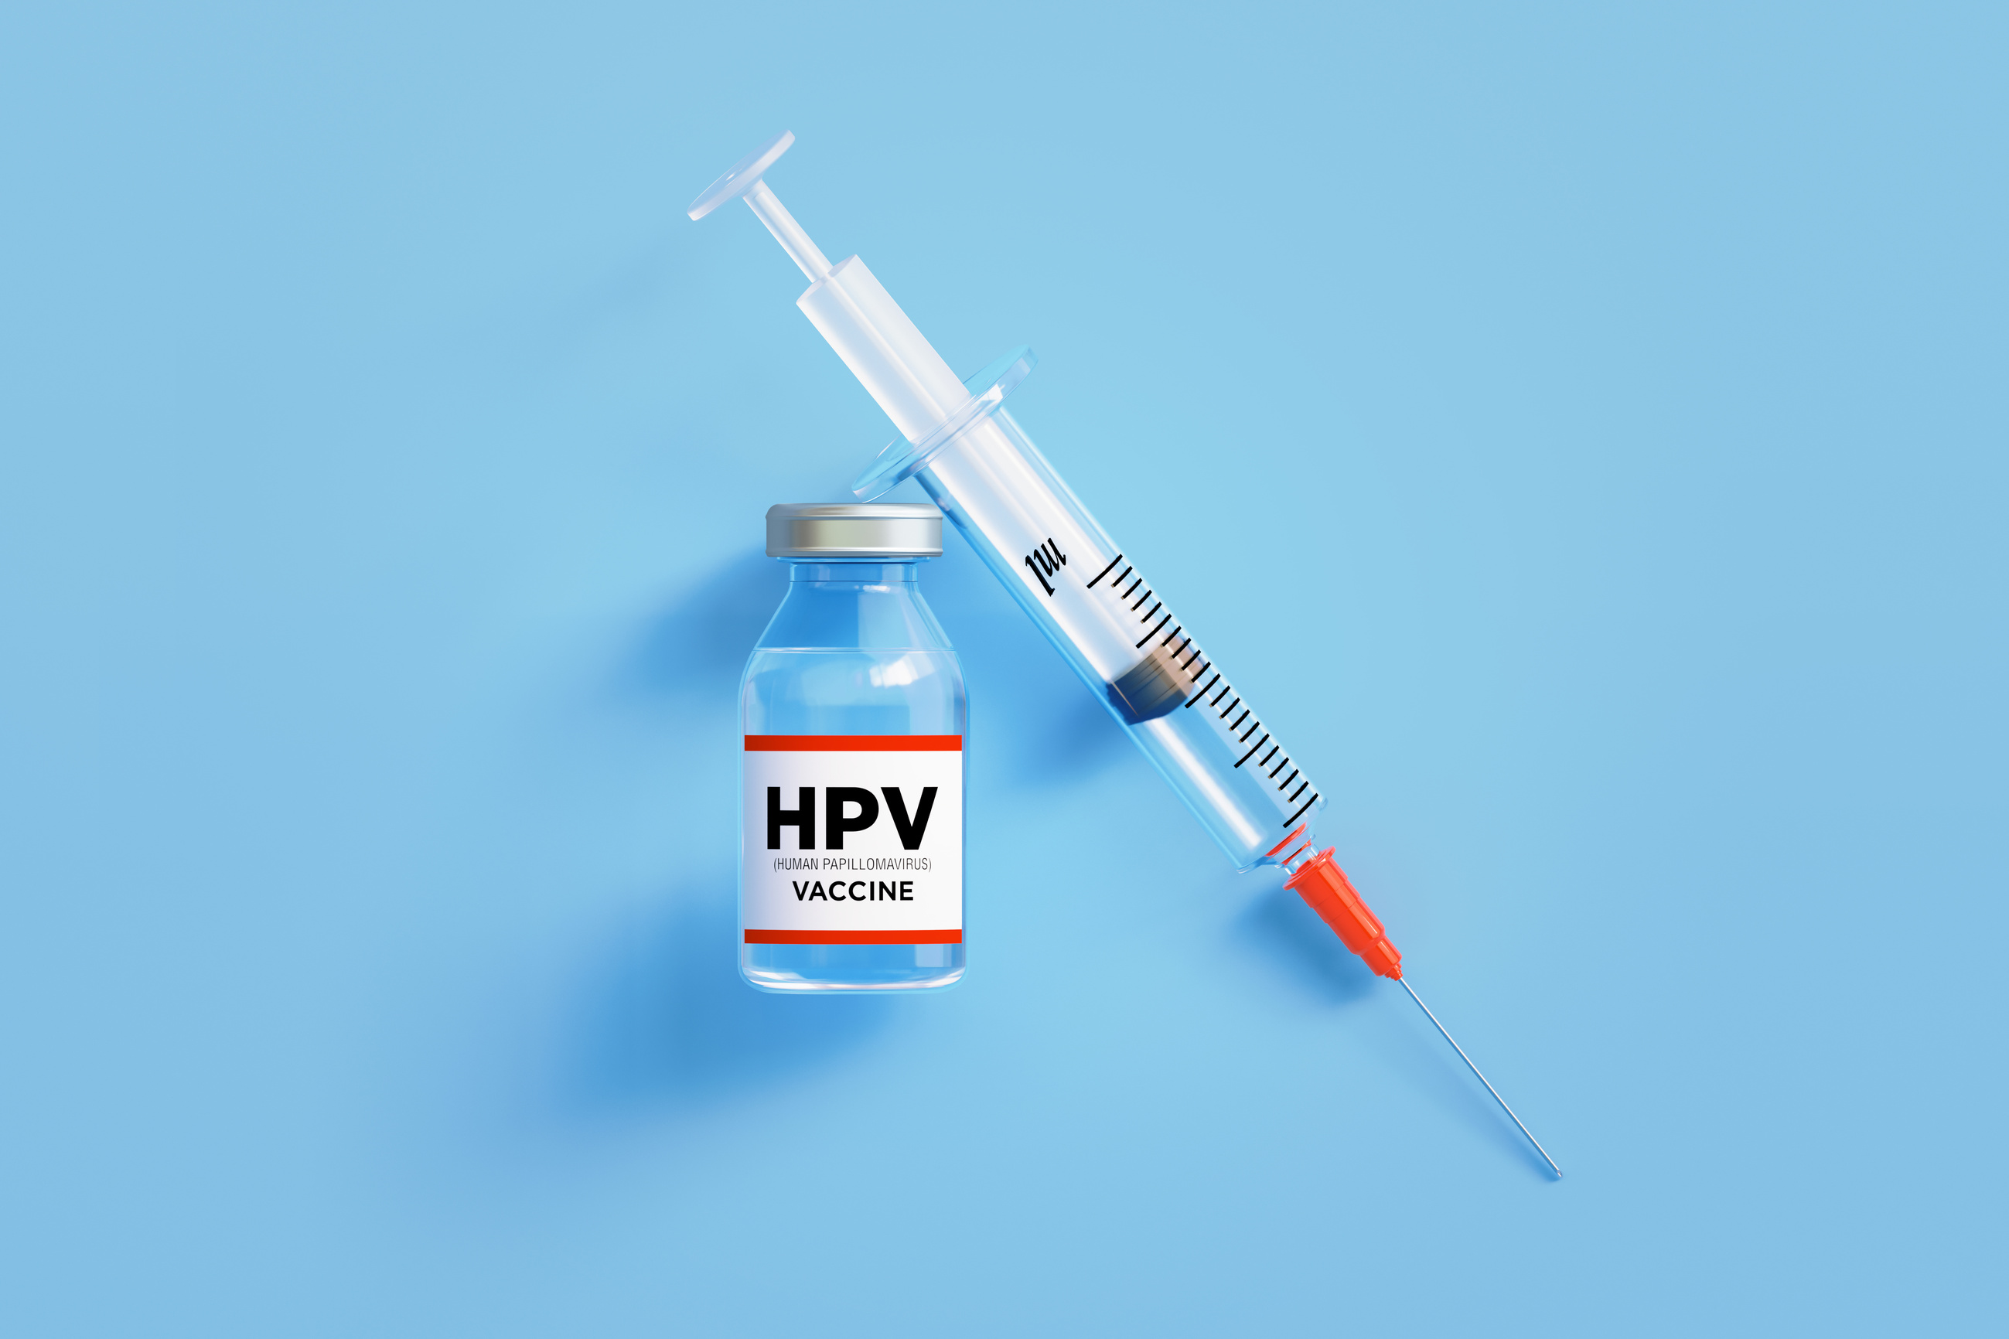
HPV vaccine
Protects against most strains of HPV that cause cervical, anal and other types of cancer as well as genital warts.
Available free in BC from school immunization clinics, public health units, and sexual health clinics.
Public Health
Healthy Sexuality
Notes:
Script
Now that we have talked about transmission risk, let focus on specific prevention strategies, one of them being the… read title and first paragraph
After first paragraph: Hundreds of millions of doses of the HPV vaccine have been given safely worldwide. It protects against 9 strains of HPV that cause about 90% of cases of cervical cancer and 91% of cases of anal cancer in women and 84% in men.
After second paragraph: Some pharmacies and health care providers also carry the vaccine. Anyone interested should call ahead to ensure vaccine availability.
Ref: http://www.bccdc.ca/health-info/diseases-conditions/human-papillomavirus-hpv
https://immunizebc.ca/vaccines/hpv#:~:text=In%20BC%2C%20the%20HPV9%20vaccine,dose%20before%20they%20turn%2026.
Slightly different percentages: https://www.healthlinkbc.ca/sites/default/files/documents/healthfiles/hfile101b.pdf

Slide 49

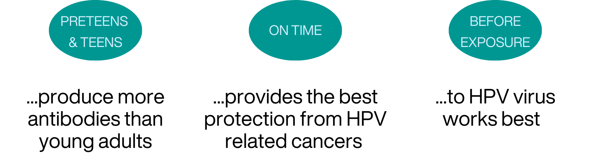
HPV vaccine recommendations for school aged youth
Public Health
Healthy Sexuality
Notes:
Script
Read title
HPV vaccine is provided in grade 6, the reason for this is that….read first section. If HPV vaccine was missed, catch up can occur in any grade.
It is best to provide the vaccine on time as it…. read second section and before exposure. Do not read third bubble
However, there is still benefit in receiving the vaccine after becoming sexually active as it protects against different strains of HPV.
Ref: https://immunizebc.ca/vaccines/hpv

Slide 50
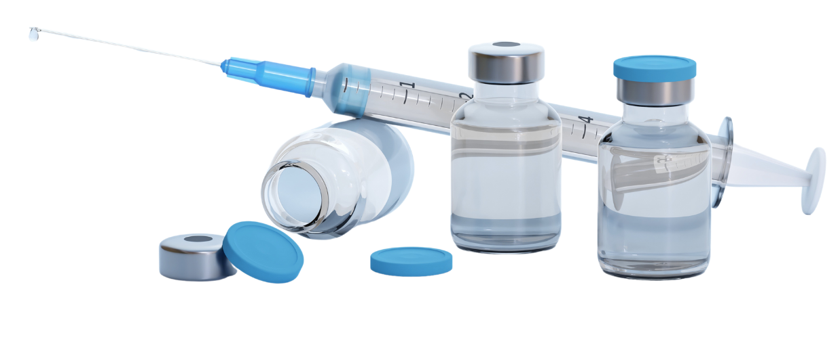
Vaccines are also available to protect against Hepatitis A, B and Mpox
Hepatitis A and Mpox vaccine are publicly funded for some people based on set criteria
Hepatis B vaccine is provided to babies as part of routine immunizations
Public Health
Healthy Sexuality
Notes:
Script
Read slide
Ref: https://www.healthlinkbc.ca/tests-treatments-medications/medications/hepatitis-vaccine
https://www.healthlinkbc.ca/healthlinkbc-files/hepatitis-b-vaccine

Slide 51
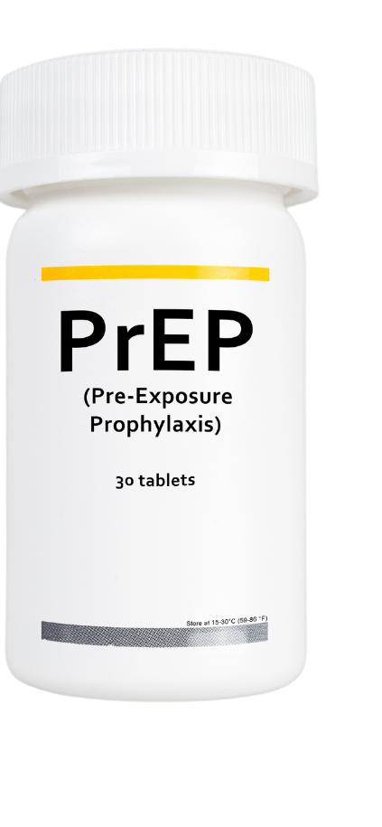
HIV Pre-Exposure Prophylaxis (PrEP)
Highly effective option to prevent HIV for those who are HIV-negative
Available at no cost in BC through Medical Services Plan (MSP)
Recommended for people at higher risk of acquiring HIV
Public Health
Healthy Sexuality
Notes:
Script
Read slide
Currently, PrEP is available as a single daily pill and may be taken on a long term basis.
If interested, individuals can speak with their health care provider or go to a VCH sexual health clinic to learn more about it.
There is also preventative treatment provided soon after exposure (or potential exposure) to HIV called PEP- which stands for post exposure prophylaxis.
Ref:
https://smartsexresource.com/sexually-transmitted-infections/stis-conditions/hiv-and-aids/#prep

Slide 52
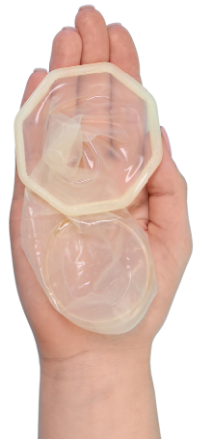
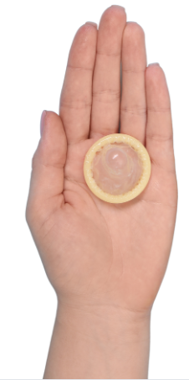
Barriers are a really important part of safer sex
Barriers lower the risk of STBBIs.
Condoms are one of the most well-known barriers.
Can be used for vaginal, anal and oral sex.
Healthy Sexuality
Notes:
Script
Read slide
Dental dams are also a type of barrier.
Ref:
VCH BLUSH Safer Sexy

Slide 53
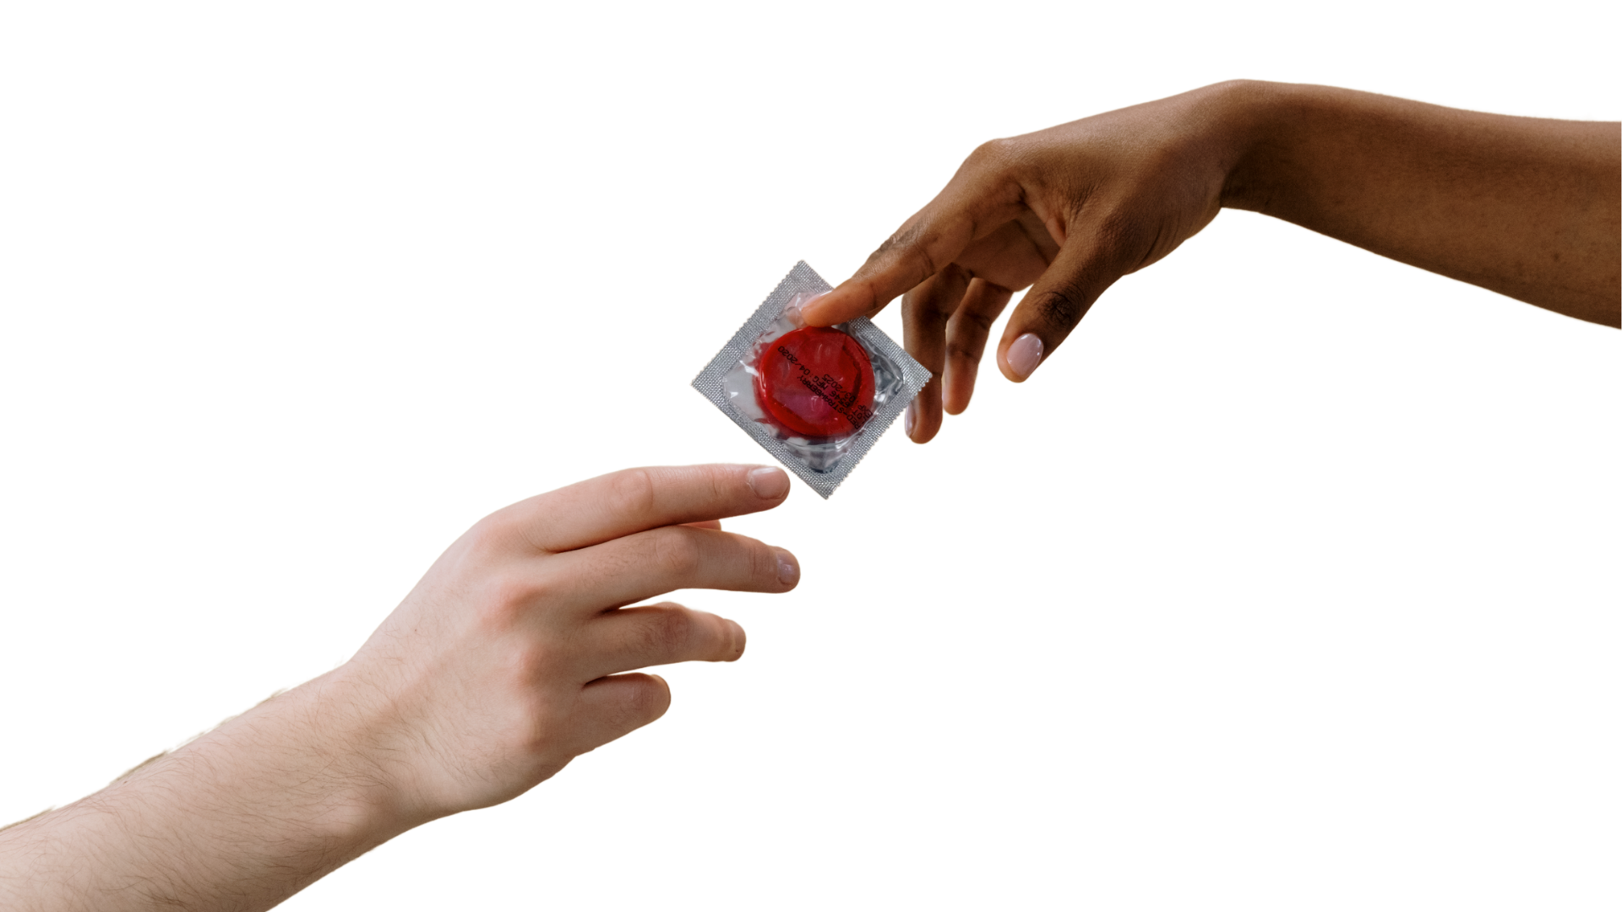
External Condoms
Also referred to as “male” condoms.
Used for oral, vaginal, or anal sex.
Put on erect penises/external genitals and sex toys.
Healthy Sexuality
Notes:
Script
Let’s review each type of barrier in detail
Read slide
Ref:
https://www.optionsforsexualhealth.org/facts/birth-control/methods/external-condoms/#:~:text=You%20can%20purchase%20condoms%20at,clinics%2C%20or%20at%20youth%20clinics.

Slide 54
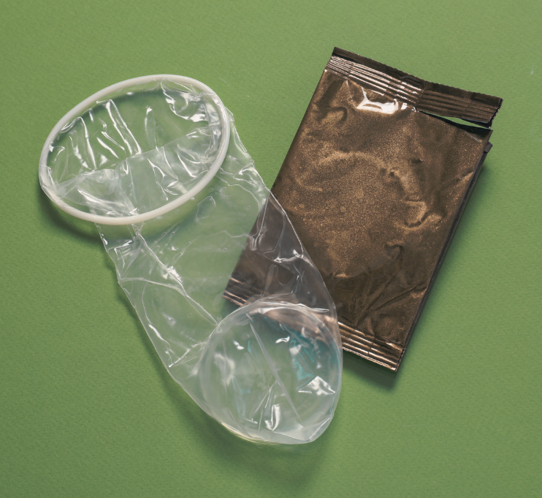
Internal Condoms
Also referred to as “female condoms” and may say this on the packaging.
Used for vaginal or anal sex.
Internal condoms can be inserted into the vagina or anus up to 8 hours before intercourse.
Healthy Sexuality
Notes:
Script
Read slide
Internal condoms are a great alternative to external condoms for those who do not like using external condoms, or are allergic to latex, as these condoms are made out of plastic.
Ref: VCH BLUSH

Slide 55
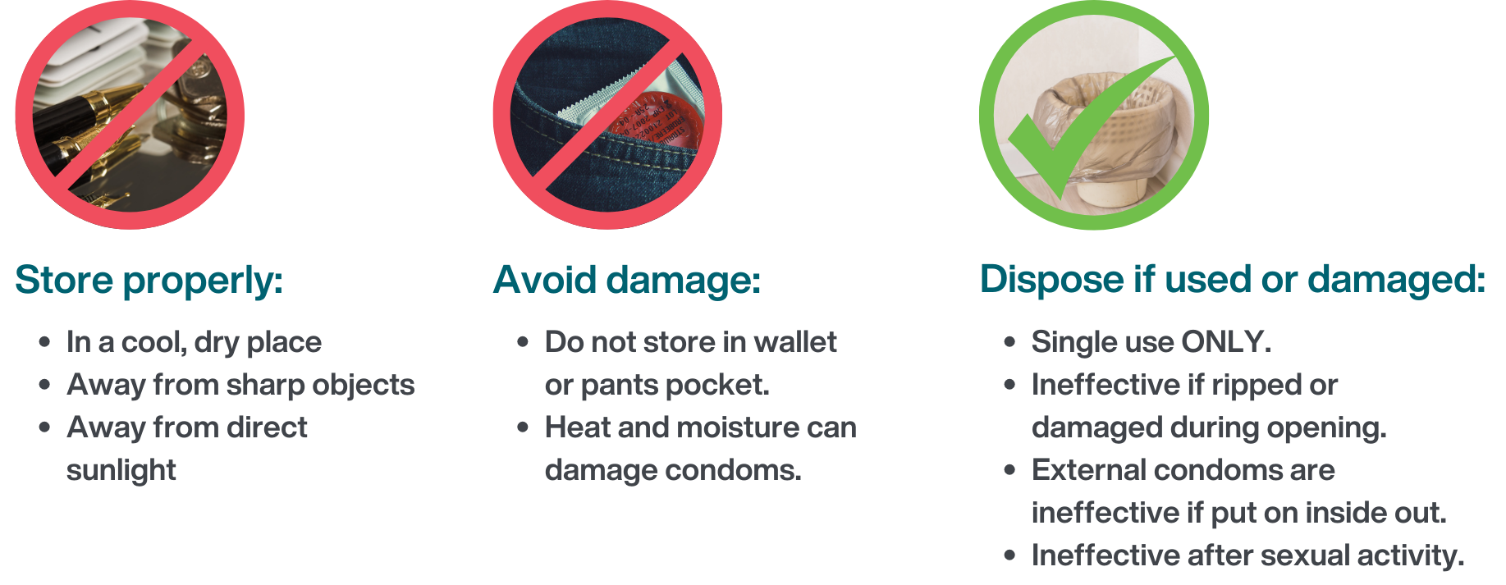
Condom storage and handling
Public Health
Healthy Sexuality
Notes:
Script
Read title
Condoms should be stored properly in…
Ref: VCH BLUSH

Slide 56
Dental dams
A piece of thin latex that is placed over the vulva or anus during oral sex.
Healthy Sexuality
Notes:
Script
Read slide
You will see a blue square on the slide because many dental dams look like blue sheets.
It can also be called a latex barrier/sheet, latex dam, oral dam or sheet.
An external condom cut length-wise can be used in the same way as a dental dam.
Ref:
https://smartsexresource.com/sexually-transmitted-infections/sti-basics/preventing-stis/

Slide 57
Video: How to use a condom
Using an external condom
Public Health
Healthy Sexuality
Notes:
Script
Now I will play a condom demonstration video from teaching sexual health
Show external condom video demo-3:30 minutes (will require internet connection to view)
Note:
If you do not have access to the internet, the video wont play. Proceed with condom demo found on slide 64 instead.
Ref: https://teachingsexualhealth.ca/teachers/lesson-plans-resources/videos/

Slide 58
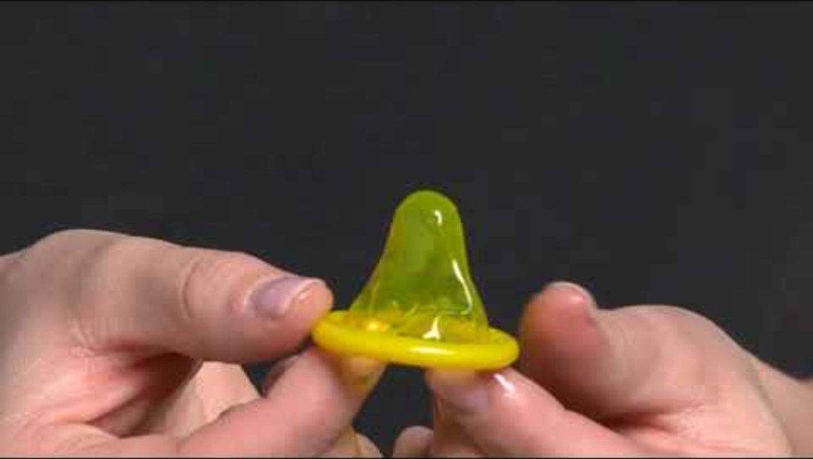
Public Health
Healthy Sexuality
Notes:
Script
This slide contains links to condom demonstration video from teaching sexual health
Show external condom video demo-3:30 minutes (will require internet connection to view)
Note:
If you do not have access to the internet, the video wont play. Proceed with condom demo found on slide 64 instead.
Ref: https://teachingsexualhealth.ca/teachers/lesson-plans-resources/videos/

Slide 59
Video: How to use a condom
Using an internal condom
Public Health
Healthy Sexuality
Notes:
Script
This slide contains links to condom demonstration video from teaching sexual health
Internal condom video is 3:15 min
Note:
If you do not have access to the internet, the video wont play. Proceed with condom demo found on slide 64 instead.
Ref: https://teachingsexualhealth.ca/teachers/lesson-plans-resources/videos/

Slide 60
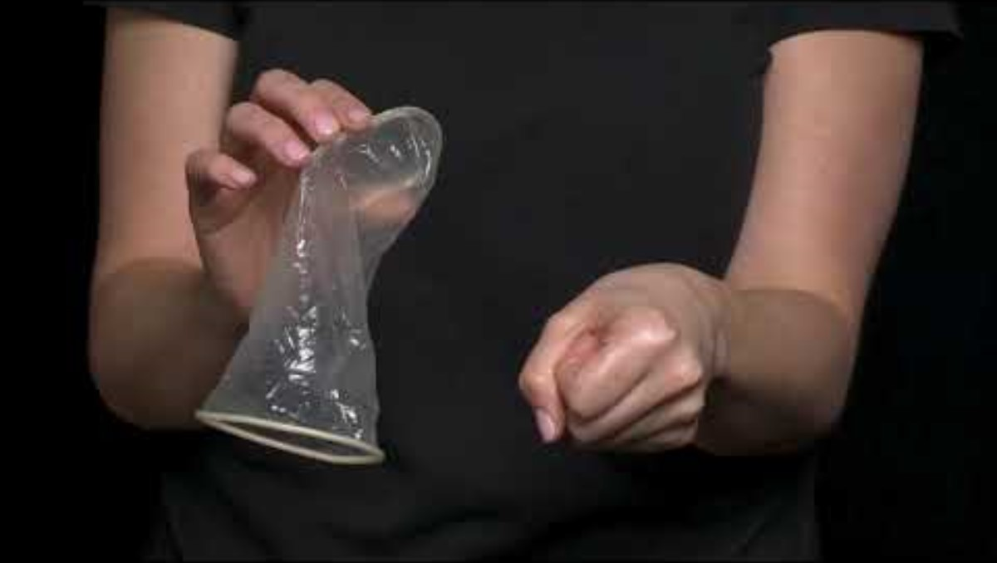
Public Health
Healthy Sexuality
Notes:
Script
This slide contains links to condom demonstration video from teaching sexual health
Internal condom video is 3:15 min
Note:
If you do not have access to the internet, the video wont play. Proceed with condom demo found on slide 64 instead.
Ref: https://teachingsexualhealth.ca/teachers/lesson-plans-resources/videos/

Slide 61
Video: How to use a dental dam
Using a dental dam
Public Health
Healthy Sexuality
Notes:
Script
This slide contains links to condom demonstration video from teaching sexual health
Dental dam video demo-2:50 minutes (will require internet connection to view)
Note:
If you do not have access to the internet, the video wont play. Proceed with condom demo found on slide 64 instead.
Ref: https://teachingsexualhealth.ca/teachers/lesson-plans-resources/videos/

Slide 62
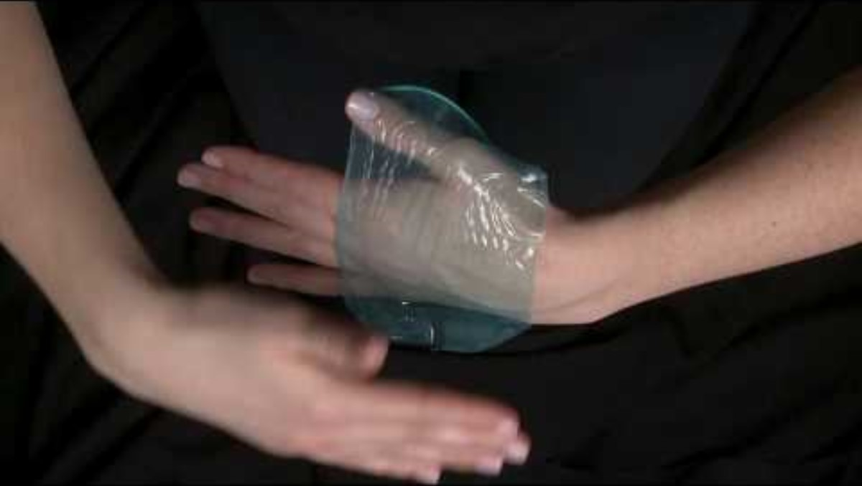
Notes:
Script
This slide contains links to condom demonstration video from teaching sexual health
Dental dam video demo-2:50 minutes (will require internet connection to view)
Note:
If you do not have access to the internet, the video wont play. Proceed with condom demo found on the next slide instead.
Ref: https://teachingsexualhealth.ca/teachers/lesson-plans-resources/videos/

Slide 63
Videos: How to use barriers
Using an external condom
Using an internal condom
Using a dental dam
https://teachingsexualhealth.ca/ teachers/resource/ using-a-condom-video/
https://teachingsexualhealth.ca/ teachers/resource/ using-a-vaginal-condom/
https://teachingsexualhealth.ca/ teachers/resource/ using-a-dental-dam/
Public Health
Healthy Sexuality
Notes:
All videos in one slide version- Show videos if internet connection available.
Script
These are some great barrier protection videos available at teaching sexual health resource. Please note that the internal condom video refers to it as a “female condom”.
Ref: https://teachingsexualhealth.ca/teachers/lesson-plans-resources/videos/

Slide 64
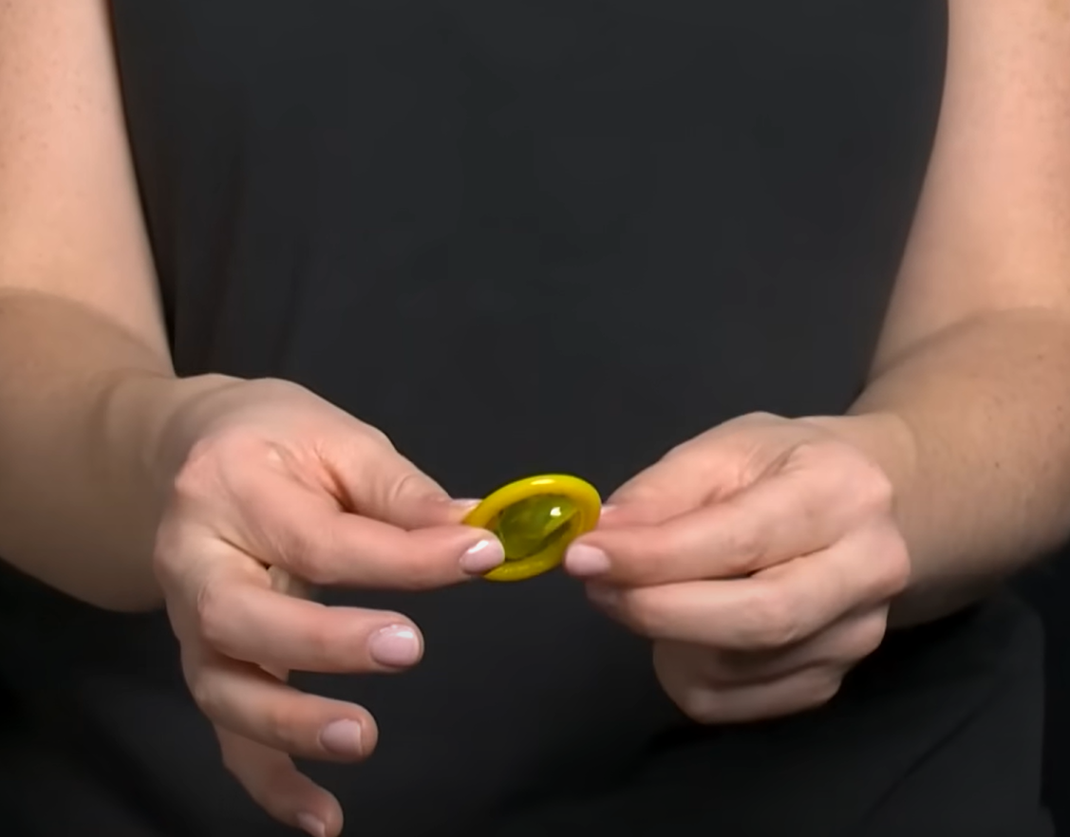
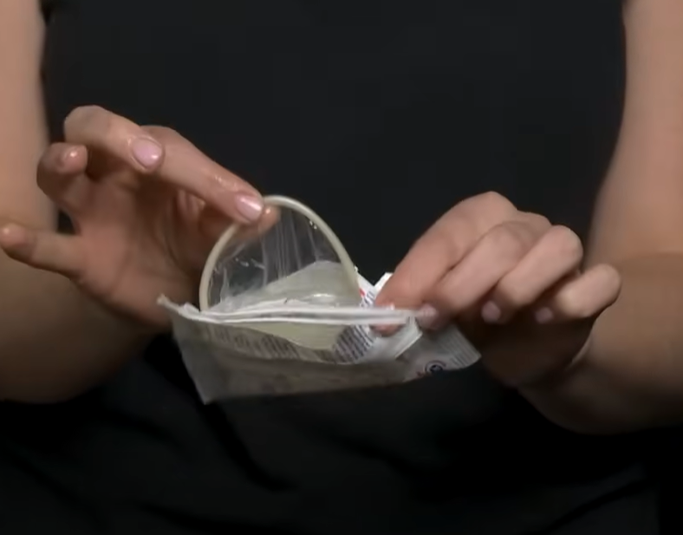
Demonstration: How to use a condom
Using an external condom
Using an internal condom
Public Health
Healthy Sexuality
Notes:
It will take about 10 minutes to show all three videos.
Provide a demonstration if internet connection not available to play videos – Ensure to bring condoms to the workshop. May bring scissors if planning on creating a dental dam from a flavoured condom.
Script
When doing a condom demo in the classroom, the following points are usually discussed:
“Look at the expiry date”
“What is an expiry date?”
“It is typically written as EXP”
“Does the package have a pocket of air? Gently squeeze to ensure there are no holes”
For external condom: “Open the condom package carefully and take the condom out. The condom should resemble a sombrero. If the condom is inside out and came into contact with the penis/external genital, discard and grab a new one. Gently pinch the tip of the condom and roll over the erect (hard) penis/external genital”
For internal condom: “A brand available in BC is labelled as a “female” condom”, “Open the package carefully and take the condom out. The closed end of the condom should go inside the vagina/internal genital or anus”
Store condoms at room temperature.
When removing a condom, do so carefully and avoid spilling, external condoms should be removed. while penis is still erect.
Make a knot in the condom when it is out and throw out in the garbage.
A reminder to never use more than one condom at a time! (i.e. an internal and external condom or double up). The friction makes the material weaker/break or slip.
We have been talking about things very factually during this demo, but we can remind youths that this is a good time to check-in with their partner(s) to see how they are doing.
Ref: https://teachingsexualhealth.ca/app/uploads/sites/4/Birth-Contol-Kit-ENGLISH-FINAL.pdf
Image: Cottonbro Studio-https://www.pexels.com/photo/person-opening-a-plastic-3923170/ and https://www.pexels.com/photo/person-holding-white-plastic-pack-3923177/

Slide 65
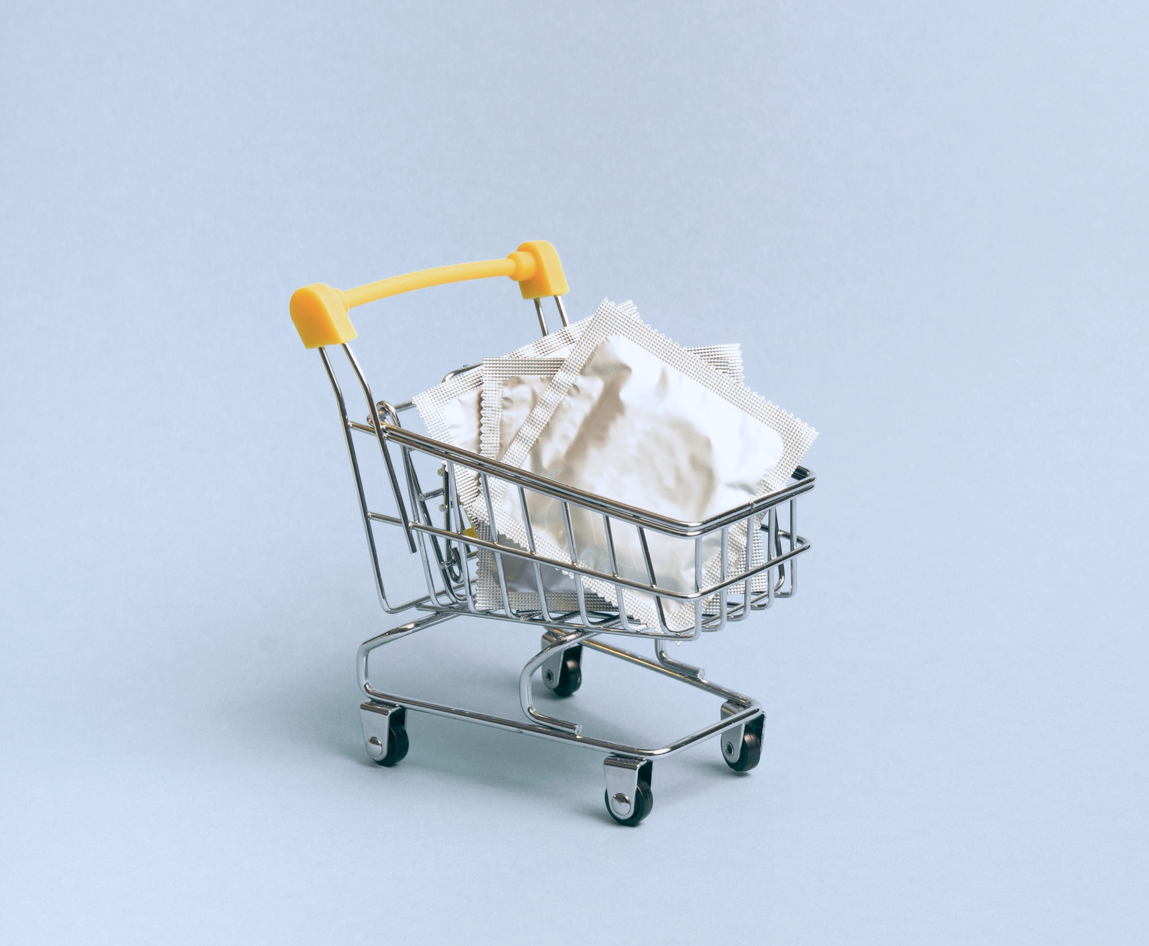
Where to get barriers
Condoms are available free of charge at sexual health clinics
Condoms and dental dams can also be purchased at drugstores, grocery stores, convenience stores and online
Public Health
Healthy Sexuality
Notes:
Script
Read slide
Youth may not be keen on using condoms or barriers for oral sex due to taste – flavoured condoms are available and often more appealing to youth!

Slide 66
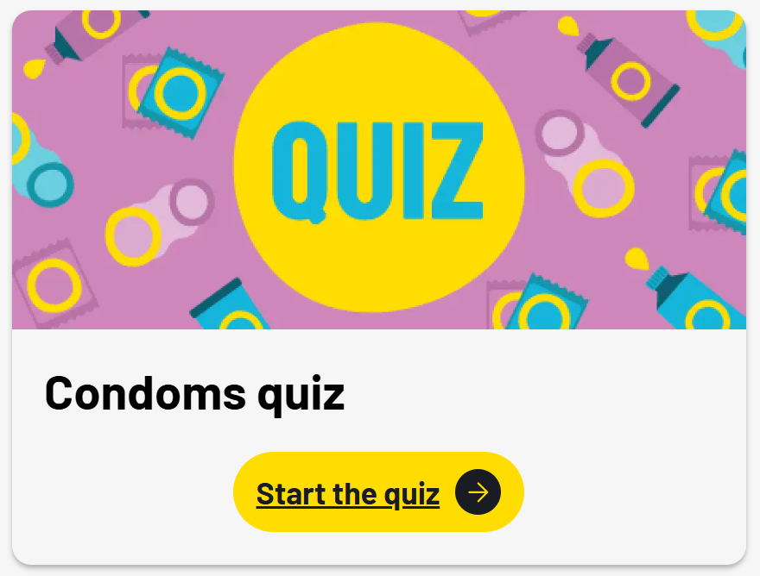

Notes:
Script
This is a great 10 question quiz from Be In The Know that can also be used in the classroom. I will open it and show you a few of the questions.
Ref: https://www.beintheknow.org/resources/quizzes/condoms-quiz-0?page=start

Slide 67
Choosing not to have sex
The only way to fully avoid STIs is to abstain from any activity that involves sexual contact between one person’s body and another person’s genital area, semen, vaginal fluid or blood.
Choosing not to have sex won’t fully protect against BBIs, because BBIs are also transmitted through contact with blood and body fluids such as sharing drug use equipment, tattoo supplies, etc.
Public Health
Healthy Sexuality
Notes:
Script
After first bullet: Some people chose to decrease or eliminate risk by not having sex as they feel this is the right choice for them. This is sometimes referred to as abstinence. The activities people abstain from can vary from person to person.
Read second bullet
Ref: https://teachingsexualhealth.ca/app/uploads/sites/4/Gr7LP4-Abstinence-ENGLISH-FINAL.pdf

Slide 68
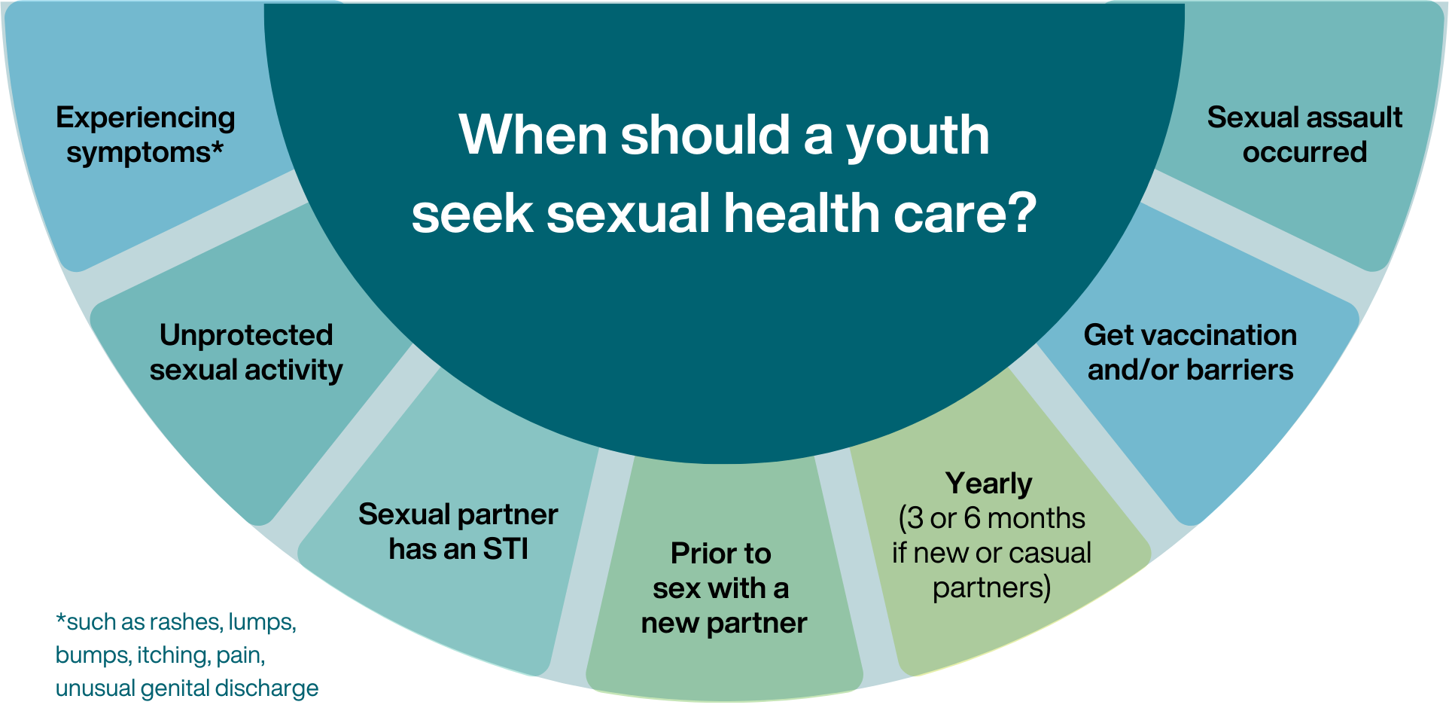
Public Health
Healthy Sexuality
Notes:
Script
After first reason: a reminder that many people do not experience STBBI symptoms at all.
After fifth reason: once a person starts having sex
After last bullet: For sexual assault services, youths are encouraged to go to the emergency department 24 hours a day.
Youths can visit a VCH sexual health clinic for non-urgent sexual assault support and follow-up.
Ref: https://smartsexresource.com/sexually-transmitted-infections/sti-basics/symptoms-testing/

Slide 69
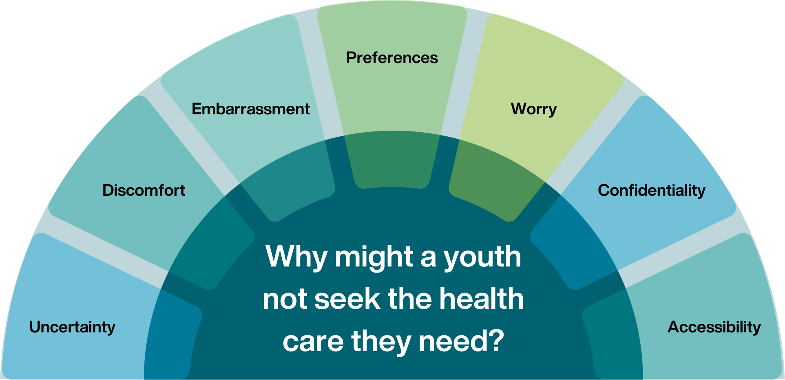
Public Health
Healthy Sexuality
Notes:
Script
Let us understand the reasons why youths may avoid seeking sexual health care.
Youth may feel uncertain about what to expect. They may not know what the visit will entail, what will be discussed, what will be provided and whether their needs will be met. Our clinic services hand outs have a description of services available and we recommend you review this with your students.
Youths may feel discomfort and embarrassment about discussing their sexual history openly with someone. Please let them know that health care providers are trained to provide non-judgmental sexual health care and see individuals with all sorts of sexual histories.​ We are here to help. They may be concerned about having a physical examination. Please let them know a physical examination may or may not be needed. If it is needed, we will help them every step of the way. They are always able to decline a physical exam. They may also be uncomfortable with seeing a health care provider of a certain gender. Please let them know that they can request a health care provider of a certain gender. If we don’t have one available, we can help them with options to access one.
Youths may also be worried about what they might find out, for example having a STBBI or unintended pregnancy. Please let them know that we are there to help and options are available. Youth may also worry about confidentiality. Particularly that their visit will become known to their parents/guardians. Please let them know that sexual health services are always confidential unless a youth tells us that they are at risk of being harmed or harming themselves or others. ​
Some youth may have difficulty accessing sexual health care services, for example, they may not have transportation. If this is an issue, please let them know to speak to one of the school counsellors or myself.
The following slide will touch on where youths can seek sexual health care as well as resources.
New image:
Uncertainty, Discomfort, embarrassment, preferences, worry, confidentiality, accessibility,

Slide 70




Youth-friendly health clinics
Youth and Sexual Health clinics
vch.ca/en/health-topics/sexual-health
getcheckedonline.com
foundrybc.ca
optionsforsexualhealth.org/care/
Public Health
Healthy Sexuality
Notes:
Script
Where can youths go for care? The following is a list of youth specific clinics/services.
We recommend you discuss these health clinic resources with your class, and post within the class or school.
VCH Youth and Sexual Health clinics (across the VCH region) and Options for Sexual Health clinics offer sexual and reproductive health care services, including STI testing and contraception.
Foundry offers health and counselling services for young people ages 12-24.
Get Checked Online is an easy way to test for STBBIs without visiting a health care provider

Slide 71
Free of charge services at VCH sexual health clinics
Emergency contraception
Sexual health related immunizations
Most clinics offer contraception
Free condoms
STBBI testing and treatment
Harm reduction supplies
Some clinics may offer:
Pregnancy testing and next steps counselling
Non-urgent sexual assault support and follow-up
Intrauterine Device (IUDs), PrEP
Notes:
Script
Read slide

Slide 72





Youth-friendly sexual health information sources
SEX SENSE
1-800-739-7367
optionsforsexualhealth.org/sex-sense
smartsexresource.com
Public Health
Healthy Sexuality
Notes:
Script
Read title
There are many excellent resources, but here are the ones we’d particularly recommend.
Sex Sense is a resource from Options for Sexual Health. They have great evidence-based information on their website. They also take questions by phone or online through their website. Individuals can call and ask questions or submit a question online.
Smart Sex Resource was developed by the BC Centre for Disease Control (BCCDC). It provides comprehensive sexual health information and links to services for British Columbians of all ages. A large library with more than 1000 questions from the public on various sexual health related topics is also available.

Slide 73

Public Health
Healthy Sexuality

Slide 74

Public Health
Healthy Sexuality
Notes:
Before we move on, I would like to show you the speakers notes- go to slide 12

