Slide 1



Substance Use
Care and Management
ED Substance Use Care Updates, March 2025
What’s New (Hospital Policy)?
What to Know and How to Prepare
Where to Find More Information
Notes:
Welcome! This session is designed to provide emergency department (ED) educators with essential updates on hospital policies and protocols related to substance use management.
This is based on BC Ministry of Health policy, professional standards, decision support tools (DSTs), guidelines, and new BCCSU Protocols. So you are up to date on what you need to know, and what you need to do.

Slide 2

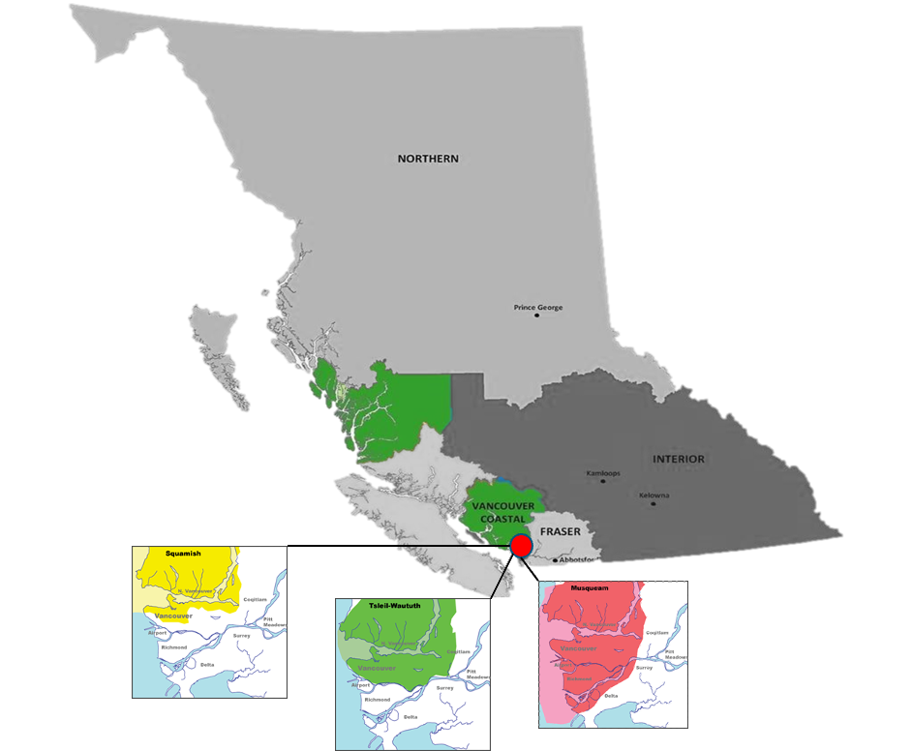

Territorial Acknowledgement
We wish to acknowledge that the land on which we gather is the traditional and unceded territory of the Coast Salish Peoples, including the Musqueam, Squamish, and Tsleil-Waututh Nations.
Vancouver Coastal Health is committed to delivering exceptional care to 1.25 million people, including the First Nations, Métis and Inuit, within the traditional territories of the Heiltsuk, Kitasoo-Xai'xais, Lil'wat, Musqueam, N'Quatqua, Nuxalk, Samahquam, shíshálh, Skatin, Squamish, Tla'amin, Tsleil-Waututh, Wuikinuxv, and Xa'xtsa.
Notes:
If this territorial acknowledgement is incorrect for your location, please feel free to update the bolded paragraph.

Slide 3


Contents
01 | Overview: Why does this matter?
02 | Objectives: What do I need to do?
03 | Protocols: What do I need to know?
04 | Power Plans: What does this look like?
05 | Resources: Where can I find more information?

Slide 4

Overview
The BC Ministry of Health introduced a policy in May 2024 to improve care for patients who use substances.
As Emergency nurses, your role includes asking patients about substance use, managing withdrawal, supporting opioid agonist treatment (OAT), and ensuring proper discharge planning.
Notes:
This policy change addressed the public backlash about substance use in public and complaints from hospital staff about unregulated substance use in hospitals.
Approved by Health Canada and now in effect. Applicable to inpatient and emergency departments.
Policy objectives for this are:
1. A consistent approach in all BC hospitals that prohibits unregulated substance use by patients outside of designated overdose prevention service
2. Improve how patients are supported in managing their SU disorder while in hospital by providing more effective support toward stabilization, withdrawal management, treatment, and recovery services while in hospital and post-discharge
3. Standardize the way overdose prevention sites function in hospitals
4. Expand and add in-person addiction medicine specialists, psychosocial and clinical team s and provincial virtual clinical consultation support to hospitals
5. Provide a culturally safe approach to care in hospitals free of Indigenous-specific racism
6. Provide improved education and training to better equip hospidal staff to develop care plans and work effectively and safely with patients that use unregulated substances.

Slide 5
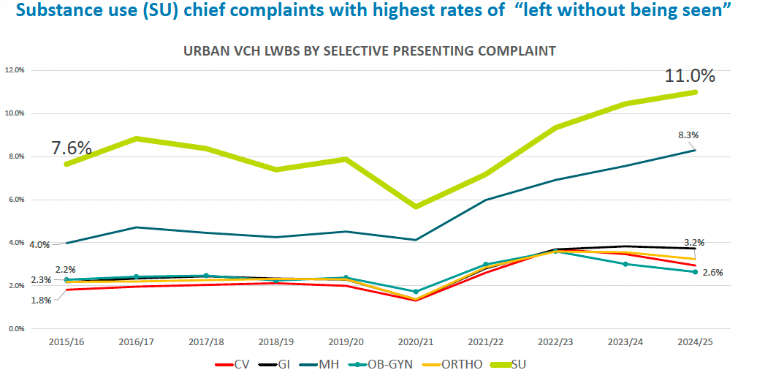
Why does this matter?
Improve Service for ED patients
Reduce patient-initiated discharges and ensuing poor outcomes
Ensure practice meets requirements of 2024 BC Ministry of Health Policy
People with substance use chief complaints persistently leave without being seen at higher rates. This results in poorer health outcomes and repeat emergency visits.
Notes:
Like any other conditions we treat everyday in emergency:
Our general goals are:
1. Start immeiate treatment
2. Call for specialist support if needed.
We want to build our comfort and capacity.
Citing for poor health outcomes when leaving without being seen:
Otterstatter, M. C., Crabtree, A., Dobrer, S., Kinniburgh, B., Klar, S., Leamon, A., May-Hadford, J., Mill, C., Park, M., Tu, A. W., & Zheng, L. (2018). Patterns of health care utilization among people who overdosed from illegal drugs: a descriptive analysis using the BC Provincial Overdose Cohort. Health promotion and chronic disease prevention in Canada : research, policy and practice, 38(9), 328–333. https://doi.org/10.24095/hpcdp.38.9.04
Citing for repeat emergency visits:
Moe, J., Wang, Y. E., Schull, M. J., Dong, K., McGregor, M. J., Hohl, C. M., Holroyd, B. R., & McGrail, K. M. (2022). Characterizing people with frequent emergency department visits and substance use: a retrospective cohort study of linked administrative data in Ontario, Alberta, and B.C., Canada. BMC emergency medicine, 22(1), 127. https://doi.org/10.1186/s12873-022-00673-x

Slide 6




Key Objectives
What do I need to do?
Check In with Patients
Withdrawal Management
OAT Initiaition & Maintenance
Connect to Care
Ask all patients about substance use. Offer naloxone kits, safer use kits and education to reduce risk such as overdose.
Identify and respond to withdrawal symptoms early to improve care retention
Administer OAT, assess pre and post opioid doses using POSS to gain confidence with evidence based treatments.
Inform patients about community resources after leaving ED to improve connection to supports.
Notes:
These are directly listed in the hospital policy under Objectives. And are standard to all hospitals across BC.
ED nurses should be able to:
-Address withdrawal quickly
-Work with physicians to provide continuation OAT to someone in the ED for several hours
-Work with physicians to initiate OAT in uncomplicated patient requesting OAT after hours
-Consult with addiction
specialists for complicated scenarios.

Slide 7
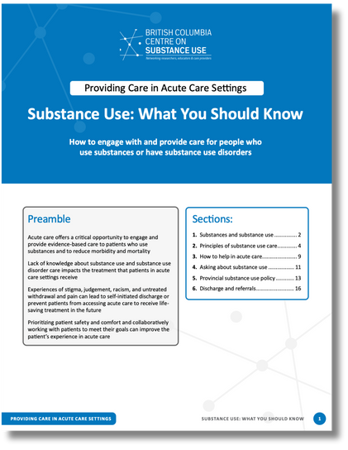
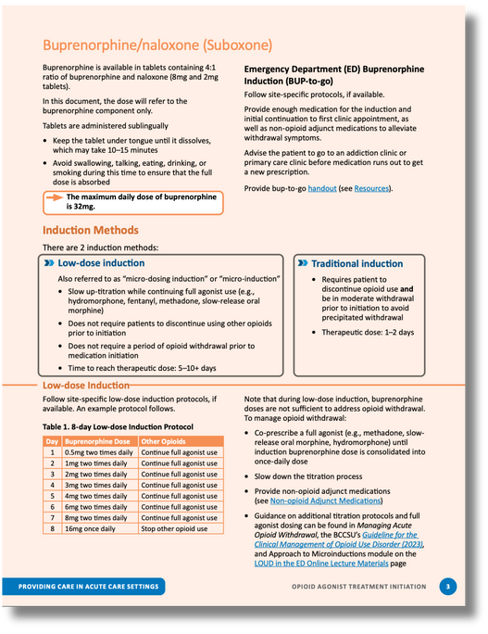
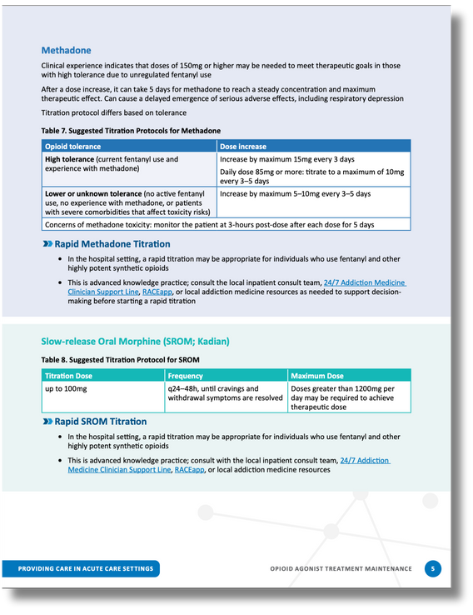
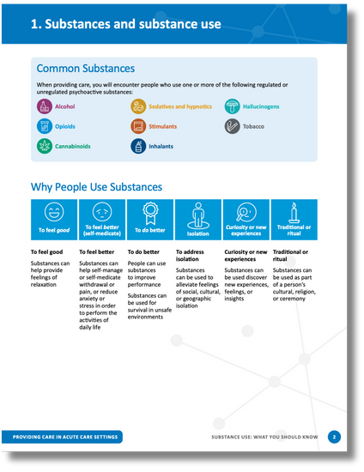
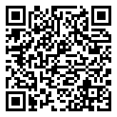
Protocols
Stimulant Use Disorder:
7. Managing Stimulant Intoxication and Withdrawal
General Information:
1.Substance use: What you should know
2.Co-occuring Substance use Principles
What do I need to know?
There are 8 protocols to help inform and guide your practice.
VCH SHOP:
BCCSU/VCH Hospital Care Substance Use Guidelines
Opiate Use Disorder:
3.Acute Care & OUD
4.Managing Acute Opioid Withdrawal
5.OAT Initiation
6.OAT Maintenance
Benzo Contamination:
8.Withdrawal from benzo contamination of the unregulated drug supply
Notes:
These resources are intended to support all hospital staff, regardless of department, identify and provide adequate support and treatment for patients who use unregulated substances.
These policies have been turned into Power Plans in Cerner (covered in the next slides) and are available on SHOP.

Slide 8
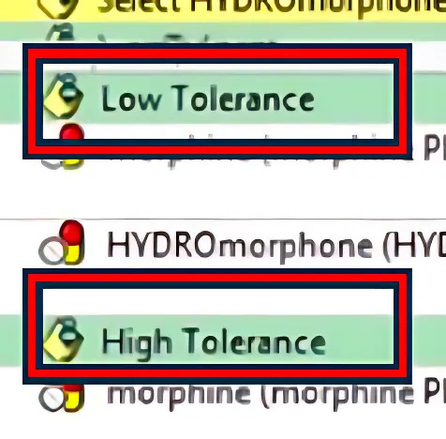
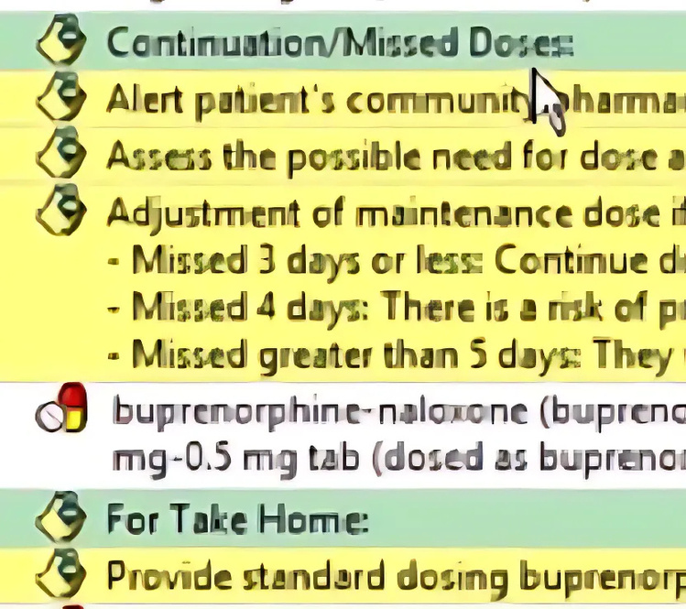

Power Plans
Powerplans in CERNER help to quickly start treatment protocols. Here are 2 that have been updated recently.
What Will this look like?
Opioid Withdrawal
Buprenorphine/ Naloxone
New distinction between Low, high and very high tolerance
Higher doses are for higher tolerance (You may see higher doses)!
If Very High Tolerance or if on daily dispense safe supply of hydromorphone, ask how much the person takes at one time for withdrawal.
Addition of Continuation/Missed Doses
Standard dosing take-home kits are now available in all VCH EDs.
Prescription options include 2 different microdosing protocols.
Notes:
What’s new in power plans:
distinction between high and low tolerance.
Higher doses for high tolerance. Consider more rapid escalation
for Very high Tolerance, or if on daily dispense safe supply HM, consider asking how much they would take at one time for withdrawal.
For all three, you can reassure your patient that you will re-assess and titrate upward more frequently and with higher doses if initial doses not quickly effective
Buprenorphine module relatively unchanged other than addition of Continuation. In-ED protocol for initiation consists of standard dosing and requires withdrawal. Standard dosing take-home kits now available in all VCH EDs. Prescription options include 2 different microdosing protocols if patient prefers outpatient microdosing.

Slide 9

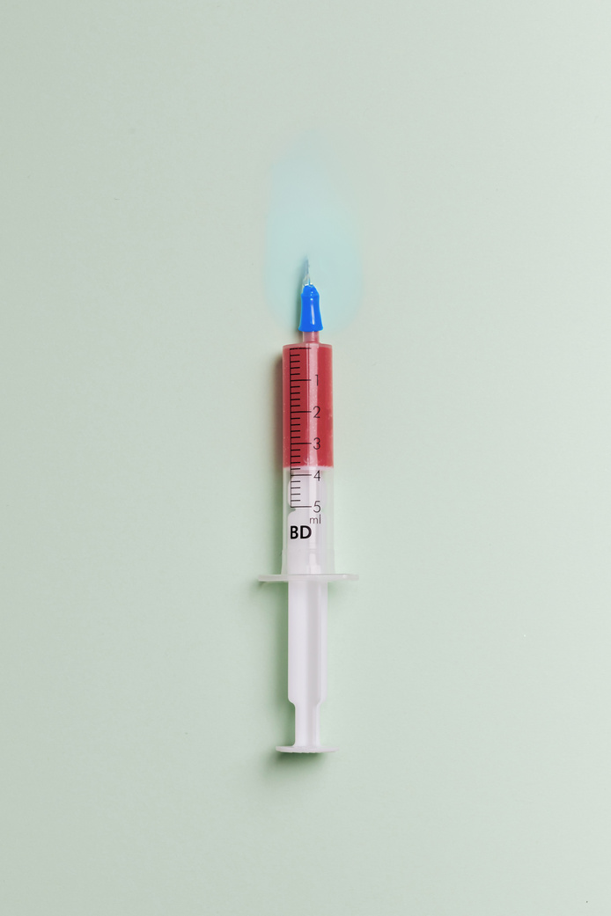


Power Plan Modules
What to Expect
Morhine (KADIAN) Long Acting for Opioid Use Disorder
Methadone for Opioid Use Disorder
Benzo Contamination Withdrawal Management
There are 3 Modules in Powerplans that you will find on CERNER
Expect higher doses of opioids. Use the POSS (Pasero opioid-Induced Sedation Scale) assessment pre/post opioid doses.
Be aware of OAT that may need to be started or continued. Use the POSS, and check in with patients often for effectiveness of medication.
Patients may experience opioid and benzo withdrawal symptoms. Assess and advocate to treat withdrawal symptoms early.

Slide 10



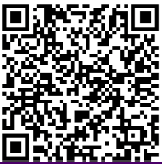
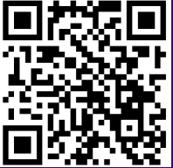
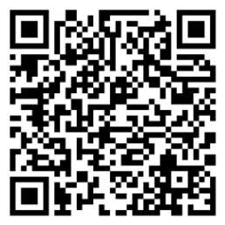
For everyday tasks and workflow:
What to do to prepare
Do I know how to use the POSS Scale?
Do I know where to document POSS?
Do I need more guidance/ info?
Short TikTok: How to use POSS
Video: How to document POSS
Guidance to ED SU Care (All the info)!

Slide 11
Nursing Competency Questions
What do I need to know how to do?
Check In with Patients
Withdrawal Management
OAT Initiaition & Maintenance
Connect to Care
Do I know how to ask about substance use in a trauma informed supportive way?
Do I know what withdrawal symptoms look like, and what to do about them?
Do I know what to do if a patient needs OAT? Do I know how to use the POSS?
Do I know where to direct patients to community supports?
Notes:
These are directly listed in the hospital policy under Objectives. And are standard to all hospitals across BC.
ED nurses should be able to:
-Address withdrawal quickly
-Work with physicians to provide continuation OAT to someone in the ED for several hours
-Work with physicians to initiate OAT in uncomplicated patient requesting OAT after hours
-Consult with addiction
specialists for complicated scenarios.

Slide 12
Insert resource links here?
Substance use resources for health professionals?
24/7 BCCSU phone line?
Specific trainings- Included as the last slide
Insert Resource here
Insert Resource here
Resources
Reach out to your Emergency educator or leadership team if you have any questions!

Slide 13
Appendix A: Checking in with Patients
Do I know how to check in about substance use?
5 steps conversation guide (Adapted from acute DST)
Ideas to stay alive
Harm reduction resources (Naloxone training/distribution)
Appendix B: Identifying and responding to withdrawal
Do I know what withdrawal symptoms look like?
Other assessment tools (CIWA, COWS etc)
Benzo vs Opioid withdrawal table
Appendix C: OAT Administration and Assessment
Do I know what to do if a patient needs OAT? Do I know how to use the POSS?
POSS (Pasero Opioid Sedation Scale) example & resources
Power Plan Screen Examples
Appendix D: Connection to care and Resources for Learning
Do I know where to direct patients to community supports?
Ongoing care and community resources
Further training opportunities for staff learning
Appendix Slides
The following are optional slides that include more details if you would like a longer version slide deck.

Slide 14
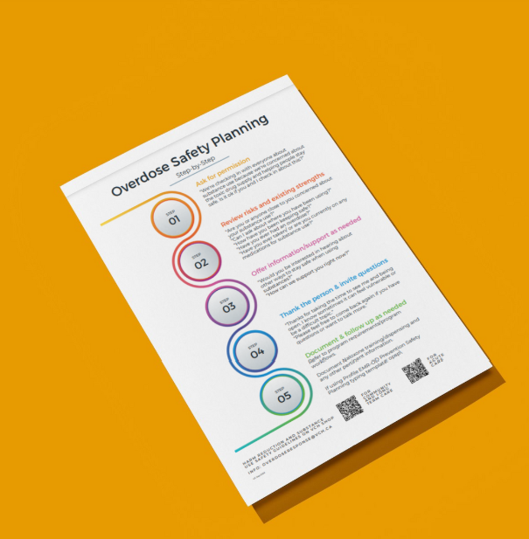
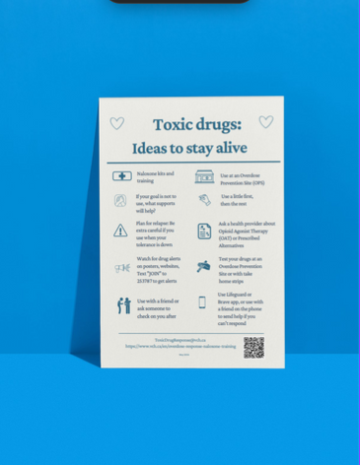
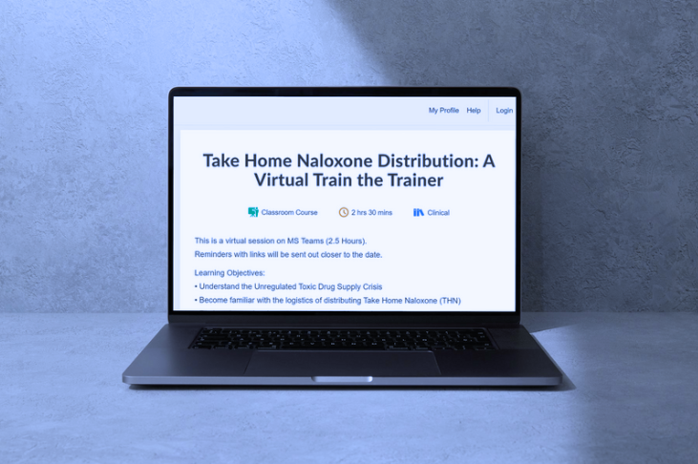
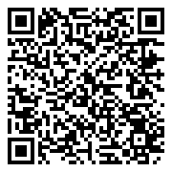
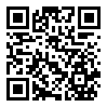
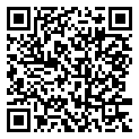
APPENDIX A: Checking In With Patients About Substance Use
Resources
Naloxone distribution training (Learning hub)
Substance use Safety Planning step by step
Ideas to stay alive harm reduction strategies
Naloxone LearningHub Course
Step by Step Safety Conversation Guide
Ideas to stay alive Harm Reduction Strategies

Slide 15

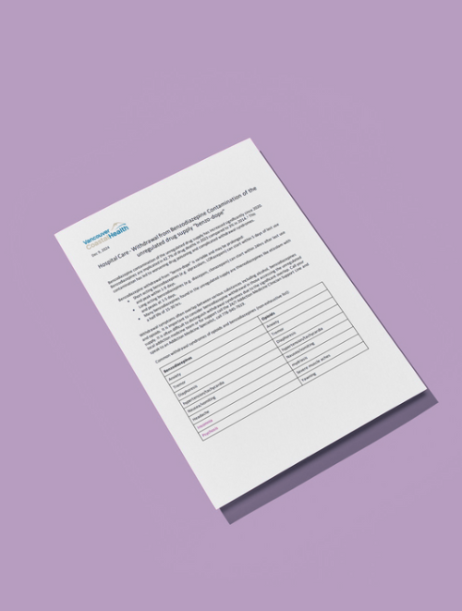

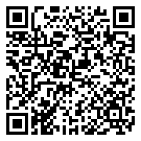
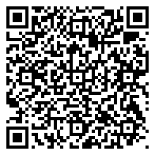
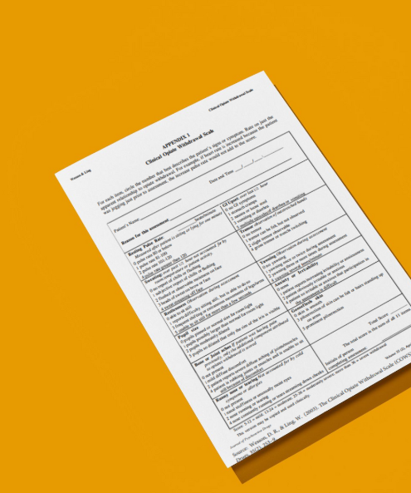

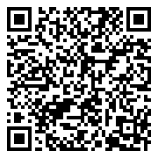
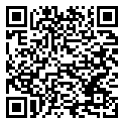
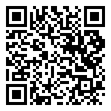
APPENDIX B: Identifying and Responding to Withdrawal
Resources
CIWA Alcohol Withdrawal (Learning hub course)
BCCSU Resources
Managing Acute Opioid Withdrawal
Managing Acute Stimulant Intoxication and Withdrawal
COWS (Opiate Withdrawal Scale)
Withdrawal from Benzo Contamination VCH guide
Opioid Withdrawal
Stimulant Intoxication and Withdrawal
CIWA LearningHub Course
COWS Assessment
Withdrawlal from Benzo Contamination

Slide 16
APPENDIX B: Identifying and Responding to Withdrawal
Benzodiazepine Vs. Opioid Withdrawal Symptoms
BENZODIAZEPINE WITHDRAWAL | OPIOID WITHDRAWAL
Anxiety | Anxiety
Tremor | Tremor
Diaphoresis | Diaphoresis
Hypertension/Tachycardia | Hypertension/Tachycardia
Nausea/ Vomiting | Nausea/Vomiting
Headache | Mydriasis
Insomnia | Severe Muscle Aches
Psychosis | Yawning
Perceptual Distrubances (Audio/Visual hallucinations, Photo/phonophobia) | Piloerection
Delerium | Rhinorrhea
Seizures | Diarrhea
Catatonia
Withdrawlal from Benzo Contamination VCH Guidance

Slide 17
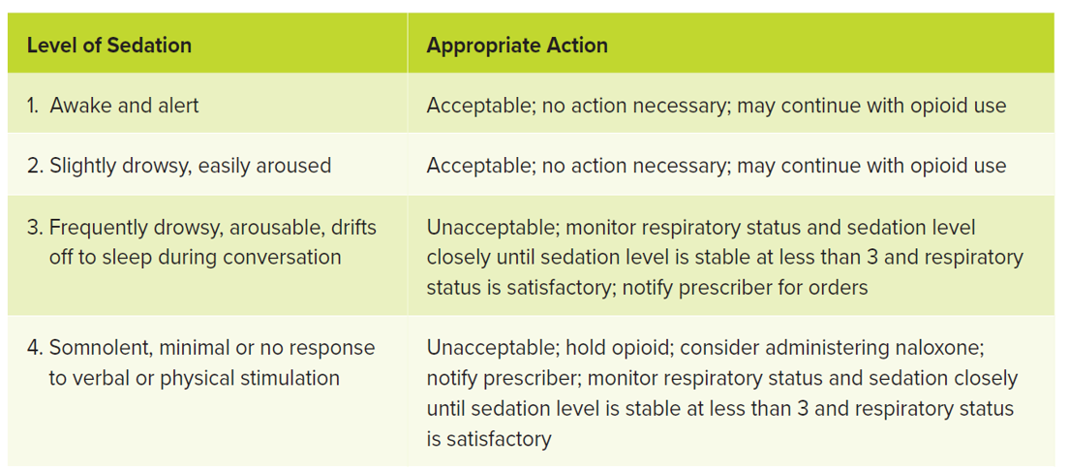
APPENDIX C: OAT Administration and Assessment
Pasero Opioid-induced Sedation Scale (POSS)
Short TikTok:
How to use POSS
Video: How to document POSS

Slide 18
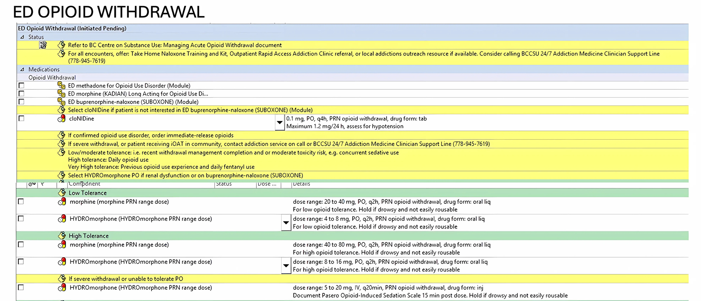
APPENDIX C: OAT Administration and Assessment
ED Opioid Withdrawal Power Plan Example
Take note of the different tolerance levels and dosage ranges.
You may see more rapid titration or higher doses of medication for those with higher levels of tolerance.
If a patient is on daily dispense safer supply hydromorphone, consider asking them how much of these they would take at one time for withdrawal.
For all three tolerance levels, check in with your patient and re-assess how effective initial doses are. They may need to tirate more frequently with higher doses.

Slide 19
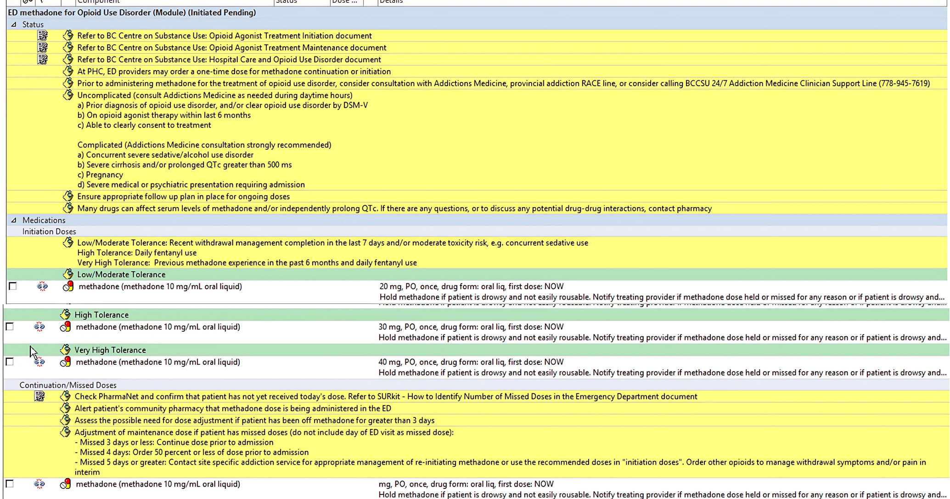
APPENDIX C: OAT Administration and Assessment
ED Methadone for Opioid Use Disorder (Module) Example
Take note of nursing related notes to help guide your practice.
The Methadone module includes a section for initiation and continuation. Initiation section includes low and high tolerances just like the opioid withdrawal power plan. 20mg of methadone for low tolerance, 30mg for high tolerance, and 40mg for high tolerance.
For most patients, 40mg will still be a low dose initiation dose. Check in with your patients and be aware they may need more medication.

Slide 20
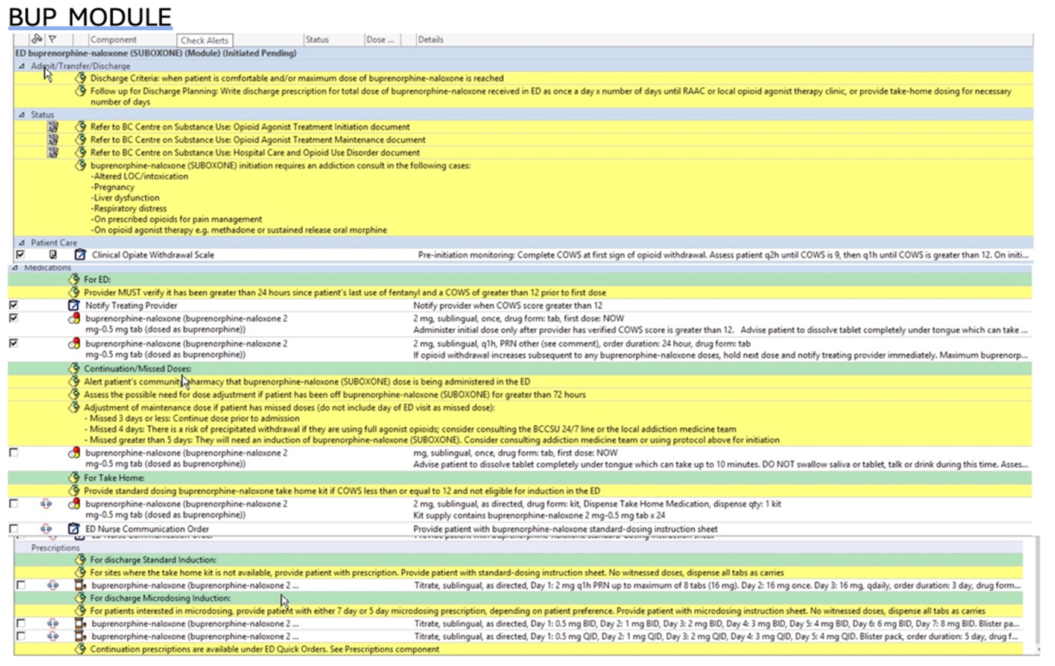
APPENDIX C: OAT Administration and Assessment
Buprenorphine-Naloxone (Suboxone) Module Examples
Initiation
Continuation
Microdosing Prescriptions
Take note of initiation, continuation protocols, and microdosing prescriptions
Buprenorphine module relatively unchanged aside from the addition of continuation.
ED protocols for initiation consists of standard dosing and requires the patient to be in withdrawal.
Standard dosing take-home kits are now available in all VCH EDs.
Prescription options include 2 different microdosing protocols if the patient prefers outpatient microdosing.

Slide 21
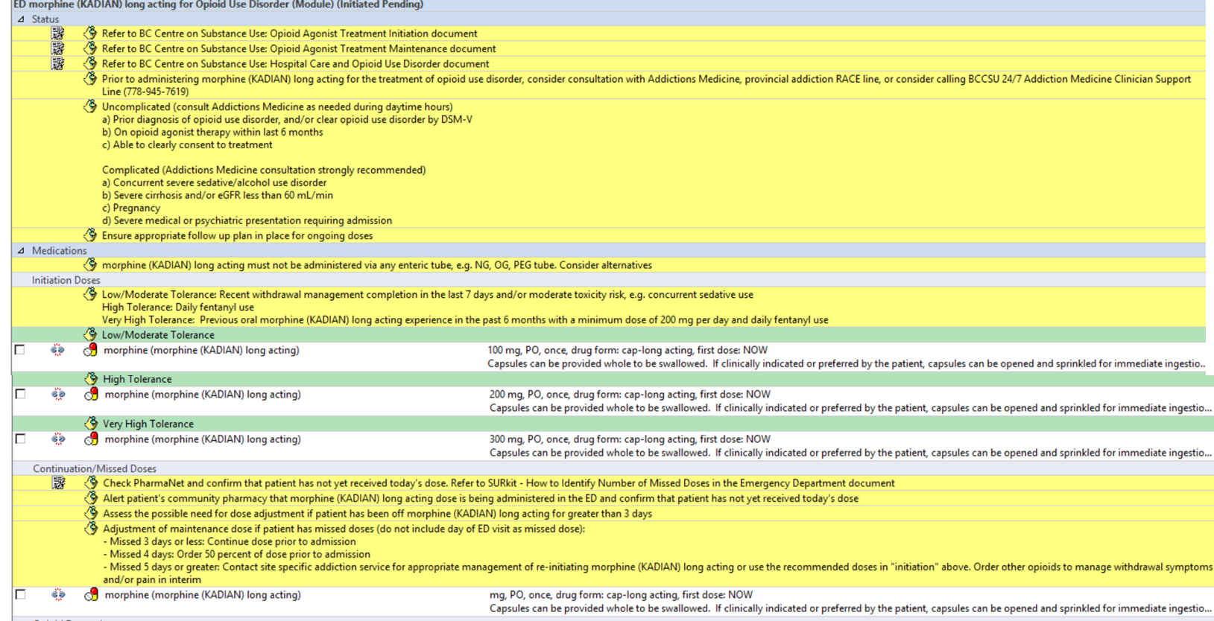
APPENDIX C: OAT Administration and Assessment
ED Morphine (Kadian) long acting for Opioid Use Disorder Module Example
Take note of those with very high tolerance for Slow-Release Oral Morphine (SROM or Kadian)
In this module, the criteria for “Very High Tolerance” includes previous experience with SROM.
Starting doses are relatively low for high tolerance patients, and you may notice that they need additional medication such as hydromorphone PRN.

Slide 22

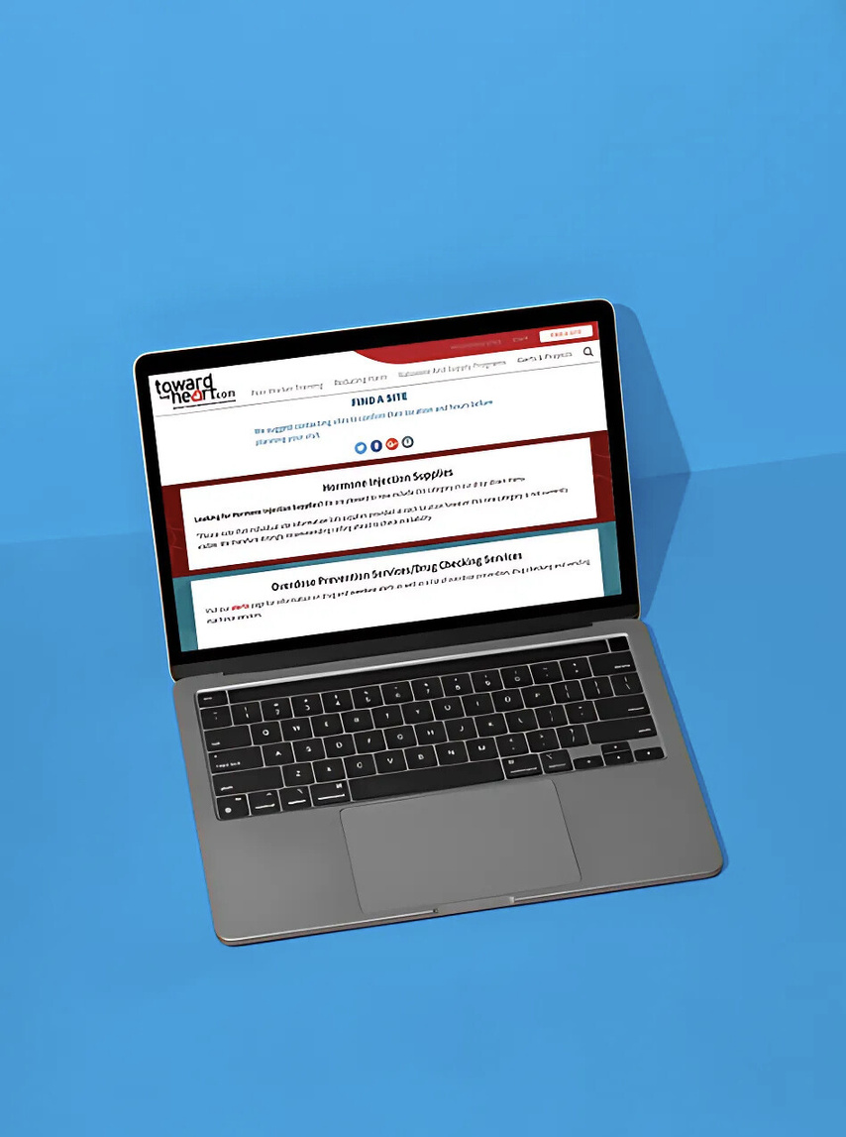
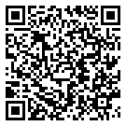
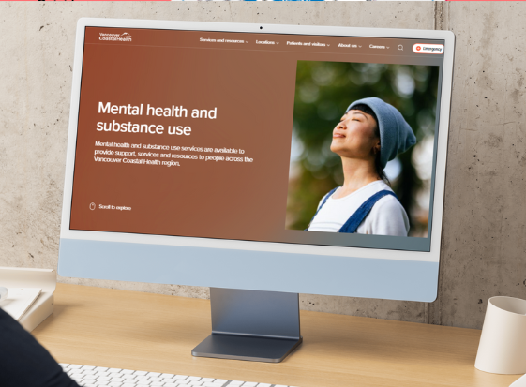

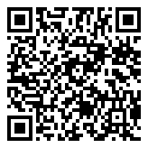
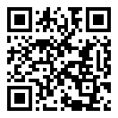
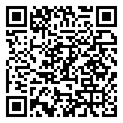
APPENDIX D: Connecting Patients to Care & Resources for Learning
Resources
VCH Mental Health and Substance Use Webpage
Lighthouse Virtual Substance Use Care Clinic
VCH Overdose Outreach Teams
Toward the Heart Harm Reduction Resources (where to find supplies, naloxone training etc).
Lighthouse Virtual Clinic
Toward the Heart Harm Reduction Resources
VCH Overdose Outreach Teams
VCH MHSU Webpage

Slide 23

SUBSTANCE USE TRAINING QUICK GUIDE
Supporting patients with substance use needs in the hospital can feel challenging, but the right training can equip you with practical skills you can start using immediately. This guide highlights impactful and recommended training opportunities sorted by time commitment and format.
ESSENTIAL TRAINING
(UNDER 1 HR)
INTERMEDIATE TRAINING
(2-3HRS)
ADVANCED TRAINING
(10+ HRS)
Quick, actionable self paced courses to build immediate competency
For those looking to deepen understanding, or prefer live facilitated group training
For those seeking comprehensive training and a deeper dive into substance use care.
INTRODUCTION TO HARM REDUCTION (Orientation)
FOUNDATIONAL CONCEPTS OF WORKING WITH PEOPLE WHO USE SUBSTANCES
ADDICTION CARE AND TREATMENT CERTIFICATE
RESISTING STIGMA ON SUBSTANCE USE
22 modules of online self paced comprehensive substance use training
HARM REDUCTION AND SUBSTANCE USE SAFETY PLANNING
BCCDC NALOXONE ADMINISTRATION
NALOXONE: TRAIN THE TRAINER
PROVINCIAL OPIOID ADDICTION TREATMENT SUPPORT PROGRAM
ALCOHOL USE:
IMPLICATIONS FOR HEALTH CARE
CLINICAL INSTITUTE WITHDRAWAL ASSESSMENT (CIWA-AR)
Comprehensive training for OAT prescribers and the first step in obtaining authorization to treat opioid use disorder.
BUPRENORPHINE-NALOXONE (SUBOXONE)
INTERACTIVE STORY SESSIONS (SIMS)
Funding may be available for these opportunities. Click on the links to learn more on eligibility and how to apply.
Search and sign up on LearningHub, or click on titles
Questions? Contact us: RegionalAddictionProgram@vch.ca
Ver. ED 01.23.2025

